Slide 1
The Complete JavaScript Course 2022: From Zero to Expert!
A brief Introduction to Javascript
JavaScript Fundamentals part 1
JavaScript Fundamentals part 2
Developer Skills and Vs console setup
JavaScript in the Browser: DOM and Event Fundamentals - Guess my Number
JavaScript in the Browser: DOM and Event Fundamentals - pop up modal window
JavaScript in the Browser: DOM and Event Fundamentals – Pig Game
How JavaScript works behind the Scenes
Data Structures, Modern Operators and Strings
A closer look at functions
Working with Arrays
Numbers, Dates, Intl and Timers
Advanced DOM and Events

Slide 2
A BRIEF INTRODUCTION TO JAVASCRIPT

Slide 3



Javascript is one of three core languages that are used to build websites.
HTML 5 is responsible for the content of the page, text, images, links etc.
CSS 3 is responsible for the presentation. I.e layout, positioning, font sizes, colours etc.
JS is used to add dynamic and interactive effects to the webpage, manipulate content or CSS and build entire web applications in the browsers.
JavaScript has many popular frameworks that allow us to write code easily. Examples are jQuery, angular etc.
Javascript is a front end language that interacts with the user and the backend languages like PHP. JavaScript can also be run in the backend server-side as a browser independent application using tools like Nodejs.
A brief Introduction to Javascript
HTML 5
CSS 3
JAVASCRIPT

Slide 4
Javascript Releases
Minor updates to Javascript every year
Biggest ever update to the language
ES6 / ES2015
ES7 / ES2016
ES8 / ES2017
ES9 / ES2018
ES10 / ES2019
ES11 / ES2020
ES5
Modern JavaScript
ECMAscript

Slide 5
JAVASCRIPT FUNDAMENTALS PART 1

Slide 6
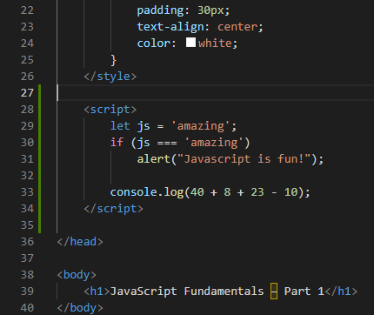
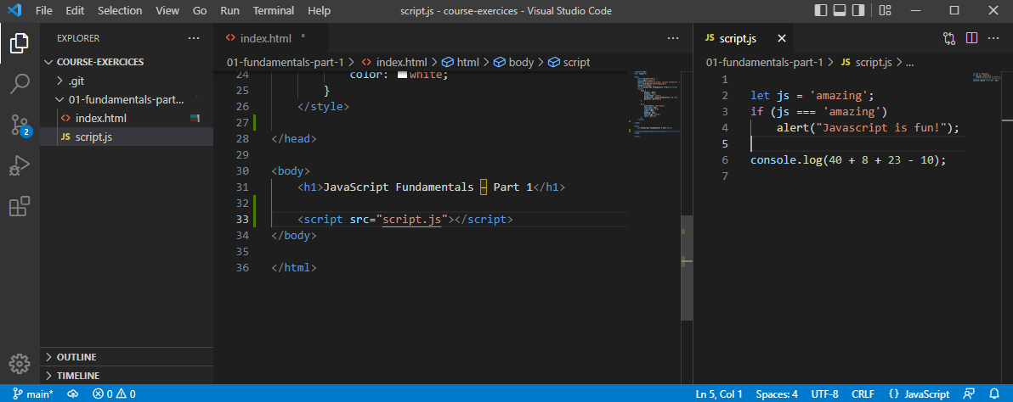
This is an example of inline script because the script code is within the html file within <script> tags.
Better to create a separate external Javascript file and link to it in the html file.

Slide 7
Javascript 7 primitive data types
1
Number
Floating point numbers. Used for decimals and integers i.e. let age = 23;
2
Strings
Used for text. Always put strings in quotes. Let firstName = “Jonus”;
3
Boolean
Logical values than can be true or false. Let fullAge = true;
4
Undefined
Value taken by a variable that is not yet defined. Let children;
5
Null
Also means empty value.
6
Symbol (ES2015)
Value that is unique and cannot be canged (Not usefull for now)
7
BigInt (ES 2020)
For integers that are too large to be represented by the number type.
Javascript has dynamic typing: We do not have to manually define the data type of a value in a variable. Javascript will automatically determine the data type.
Note that it is the value that has datatype and not the variable.
Variable X can be a Number then it can be a string in our code later on. This can cause some tricky bugs.

Slide 8
Let, const & var – 3 ways to define variables.
var
let
const
Var is the old way to define variables pre ES6.
Let is used to define variables that may change later on in our code.
Cosnt is used to define variables that never change.
Var should not be used but may exist in older code. Using var is still valid but it is a bad practice.
For example date of birth. This is an immutable variable because the birthday of a person can never change.
For example age is a variable that may change. It mutates yearly increasing by one.
Because a const variable is immutable we cannot declare and empty variable.
Const should always be used in preference to let unless you are absolutely sure that the variable will mutate later in the code. This is to avoid possible future bugs.

Slide 9
Javascript basic Operators.
Mathematical or Arithmetic operators
Multiplication, Division addition, subtraction and to the power of.
Note that the plus symbol is also used to concatenate or join together, i.e. fistName and lastName
Assignment operators
Equals (=) , plus Equals (+=) , munus Equals (-=) , divide Equals (/=) , multiply Equals (*=) ,
plus plus (++) , minus minus (--)
Comparison operators
Used with Boolean. i.e. is age Jonas greater than age Sarah? True or false?
Grater than (>) , Less than (<) , grater than or equal to (=>) , less than or equal to (=>)

Slide 10
Operator Precedence.
https://developer.mozilla.org/en-US/docs/Web/JavaScript/Reference/Operators/Operator_Precedence
console.log(now - 1991 > now - 2018);
Consulting the operator precedence table on the above website we see that Minus has a higher precedence number than > so it is executed first.
Operator precedence also has Associativity. I.e. if the code is executed left-to-right or right-to-left.

Slide 11

Strings and Template Literals.
const firstName = "Jonas";
const job = "teacher";
const birthYear = 1991;
const year = 2037;
const jonas = "I'm " + firstName + ", a " + (year - birthYear) + " year old " + job + "!";
console.log(jonas);
We use concatenation with strings to produce a the text output of I'm Jonas, a 46 year old teacher!
const jonasNew = `I'm ${firstName}, a ${year - birthYear} year old ${job}!`;
console.log(jonasNew);
A better way to achieve this would be using template literals. Here the variables are placed inside curly braces and preceded by a dollar sign. Note that the start and end of the string is defined by a backtick ` symbol which on a Spanish keyboard is found to the left of the P key.
console.log(`Just a regular string....`)
We also use backticks to output directly a string.

Slide 12
If Else statements.
const age = 17;
if (age >= 18) {
console.log(`Sarah can start learning to drive🚗`);
} else {
yearsLeft = 18 - age;
console.log(`Sarah can't start learning to drive for ${yearsLeft} years 🛴`);
}
Note that the else block is optional. If no else statement is present and the condition is false then JavaScript will just move onto the following line of code.
Emoji’s are found by using the windows and dot key.

Slide 13
const birthyear = 1991;
if (birthyear <= 2000) {
let century = 20;
} else {
/ let century = 21;
}
console.log(century);
}
const birthyear = 2001;
let century;
if (birthyear <= 2000) {
century = 20;
} else {
century = 21;
}
console.log(century);
Note that the variable century is defined within the if else code block and so will produce an error if we try to call it outside the if else code block.
Uncaught ReferenceError: century is not defined.
so we first need to define an empty variable outside of the if else block to be able to call century outside of the if else statement.

Slide 14
Type Conversion & Coercion
Type conversion is when we manually convert from one data type to another, I.e. String to number.
const inputYear = "1991";
console.log(inputYear + 18);
console.log(Number(inputYear) + 18);
console.log(Number("Jonas"));
console.log(String(23), 23);
console.log(typeof String(23));
The year is a string not a number because it is in quotes.
This will concatenate to give output of 199118.
Number will convert the string to a number
When a string cannot be converted to a number we get NaN – Not a Number.
We can convert a number to a string.
Type coercion is when JavaScript automatically does the type conversion behind the scenes.
console.log('I am ' + 23 + ' years old’);
console.log("23" - "10" - 3);
console.log("23" * "2");
Here JavaScript is automatically treating 23 as a string.
JavaScript does type coercion here to convert strings to numbers outputting 10.
JavaScript does type coercion here to convert both strings to numbers outputting 46.

Slide 15
What value will be logged to the screen?
let n = "1" + 1;
n = n - 1;
console.log(n);
JavaScript does type coercion to string so “1” + “1” will be 11.
Now n with a value of 11 is treated as a number so the output will be 10.
let x = 2 + 3 + 4 + “5”;
console.log(x);
JavaScript will treat 2 + 3 + 4 as a number giving a value of 9 then concatenate the 5 onto string 9 -> “95”
let y = "10" + "4" - "3" - 2 + "5";
console.log(y);
JavaScript will treat 10 - 4 - 3 as a number giving a value of 1 then concatenate the 1 onto string 5 -> “15”

Slide 16
Truthy values & Falsy Values
5 Falsy Values: Zero 0, Empty string “”, undefined, Null and NaN
console.log(Boolean(0)); // False
console.log(Boolean(undefined)); // False
console.log(Boolean("Jonas")); // True - Strings are truthy when converted to Boolean.
console.log(Boolean({})); // True
console.log(Boolean("")); // False
JavaScript performs type coercion in a Boolean operation.
const money = 0;
if (money) {
console.log("Don´t Spend it all;)");
} else {
console.log("You have no money!");
}
const money = 100;
if (money) {
console.log("Don´t Spend it all;)");
} else {
console.log("You have no money!");
}
What operation will be logged? The If or the Else?
The zero will be treated as a falsy Boolean so the else statement will be executed.
100 is a truthy Boolean so the if statement will be executed.

Slide 17
Boolean can be used to check if a variable is defined.
let height;
if (height) {
console.log('YAY! Height is defined');
} else {
console.log('Height is NOT defined');
}
let height = 0;
if (height) {
console.log('YAY! Height is defined');
} else {
console.log('Height is NOT defined');
}
let height = 10;
if (height) {
console.log('YAY! Height is defined');
} else {
console.log('Height is NOT defined');
}
Height is UNDEFINED and therefore a falsy value so the else statement will be executed.
Height is set to zero and therefore a falsy value so the else statement will be executed, even though height is defined.
Height is set to 10 and therefore a truthy value so the if statement will be executed.

Slide 18
Equality Operators == or ===
const age = 18;
if (age === 18) console.log('You Just became an adult’);
const age2 = "18";
if (age2 == 18) console.log('You Just became an adult’);
const age3 = "18";
if (age3 === 18) console.log('You Just became an adult');
=== returns a Boolean value if the results match strictly.
== returns a Boolean value if the results match. Note that this is not strict so JavaScript does type coercion.
=== returns a Boolean value if the results strictly match. Note a string and a number do not match strictly because they are different data types.
Boolean True
Boolean True
Boolean False
The loose equality operator of == can introduce a lot of unusual bugs in JavaScript so it is always better to use strict === and perform manual type conversion if needed.

Slide 19
The prompt asks the user for a number and of course we input 23.
When we run the if statement using loose equality operator == the Boolean is true.
However when we run the if statement with strict equality then the Boolean is false and it returns nothing.
This is because the user input from the prompt is treated as a string.
To get around this perform manual type conversion of the prompt into a number.
const favorite = prompt("what is your favorite number?");
console.log(favorite);
if (favorite == 23) {
console.log('Cool! 23 is an amazing number!');
}
if (favorite === 23) {
console.log('Cool! 23 is still an amazing number!');
}
console.log(typeof favorite);
const favorite2 = Number(prompt("what is your favorite number?"));
console.log(favorite2);
if (favorite2 === 23) {
console.log('Cool! 23 is still an amazing number!');
}

Slide 20
const favorite3 = Number(prompt("what is your favorite number?"));
console.log(favorite3);
if (favorite3 === 23) {
console.log('Cool! 23 is still an amazing number!');
} else if (favorite3 === 7) {
console.log('Cool! 7 is a lucky number!');
} else if (favorite3 === 9) {
console.log('Cool! 9 is the square of three!');
} else {
console.log('Number is not 7 or 23');
}
if (favorite3 !== 23) console.log('Why not 23?');
Else if can be used to add more options to the statement.
!== means not equal to (strict mode)
!= Means not equal to (loose mode)
An input of 9
Cool! 9 is the square of three!
Why not 23?
An input of 7
Cool! 7 is a lucky number!
Why not 23?
An input of 23
Cool! 23 is still an amazing number!
All other numbers
Number is not 7 or 23!
Why not 23?

Slide 21
Boolean Logic – And // Or // Not
A: Sarah has a driving license
B: Sarah has good Vision
Boolean values that can be TRUE or FALSE
A and B: Sarah has a driving license AND good vision
A or B: Sarah has a driving license OR good vision
Not A, Not B
Inverts true/false value.
AND
TRUE
FALSE
OR
TRUE
FALSE
TRUE
TRUE
FALSE
TRUE
TRUE
TRUE
FALSE
FALSE
FALSE
FALSE
TRUE
FALSE
Truth table for AND
Truth table for OR
True when ALL are true
True when ONE is true
No matter how many variables

Slide 22
A:
Boolean Variables that can be TRUE or FALSE
AND
TRUE
FALSE
A: Age is greater than or equal to 20
B: Age is less than 30
FALSE
Age = 16
B:
TRUE
TRUE
FALSE
TRUE
FALSE
FALSE
FALSE
JavaScript Operators
A:
(Not A)
!A
=
TRUE
A Or !B
OR
TRUE
FALSE
=
FALSE
FALSE
FALSE
FALSE
B:
TRUE
TRUE
TRUE
A and B
!A and B
FALSE
TRUE
=
FALSE
TRUE
TRUE
=
TRUE
FALSE
TRUE
FALSE
A or B
FALSE
TRUE
=
TRUE

Slide 23
Logical Operators
&& = And
|| = Or
! = Not
const hasDriversLicense = true;
const hasGoodVision = true;
console.log(hasDriversLicense && hasGoodVision);
console.log(hasDriversLicense || hasGoodVision);
console.log(!hasDriversLicense);
const shouldDrive = hasDriversLicense && hasGoodVision;
if (hasDriversLicense && hasGoodVision) {
console.log("Sarah is able to drive!")
} else {
console.log("someone else should drive....")
}
const isTired = true;
console.log(hasDriversLicense && hasGoodVision && isTired);
if (hasDriversLicense && hasGoodVision && !isTired) {
console.log("Sarah is able to drive!")
} else {
console.log("someone else should drive....")
}
Variable A Variable B
Varible C

Slide 24
The Switch Statement
const day = "monday";
switch (day) {
case 'monday':
console.log('Plan Course Structure');
console.log('Go to coding meetup');
break;
case 'tuesday':
console.log('Prepare theory videos');
break;
case 'wednesday':
case 'thursday':
console.log('write code examples');
break;
case 'friday':
console.log('Record Videos');
break;
case 'saturday':
case 'sunday':
console.log('Enjoy the weekend');
break;
default:
console.log('not a valid day!');
}
The switch statement is like a string of If else statements.
We define the true condition with a case, followed by the code we want to operate then a break.
Default is used at the end to cover a scenario where none of the cases match the true clause.

Slide 25
const dayOfWeek = 'Saturday';
if (dayOfWeek === 'Monday') {
console.log('Plan Course Structure');
console.log('Go to coding meetup');
} else if (dayOfWeek === 'Tuesday') {
console.log('Prepare theory videos');
} else if ((dayOfWeek === 'Wednesday') || (dayOfWeek === 'Thursday')) {
console.log('write code examples');
} else if (dayOfWeek === 'Friday') {
console.log('Record Videos');
} else if ((dayOfWeek === 'Saturday') || (dayOfWeek === 'Sunday')) {
console.log('Enjoy the weekend');
} else {
console.log('not a valid day!');
}
The switch statement written as If else would be something like this.

Slide 26
Statements & Expressions
An Expression is a line of code that produces a value. For example:
The expression is 3 + 4.
3 + 4
True && false && !true
1991
A Statement is an action to be performed, like a complete sentence.
if (23 > 10) {
const str = "23 is bigger";
}
This is important because JavaScript expects statements and expressions in certain places. For example we cannot insert a statement in a template literal.
const me = 'Jonas'
console.log(`i'm ${2037 - 1991} years old and my name is ${me}`)
console.log(`i'm ${if (23 > 10) { const str = "23 is bigger"; }}`)
We can insert variables and values into the template literal because they are expressions.
But we cannot insert an if statement into a template literal.

Slide 27
The Conditional Ternary Operator
The ternary operator can be used to replace an if else with one line of code. It is called a ternary operator because it has 3 parts.
const age = 19;
age > 18 ? console.log('I drink wine🍷') : console.log('I drink water🥛');
Condition
(age is greater than 18)
True expression
false expression
Condition ? True expression : false expression
Conditional ternary operators are really useful for declaring a variable and a lot shorter than writing a full if else statement.
let drink2;
if (age <= 18) {
drink2 = 'wine🍷';
} else {
drink2 = 'water🥛';
}
console.log('I like to drink ' + drink2)
const drink = age > 18 ? 'wine🍷' : 'water🥛';
console.log('I like to drink ' + drink)
Additionally, because a ternary operator is an expression it can be inserted into a template literal.
console.log(`I like to drink ${age > 18 ? 'wine🍷' : 'water🥛'}`);
Ternary operator is not a replacement for if else but a substitution for a quick calculation for two options.

Slide 28
JavaScript Releases: ES5, ES6+ and ESNext
1995
Brendan Eich creates the very first version of JavaScript in just 10 days for Netscape, It was called Mocha but already had many fundamental features of modern JavaScript.
1996
Mocha changed to liveScript then JavaScript in order to attract java developers. However JavaScript has nothing to do with Java.
1997
Microsoft launches IE copying JavaScript from Netscape and calling it jScript.
1997
Not a good idea to have two versions of a similar language so ECMA releases ECMAscript (ES1), the first official standard for JavaScript. (ECMA is the standard, Javascript is the language in practice.
2007
ES5 (ECMAscript 5) was released with plenty of cool new features.
2015
ES6 (ECMAscript 2015) was released with the biggest update to features.
2016 ∞
ES2016, ES2017, ES2018, ES2019, ES2020, ES2021, ES2022. ECMAscript changes to an annual release cycle for new features to ship less features per update.

Slide 29
JavaScript has full backwards compatibility. If we take code written in 1997 then it will still work today in the browser.
The guiding principle behind this is to not break the web. Websites keep working forever.
Forwards compatibility: If we take code written in 2009 and try and run it in a browser from 1997 then it will not work!
How can we use JavaScript today when coding for possible users that have an outdated browser?
Well as a developer all we have to do is use the most up to date version of a browser with dev tools.
When we finish the code we can use a tool like babel to transpile and polyfill the code converting it back to an ES5 version to ensure most browser compatibility for must users.
ES5
Fully supported in all browsers back to IE9 from 2011 → Ready to be used today.
ES6
ES2022
ES6+ Fully supported in most modern browsers
No support in older browsers
→ Can use most features with transpilling and pollyfilling
ES2022 ∞
Esnext New versions of the language (new feature proposals that reach stage 4)
→ Can already use SOME features in production with transpilling and pollyfilling
https://kangax.github.io/compat-table/es6/
https://kangax.github.io/compat-table/es2016plus/

Slide 30
JAVASCRIPT FUNDAMENTALS PART 2

Slide 31
Activating Strict Mode in JavaScript
Strict Mode allows us to write better, more secure, less buggy JavaScript code.
'use strict’; Enable strict mode with use strict command.
This command takes effect for all lines of JavaScript code below the use strict line so it is important that this appears at the very top of our JavaScript file.
Strict mode prohibits us from doing certain things and also shows errors in our code that may otherwise be silent errors.
let hasDriversLicense = false;
const passTest = true;
if (passTest) hasDriverLicense = true;
if (hasDriversLicense) console.log('I can drive!’);
'use strict';
let hasDriversLicense = false;
const passTest = true;
if (passTest) hasDriverLicense = true;
if (hasDriversLicense) console.log('I can drive!');
Note in the first if statement that the variable hasDriversLicense is spelled wrong. Without strict mode enabled this will produce a silent error because the second if statement will not be executed. Console log will be blank.
But with strict mode it throws an error. “Uncaught ReferenceError: hasDriverLicense is not defined”

Slide 32
Strict Mode also protects us from using possible future protected words or actual protected words.
'use strict’;
const interface = 'Audio’; Uncaught SyntaxError: Unexpected strict mode reserved word
const private = 1; Uncaught SyntaxError: Unexpected strict mode reserved word
const if = 10; Uncaught SyntaxError: Unexpected token 'if'
Interface and private are protected words that are reserved for future JavaScript features and If is a protected word that cannot be used for a variable name.

Slide 33
JavaScript Functions
A function is a block of code that we can reuse multiple times in our project to keep the code DRY – Don’t Repeat yourself!
function logger() {
console.log('my name is Jonas');
}
logger();
logger();
logger();
We have a function called logger which performs a console log of a text string. We can then call or run or invoke that function multiple times, in this case three times.
my name is Jonas script.js:19
my name is Jonas script.js:19
my name is Jonas script.js:19
We have a fruit processor function that returns apple and orange juice.
function fruitProcessor(apples, oranges) {
const juice = `juice with ${apples} apples and ${oranges} oranges.`;
return juice;
}
const appleJuice = fruitProcessor(5, 0);
console.log(appleJuice);
const orangeJuice = fruitProcessor(0, 2);
console.log(orangeJuice);
const mixedJuice = fruitProcessor(1, 1);
console.log(mixedJuice);
We can use that function to call an apple juice from 5 apples!
We can use that function to run an orange juice from 2 oranges!
We can use that function to invoke an orange and apple juice from 1 apple and 1 orange!

Slide 34
JavaScript Function Declarations vs Expressions
The food processor was a function declaration where we simply declare it as a function
function calcAge1(birthYear) {
return 2037 - birthYear;
}
const age1 = calcAge1(1991);
console.log(age1);
const calcAge2 = function (birthYear) {
return 2037 - birthYear;
}
const age2 = calcAge2(1991);
console.log(age2);
CalcAge1 is also a function declaration where we have a placeholder called birthyear that we can insert values into when we call that function.
CalcAge2 is also function expression or anonymous function where we define a variable as a function then invoke that variable latter.
Remember that expressions produce values to the variable calcAge2 just holds a value such as a number, string or Boolean.

Slide 35
We can call function declarations BEFORE the are defined in the code whereas function expressions cannot be called before they are written in the code. This is due to Hoisting which will be covered in a future lesson.
const age3 = calcAge1(1991);
console.log(age3);
// function declaration
function calcAge1(birthYear) {
return 2037 - birthYear;
}
const age4 = calcAge2(1991);
console.log(age4);
// function expression
const calcAge2 = function (birthYear) {
return 2037 - birthYear;
}
Uncaught ReferenceError: Cannot access 'calcAge2' before initialization
What type of function should be used? Function declaration or Function expression? Well function expression forces you to define all the functions at the top of the code with clearly defined variables but it is really down to personal choice.

Slide 36
Arrow Function (new in Javascript ES6)
const calcAge3 = birthYear => 2037 - birthYear;
const age5 = calcAge3(1991);
console.log(age5);
const yearsUntilRetirement = birthYear => {
const age = 2037 - birthYear;
const retirement = 65 - age;
return retirement;
}
console.log(yearsUntilRetirement(1991));
const yearsUntilRetirement = (birthYear, firstName) => {
const age = 2037 - birthYear;
const retirement = 65 - age;
return `${firstName} retires in ${retirement} years`;
}
console.log(yearsUntilRetirement(1991, 'Jonas'));
console.log(yearsUntilRetirement(1980, 'Bob'));
An arrow function is a shorthand way of writing a function expression with the return implicitly running.
If we want the arrow to perform multiple calculations then we need the curly braces.
We can pass multiple parameters into an arrow function but we must wrap them in brackets and separated by a coma.

Slide 37
Functions calling other functions
// The fruit dicer chops fruit into four chunks
function diceFruit(fruit) {
return fruit * 4;
}
// The fruit processor can only make juice from diced fruit
function fruitProcessor(apples, oranges) {
const dicedApple = diceFruit(apples);
const dicedOrange = diceFruit(oranges);
const juice = `juice of ${dicedApple} apple chunks and ${dicedOrange} orange chunks.`;
return juice;
}
console.log(fruitProcessor(2, 5));
3) The diceFruit function dices the fruit into 4 chunks
2) 2 apples get diced by the external diceFruit function.
4) 5 oranges get diced by the external diceFruit function.
5) The fruitProcessor returns juice containing many chunks of fruit.
1) We pass into the fruitProcessor 2 apples and 5 oranges.
This is a good example of DIY. Don’t repeat yourself because we are dicing two fruit into 4. if we were fruitProcessing 10 items of fruit then we would still only need one diceFruit Function.

Slide 38
Review Functions
To convert an arrow function into a function Expression we just remove the arrow and add function before the input params.
function
X
const yearsUntilRetirement = (birthYear, firstName) => {
const age = 2037 - birthYear;
const retirement = 65 - age;
return `${firstName} retires in ${retirement} years`;
}
const calcAge = function (birthYear) {
return 2037 - birthYear;
}
const yearsUntilRetirement = function (birthYear, firstName) {
const age = calcAge(birthYear);
const retirement = 65 - age;
return `${firstName} retires in ${retirement} years`;
}
console.log(yearsUntilRetirement(1991, 'Jonas'));
console.log(yearsUntilRetirement(1970, 'Bob'));
Now the age is calculated in a separate function called calc age. We call the calcAge function from within the yearsUntilRetirement function.

Slide 39
Now with a birth year of 1970, bob is already retired by -2 years. We can account for that with an if else statement to return either retirement variable or -1 if retirement is not greater than zero.
Note that after the return there is an explicit exit. i.e. it does not run any more of the function code.
const calcAge = function (birthYear) {
return 2037 - birthYear;
}
const yearsUntilRetirement = function (birthYear, firstName) {
const age = calcAge(birthYear);
const retirement = 65 - age;
if (retirement > 0) {
return retirement;
} else {
return -1;
}
}
console.log(yearsUntilRetirement(1991, 'Jonas'));
console.log(yearsUntilRetirement(1970, 'Bob'));

Slide 40
If I now add a console log after each of the return lines will it show in the browser? No – because it is after the return which has an explicit exit so the console log line is simply ignored.
const yearsUntilRetirement = function (birthYear, firstName) {
const age = calcAge(birthYear);
const retirement = 65 - age;
if (retirement > 0) {
return retirement;
console.log(`${firstName} retires in ${retirement} years`);
} else {
return -1;
console.log(`${firstName} is already retired`);
}
}
console.log(yearsUntilRetirement(1991, 'Jonas'));
console.log(yearsUntilRetirement(1970, 'Bob'));

Slide 41
In Visual studio code you can highlight the line and use alt and up arrow to move the highlighted line up 1. Now we see the console.log is before the return so it will be executed.
const calcAge = function (birthYear) {
return 2037 - birthYear;
}
const yearsUntilRetirement = function (birthYear, firstName) {
const age = calcAge(birthYear);
const retirement = 65 - age;
if (retirement > 0) {
console.log(`${firstName} retires in ${retirement} years`);
return retirement;
} else {
console.log(`${firstName} is already Retured`);
return -1;
}
}
console.log(yearsUntilRetirement(1991, 'Jonas'));
console.log(yearsUntilRetirement(1970, 'Bob'));

Slide 42
Function Declaration, can be used before it is declared.
// Function Declaration
function calcAge (birthYear) {
return 2037 - birthYear;
}
// Function Expression
const calcAge = function (birthYear) {
return 2037 - birthYear;
}
// Arrow Function
const calcAge = birthYear => 2037 - birthYear;
Function Expression, essentially a function stored inside a variable
Arrow Function, good for quick one line functions. Has no This keyword. More about this later.
All three types of function work in the same way, they receive input data, transform the data and then output the data.

Slide 43
Parameter names. These are placeholders for the parameters we input into the function.
Function name
const yearsUntilRetirement = (birthYear, firstName) => {
const age = 2037 - birthYear;
const retirement = 65 - age;
return `${firstName} retires in ${retirement} years`;
}
console.log(yearsUntilRetirement(1991, 'Jonas'));
console.log(yearsUntilRetirement(1980, 'Bob'));
We call or invoke or run the function with parenthesis (), In this case we are calling the function with two parameters inside the parenthesis.

Slide 44
Introduction to Arrays
An array is a means to store multiple values of the same thing i.e. friends or years, rather than a variable for each one.
const friend1 = 'Michael';
const friend2 = 'Steven';
const friend3 = 'Peter';
// Create array using littoral syntax
const friendArr = ['Michael', 'Steven', 'Peter'];
console.log(friendArr);
// Create array using the inbuilt array function
const yearsArr = new Array(1991, 1984, 2008, 2020);
console.log(yearsArr);
// retrieve a value from within the array
console.log(friendArr[0], yearsArr[2]);
// To determine array length
console.log(friendArr.length);
// To get the last value from the array
console.log(friendArr[friendArr.length-1]);
An array can be defined by using the littoral method or the inbuilt array function.
The position of values in ana array start from zero. i.e. the first value in the array is [0], the second position in the array is [1], third position [2], etc….
Array.length will always output the length counting from 1, i.e. the quantity of values inside the array.
Because the values in the array are numbered from zero the last value in the array will be length minus 1.

Slide 45
We can overwrite a position in an array with a new value by specifying it’s position number starting from zero.
// Mutate array by replacing Peter with Jay
friendArr[2] = 'Jay';
console.log(friendArr);
// We cannot overwrite the contents of the entire array
friendArr = ['Bob', 'Alice’];
Uncaught TypeError: Assignment to constant variable.
// We can populate an array with any data type. string, number etc..
const personArr = ['Jonas', 'Schmedtmann', 2037-1991];
console.log(personArr);
// We can insert variables into an array
const firstName = 'Jonas';
const lastname = 'Schmedtmann';
const age = 2037-1991;
const varArr = [firstName, lastname, age];
console.log(varArr);
But we cannot overwrite the entire contents of the array. This is illegal.
An array can be populated with more than one data type.
Variables can even be inserted into an array.

Slide 46
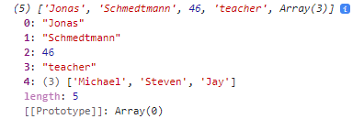
// An array can be inserted into an array
const profession = 'teacher';
const multiArr = [firstName, lastname, age, profession, friendArr];
console.log(multiArr);
Note how the array length is 5. [0] is firstName, [1] is lastName, [2] is age, [3] is profession and [4] is the friendArr. This array contains a total of five values with the fifth value being an array.
const calcAge = function (birthYear) {
return 2037 - birthYear;
}
const yearArr = [1990, 1967, 2002, 2010, 2018];
console.log(calcAge(yearArr));
const age1 = calcAge(yearArr[0]);
const age2 = calcAge(yearArr[1]);
const age3 = calcAge(yearArr[yearArr.length-1]);
console.log(age1, age2, age3);
const agesArr = [calcAge(yearArr[0]), calcAge(yearArr[2]), (yearArr[yearArr.length-1])];
console.log(agesArr);
If I try and run an array through a function I get a NaN error, Not a number.
But I can run individual values from the array through the function.
I can create an array based on values created from a function by calling that function from within the array.

Slide 47
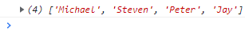
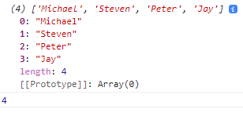
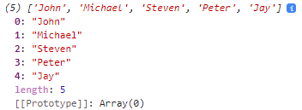
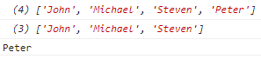
Basic Array Operations (Methods)
Push adds an element onto the end of the array
const friendArr = ['Michael', 'Steven', 'Peter'];
friendArr.push('Jay');
console.log(friendArr);
Push is also a function which returns array length by default so we can put this in a variable.
const friendArr = ['Michael', 'Steven', 'Peter'];
const newLength = friendArr.push('Jay');
console.log(friendArr);
console.log(newLength);
Unshift method adds elements to the beginning of the array
friendArr.unshift('John');
console.log(friendArr);
Pop will remove the LAST element of the array
friendArr.pop();
console.log(friendArr);
It does not return the length of the array but returns what was popped
const popped = friendArr.pop();
console.log(friendArr);
console.log(popped);

Slide 48
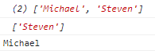
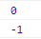
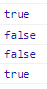
SHIFT Removes First element from the array
friendArr.shift();
console.log(friendArr);
It does not return the length of the array but returns what was shifted
const shifted = friendArr.shift();
console.log(friendArr);
console.log(shifted);
Find index of an element in array (The position starting from zero)
console.log(friendArr.indexOf('Steven'));
If we try and look for an element which is not in the array we will get -1 as a result.
console.log(friendArr.indexOf('Micahel’));
Modern Es6 method for indexOf is includes which returns a Boolean if element is in array
console.log(friendArr.includes('Steven'));
console.log(friendArr.includes('Micahel'));
Includes uses strict mode so does not do type coercion
If I add 23 as a number then try and find it as a string
friendArr.push(23);
console.log(friendArr.includes('23'));
console.log(friendArr.includes(23));

Slide 49

We can use includes to write conditionals
if (friendArr.includes('Peter')) {
console.log('you have a friend called Peter');
} else {
console.log('Peter is not your friend');
}

Slide 50
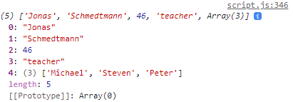
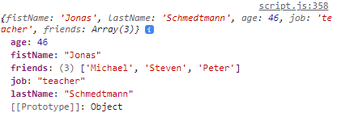
Introduction to Objects
Here we have a person array with elements in it, but we can only reference those elements by calling their position (starting from zero).
const personArr = [
'Jonas',
'Schmedtmann',
2037-1991,
'teacher',
['Michael', 'Steven', 'Peter']
];
console.log(personArr);
But we can assign a name to each element in the object array using curly braces to make key value pairs.
const personObj = {
firstName: 'Jonas',
lastName: 'Schmedtmann',
age: 2037-1991,
job: 'teacher',
friends: ['Michael', 'Steven', 'Peter']
}
console.log(personObj);
The object of PersonObj has 5 properties - firstName, lastName etc... Using curly braces to write an object is called the object literal. Note how the object is ordered alphabetically in the console.

Slide 51

Dot vs Bracket notation
Retrieving a value by property name from an object using dot notation
console.log(personObj.firstName);
Retrieving a value by property name from an object using brackets
console.log(personObj['lastname']);
Using square brackets we can concatenate
const nameKey = 'Name';
console.log(personObj['first' + nameKey]);
console.log(personObj['last' + nameKey]);
But using dot notation to compute using concatenation does not work
console.log(personObj.'last' + nameKey);
Uncaught SyntaxError: Unexpected string
We can use the function prompt to define a variable of what property we want to find.
const tellMe = prompt('What do you want to know about personObj? Choose between firstName, LastName, age, job and friends’);
Then use the bracket notation to output the contents of the object property.
console.log(personObj[tellMe]);

Slide 52
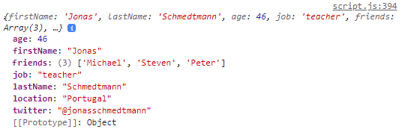
But what if the user enters a falsy value that is not a property?
const tellMe = prompt('What do you want to know about personObj? Choose between firstName, LastName, age, job and friends');
if (personObj[tellMe]) {
console.log(personObj[tellMe]);
} else {
console.log('Wrong Request! Choose between firstName, LastName, age, job and friends');
}
We can add new properties to the object using the dot notation or the bracket notation.
personObj.location = 'Portugal';
personObj['twitter'] = '@jonasschmedtmann';
console.log(personObj);

Slide 53
Challenge: Compute string ‘Jonas has 3 friends and his best friend is called michael’ using arrays.
const personObj = {
firstName: 'Jonas',
lastName: 'Schmedtmann',
age: 2037-1991,
job: 'teacher',
friends: ['Michael', 'Steven', 'Peter']
}
console.log(personObj);
Option 1
const FistName = personObj.firstName;
const bestFriend = personObj.friends[0];
const totalFriends = personObj.friends.length;
console.log(FistName + ' Has ' + totalFriends + ' friends and his best friend is called ' + bestFriend);
Option 2
console.log(`${personObj.firstName} has ${personObj.friends.length} friends and his best friend is called ${personObj.friends[0]}`);
https://developer.mozilla.org/en-US/docs/Web/JavaScript/Reference/Operators/Operator_Precedence
In the operator precedence ‘member access’ has a high precedence and associativity of left to right which is why we are able to go into the friends array of the personObj.

Slide 54
Object Methods
Objects like arrays can hold different types of data, they can even hold arrays. THey can even hold objects inside of objects. Functions are just like another type of property because they hold values.
Any function attached inside an object is called a method. But the function must be an expression.
const personObj = {
firstName: 'Jonas',
lastName: 'Schmedtmann',
birthYear: 1991,
job: 'teacher',
friends: ['Michael', 'Steven', 'Peter'],
hasDriversLicense: true,
calcAge: function(birthYear) {
return 2037 - birthYear;
}
};
We can call the method in the object using dot or bracket notation
console.log(personObj.calcAge(1991));
console.log(personObj['calcAge'](1991));

Slide 55
But we are inputting the birthYear when it is already in the object.
const personObj = {
firstName: 'Jonas',
lastName: 'Schmedtmann',
birthYear: 1991,
job: 'teacher',
friends: ['Michael', 'Steven', 'Peter'],
hasDriversLicense: true,
calcAge: function() {
console.log(this);
return 2037 - this.birthYear;
}
};
We can call the method in the object using dot notation
console.log(personObj.calcAge());
The THIS keyword refers to this object so by using it we are saying console.log this object or birthyear from this object.
Instead of the this keyword we could use personObj but what if we latter rename the object to something like personObj2? Well it would not work anymore so always use this keyword!

Slide 56
But what if we need to call the age more than once in our code?
We would be running the method within the object multiple times which could slow down our code if the method is doing complex calculations.
Better to calculate the age once and store it as a new property so that it only gets calculated once.
const personObj = {
firstName: 'Jonas',
lastName: 'Schmedtmann',
birthYear: 1991,
job: 'teacher',
friends: ['Michael', 'Steven', 'Peter'],
hasDriversLicense: true,
calcAge: function() {
this.age = 2037 - this.birthYear;
return this.age;
}
};
console.log(personObj.calcAge());
console.log(personObj.age);
console.log(personObj.age);
console.log(personObj.age);

Slide 57
Challenge: "Jonas is a 46 year old teacher and he has a drivers License OR has no drivers License"
const personObj = {
firstName: 'Jonas',
lastName: 'Schmedtmann',
birthYear: 1991,
job: 'teacher',
friends: ['Michael', 'Steven', 'Peter'],
hasDriversLicense: false,
calcAge: function() {
this.age = 2037 - this.birthYear;
return this.age;
},
getSummary: function () {
return `${this.firstName} is a ${this.calcAge()} year old ${this.job} and ${this.hasDriversLicense ? "has a drivers license." : "doesn't have a drivers license."}`;
}
};
console.log(personObj.calcAge());
console.log(personObj.getSummary());

Slide 58
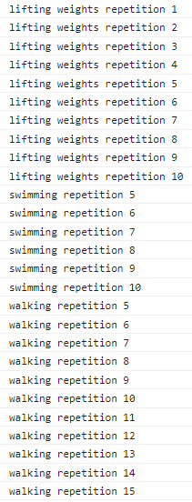
Iteration – For loop
Loops are fundamental to coding. They are used for when we have to repeat something multiple times.
For loop has three components:
1. define variable and set initial value
2. for loop keeps running while condition is true
3. Increment counter
for (let rep = 1; rep <= 10; rep++) {
console.log(`lifting weights repetition ${rep}`);
}
for (let rep = 5; rep <= 10; rep++) {
console.log(`swimming repetition ${rep}`);
}
for (let rep = 5; rep <= 15; rep++) {
console.log(`walking repetition ${rep}`);
}

Slide 59
Looping arrays, breaking and Continuing
We have an array with five elements in it.
const personObj = [
'Jonas',
'Schmedtmann',
1991,
'teacher',
['Michael', 'Steven', 'Peter']
];
We want to loop through all the elements one by one.
1. We start the array at 0 because that is the first element in the array
2. We want to stop looping at 5 (because the array contains five elements)
3. Each time through the loop we increment by 1.
for (let i = 0; i<5 ; i++) {
console.log(personObj[i]);
}

Slide 60
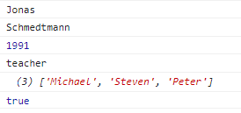
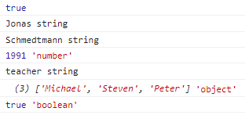
We have an array with six elements in it.
const personObj2 = [
'Jonas',
'Schmedtmann',
1991,
'teacher',
['Michael', 'Steven', 'Peter'],
true
];
But because we have manually defined the condition to be less than 5 it will not iterate through element 6 in the array.
We can dynamically calculate the array length by using built in length function!
for (let i = 0; i<personObj2.length ; i++) {
console.log(personObj2[i]);
}
for (let i = 0; i<personObj2.length ; i++) {
console.log(personObj2[i], typeof personObj2[i]);
}

Slide 61
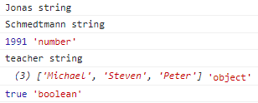

const personObj2 = [
'Jonas',
'Schmedtmann',
1991,
'teacher',
['Michael', 'Steven', 'Peter'],
true
];
We can create a new empty array outside of the loop
const types = [];
for (let i = 0; i<personObj2.length ; i++) {
Here we are reading the array for each element and getting the typeof
console.log(personObj2[i], typeof personObj2[i]);
Here we are filling the types array with typeof for each i.
types[i] = typeof personObj2[i];
}
console.log(types);

Slide 62
The same operation can be done with an array push
const types = [];
for (let i = 0; i<personObj2.length ; i++) {
console.log(personObj2[i], typeof personObj2[i]);
types.push(typeof personObj2[i]);
}
console.log(types);
We have an array of birthYears and we want to calculate ages and store it in a new array.
const birthYearArr = [1991, 2007, 1969, 2020];
const ageArr = [];
for (let i=0; i<birthYearArr.length; i++) {
ageArr.push(2037 - birthYearArr[i]);
}
console.log(ageArr);

Slide 63
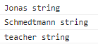
Continue and break statements
Continue is used to skip an iteration in the loop
Break is used to completely stop the loop
const personObj2 = [
'Jonas',
'Schmedtmann',
1991,
'teacher',
['Michael', 'Steven', 'Peter'],
true
];
for (let i=0; i<personObj2.length; i++) {
if (typeof personObj2[i] !== 'string') continue;
console.log(personObj2[i], typeof personObj2[i]);
}
Here we use an if statement to check if type of iteration is not a string and we skip it (continue)

Slide 64
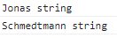
Continue and break statements
Continue is used to skip an iteration in the loop
Break is used to completely stop the loop
const personObj2 = [
'Jonas',
'Schmedtmann',
1991,
'teacher',
['Michael', 'Steven', 'Peter'],
true
];
for (let i=0; i<personObj2.length; i++) {
if (typeof personObj2[i] === 'number') break;
console.log(personObj2[i], typeof personObj2[i]);
}
Here we use an if statement to check if type of iteration a number and we stop the loop (break) at that iteration.

Slide 65
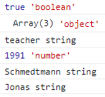
Looping backwards
To loop through an array backwards we need to modify the three parts to the for loop.
START: In this case the array has indexes of 0,1,2,3,4,5 so we want to start the loop at index five which is the length of the array minus 1.
CONDITION: We want to stop the loop when it gets to zero so the condition is going to be that I is equal to or greater than 0.
ITERATION: Finally, we want the loop to decrement by 1 the counter each iteration.
const personObj2 = [
'Jonas',
'Schmedtmann’,
1991,
'teacher',
['Michael', 'Steven', 'Peter'],
true
];
for (let i=personObj2.length-1; i>=0; i--) {
console.log(personObj2[i], typeof personObj2[i]);
}
START CONDITION ITERATION

Slide 66
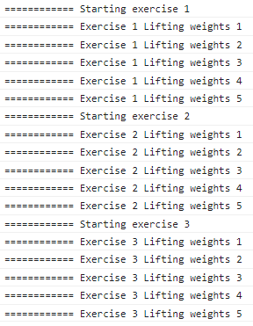
Loops within Loops
We have a routine of three exercises with each exercise being repeated (or looped 5 times)
for (let exercise = 1; exercise < 4; exercise++) {
console.log(`============ Starting exercise ${exercise}`);
for (let rep = 1; rep < 6; rep++) {
console.log(`============ Exercise ${exercise} weights repetition ${rep}`)
}
}
1)
4)
2)
4)
3)
1) We first define the outer loop with the three parameters of STARTING, CONDITION and COUNTER.
2) Within the outer loop we define the inner loop, also with starting, condition and counter.
3) On each go around of the outer loop the inner loop is executed.
4) Pay particular attention to the placement of opening and closing brackets for the outer loop.

Slide 67
The While Loop
A for loop has 3 components: Start, Condition and counter.
for (let rep = 1; rep <= 10; rep++) {
console.log(`Lifting weights repetition ${rep}`);
}
A while loop only has one component, a condition and will run until the condition is not met. However we still need to define start of the loop and counter. We define the start of the loop outside and before the loop. The counter we increment after the loop has performed its action but within the loop curly braces.
let rep = 1;
while (rep <=10) {
console.log(`swimming repetition ${rep}`);
rep ++;
}
A while loop is more versatile than a for loop because it only needs a condition. It can be used in a larger variety of situations because it does not need a counter. The condition is essential to keep it running bit the counter is not always needed.

Slide 68
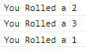
DICE ROLL WHILE LOOP: the dice will continue to roll until it lands on 6.
let dice = Math.trunc(Math.random() * 6) + 1;
while (dice !==6) {
console.log(`You Rolled a ${dice}`);
}
WHILE LOOPS CAN BE DANGEROUS: the current code will crash the browser because the while loop will run forever.
let dice = Math.trunc(Math.random() * 6) + 1;
while (dice !==6) {
console.log(`You Rolled a ${dice}`);
dice = Math.trunc(Math.random() * 6) + 1;
}
We need to reassign the dice value after each iteration of the loop to prevent infinite looping.
Lets analyse what is happening. The dice is rolled and value 2 is randomly calculated. This is not a six so we reassign the dice value and roll the dice again getting 3. We randomly reassign the dice number and roll again getting 1. Next roll we land on 6 so the loop is stopped. Note that we need to reassign the dice number after each roll because we did not specify a starting value outside of the loop.

Slide 69
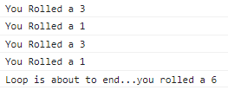
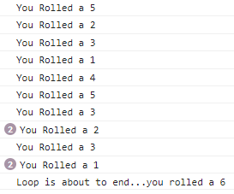
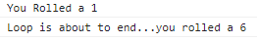
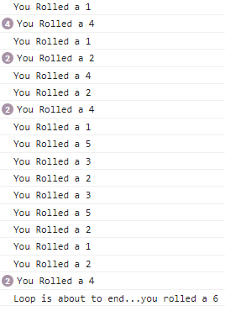
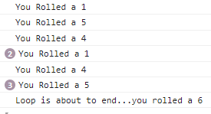
let dice = Math.trunc(Math.random() * 6) + 1;
while (dice !==6) {
console.log(`You Rolled a ${dice}`);
dice = Math.trunc(Math.random() * 6) + 1;
if (dice === 6) console.log('Loop is about to end...you rolled a 6');
}
Now each time we run this it will randomly roll the dice each time in the while loop until a 6 is found.

Slide 70
DEVELOPER SKILLS & VS CODE SETUP

Slide 71
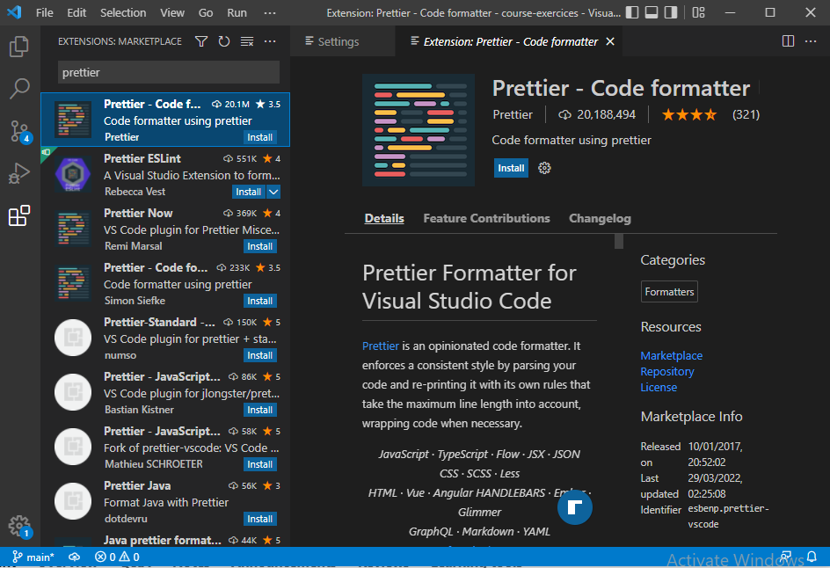
We can install prettier into vs code and restart it. This automatically format our code according to coding conventions.

Slide 72
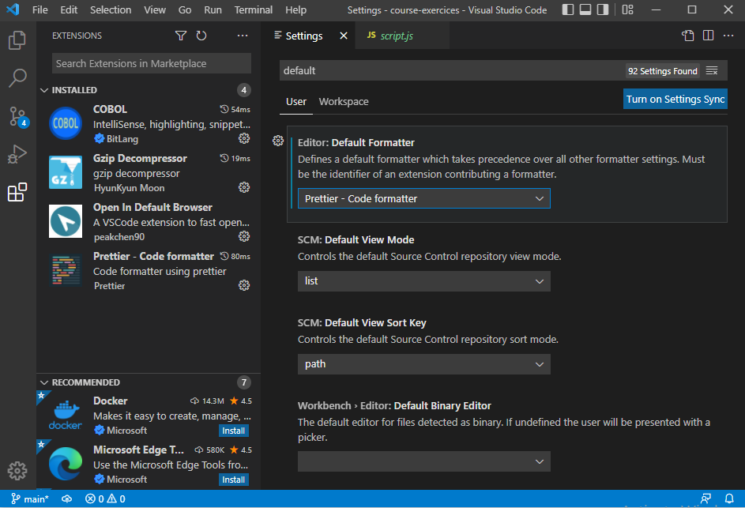
Activate prettier as the default formatter in settings.

Slide 73
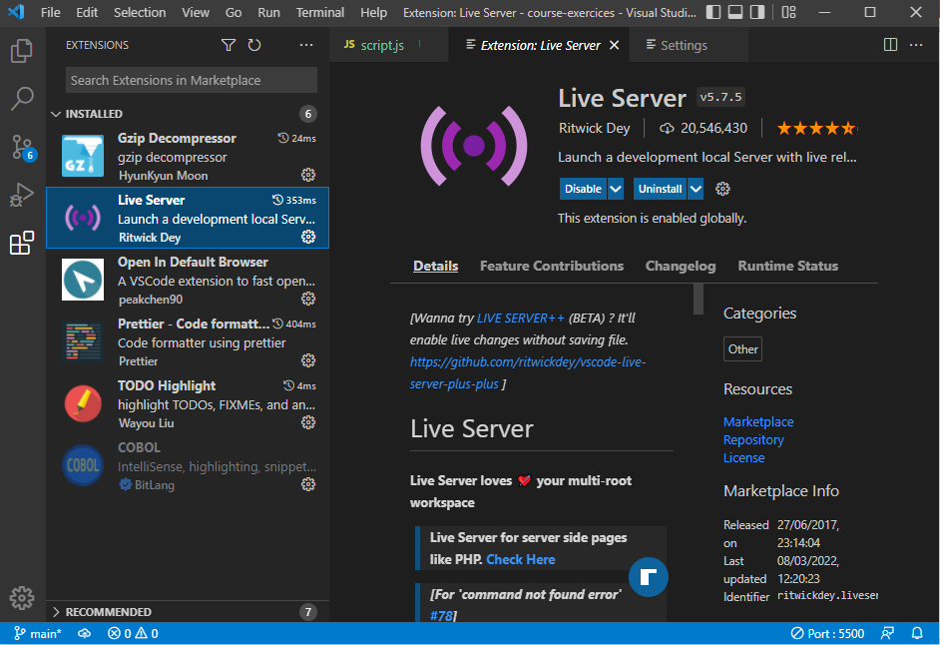
Install Live server. This will automatically reload the browser on code changes. Use the go live button at the bottom of the page.

Slide 74
Debugging
Identify
Find
Fix
Prevent
Becoming aware that there is a bug
Isolating where exactly the bug is happening in the code
Correct the code
Prevent it from happening again.
Replace wrong solution with correct solution
During Development
Testing Software
User Reports During production
Context: browsers, users etc.
Searching for same bug in similar code
Writing tests using testing software.
Developer Console (simple Code)
Debugger (complex code)

Slide 75
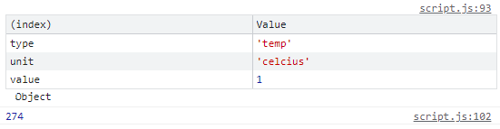
////// DEBUGGING //////
// Lets say that from our previous temperature example we need to work in kelvins.
const Measkelvin = function () {
const measmt = {
type: 'temp',
unit: 'celcius',
// C - FIX
value: Number(prompt('Degrees celcius:')),
// value: prompt('Degrees celcius:')
};
// console.log(measmt);
console.table(measmt);
// console.log(measmt.value);
// console.warn(measmt.value);
// console.error(measmt.value);
const kelvin = measmt.value + 273;
return kelvin;
};
// A) IDENTIFY
console.log(Measkelvin());
The console has various output options such as a plain log or table to help with debugging.
A good method is to put the variable into console table or log to see if it is an array, number, string etc.
In this example the prompt was returning 10 as a string when it needed to be a number to enter the Celsius to degrees conversion.

Slide 76
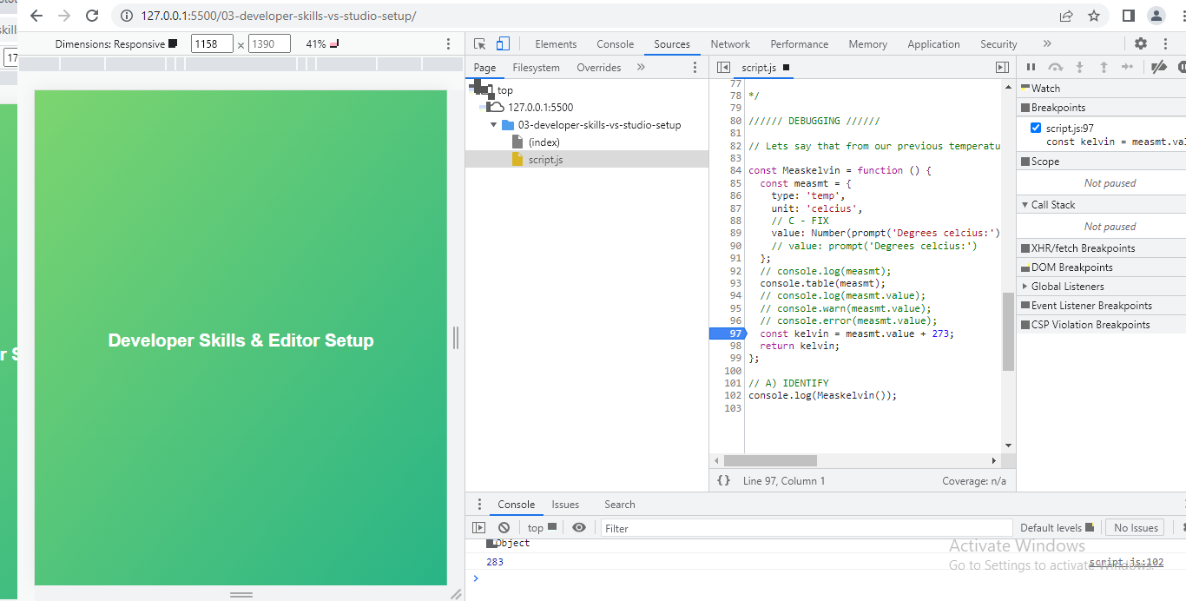
In the dev tools of chrome, we can go to sources and select our JS file. In the lines of code we can click in the left margin to insert a breakpoint.

Slide 77
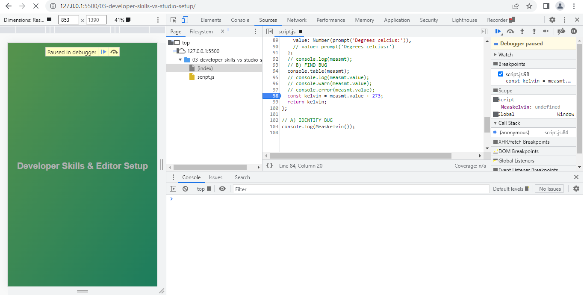
If we reload the page with the breakpoint we can see a button called debugger paused. When we press this button the code will resume execution from the beginning up to the breakpoint.

Slide 78
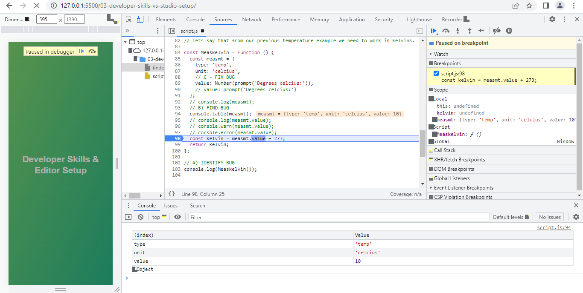
After pressing the resume button the code runs until it pauses on the previously set breakpoint. In the scope window the results of the last executed piece of code before the breakpoint will be shown for analysis. The script window shows the last executed line in the code before the breakpoint and the breakpoint is highlighted.
When finished with the debugger, don’t forget to remove the breakpoint by clicking on the blue tab in the left margin.

Slide 79
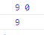
DEBUGGING 2: Here we have changed the previous code to start the min and max at zero rather than the first values of the arrays. The temperature array values are modified also.
const tempArr1 = [3, 5, 1]; // const tempArr1 = [3, -2, -6, -1, 'error', 9, 13, 17];
const tempArr2 = [9, 4, 5]; // const tempArr2 = [-3, 5, 1, 5, 18, 16, 30, 35];
const calcTempAmplBug = function (tempArr1, tempArr2) {
const tempArr = tempArr1.concat(tempArr2);
let max = 0; // let max = tempArr[0];
let min = 0; // let min = tempArr[0];
for (let i = 0; i < tempArr.length; i++) {
const curTemp = tempArr[i];
if (typeof curTemp !== 'number') continue;
if (curTemp > max) max = curTemp;
if (curTemp < min) min = curTemp;
}
console.log(max, min);
return max - min;
};
const amplBug = calcTempAmplBug(tempArr1, tempArr2);
console.log(amplBug);
This code now produces a bug with the output of max temp being 9 and min temp being 0. However looking in the arrays of values we see that the lowest temp is 1.

Slide 80
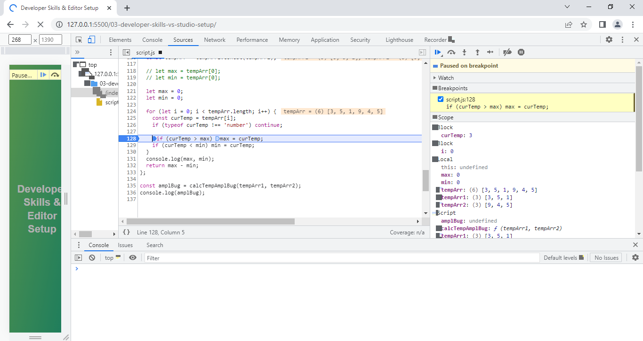
Debugger is especially useful for diagnosing problems in loops. Here I have a breakpoint set at the if statement for max temp and I can see that it has run up to this breakpoint and paused producing a curTemp of three which is the first value in the array.
When I hit the resume button the code reverts back to the beginning again running up to the breakpoint again and pausing. This time it gives curTemp of 5 which is the second value in the array. This time the max value is set to 5 because this is the highest value so far in the arrays.

Slide 81
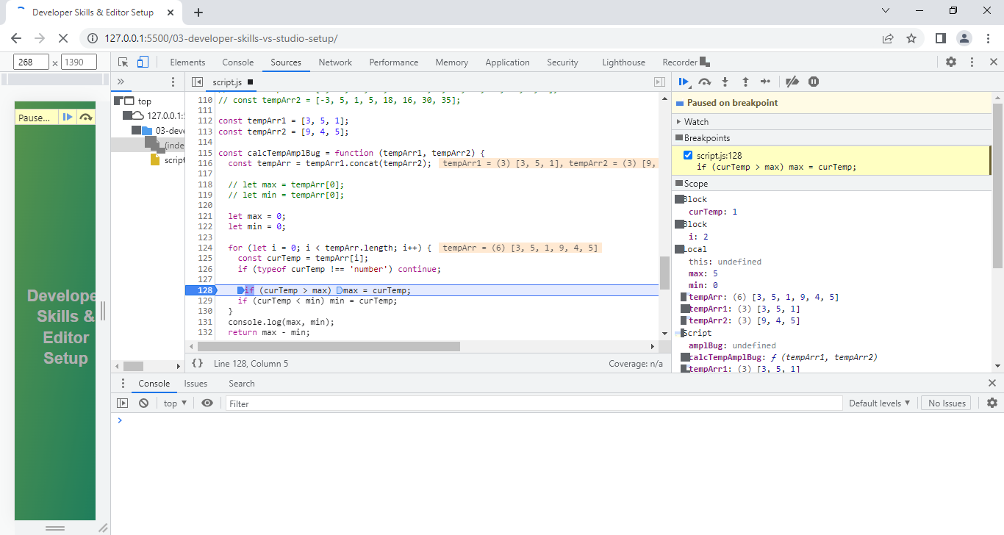
If I resume the code again it starts from the beginning and runs through the loop getting a curTemp of 1. But note how the min value stays at zero. Note also The screen outputs showing the calculated values in the arrays.

Slide 82

Two more runs through the loop and it now sets the max to 9 but the min is still set to zero despite 1 being the lowest value in the array.
Two more runs through the loop and it now sets the max to 9 but the min is still set to zero despite 1 being the lowest value in the array.

Slide 83
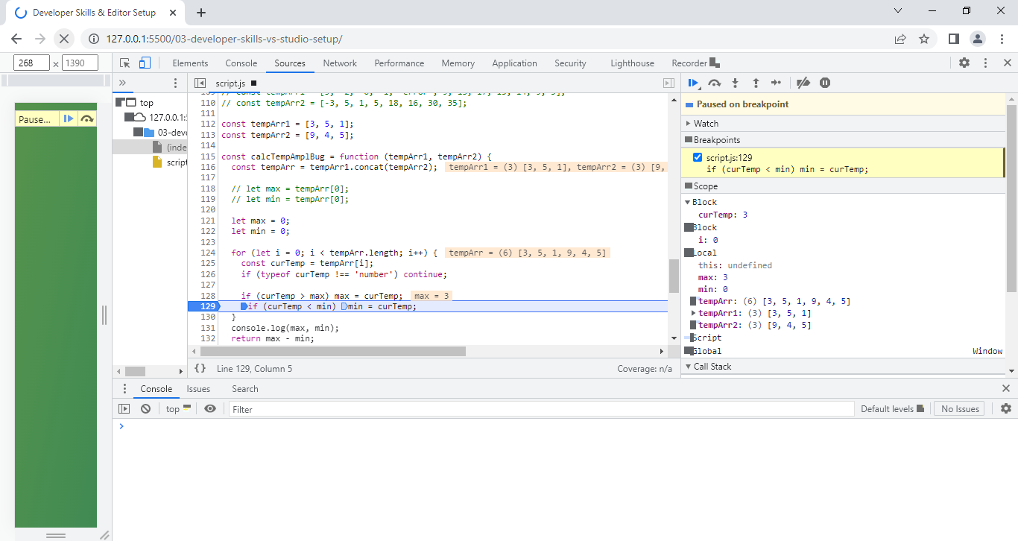
Now the breakpoint can be moved to the if statement for min. First run through the loop and it returns a curTemp of 3 and sets the max value.
I can keep resuming the loop and running through it multiple times observing that the min temp stays at zero rather than being set to 1 which is the lowest value in the array so I therefore know that I need to change the min = 0 line of code.

Slide 84
We can actually call the debugger direct from our code by inserting the line debugger; above the breakpoint that we want.
const tempArr1 = [3, 5, 1]; // const tempArr1 = [3, -2, -6, -1, 'error', 9, 13, 17];
const tempArr2 = [9, 4, 5]; // const tempArr2 = [-3, 5, 1, 5, 18, 16, 30, 35];
const calcTempAmplBug = function (tempArr1, tempArr2) {
const tempArr = tempArr1.concat(tempArr2);
let max = 0; // let max = tempArr[0];
let min = 0; // let min = tempArr[0];
for (let i = 0; i < tempArr.length; i++) {
const curTemp = tempArr[i];
if (typeof curTemp !== 'number') continue;
debugger;
if (curTemp > max) max = curTemp;
if (curTemp < min) min = curTemp;
}
console.log(max, min);
return max - min;
};
const amplBug = calcTempAmplBug(tempArr1, tempArr2);
console.log(amplBug);

Slide 85
Coding Challenge:
Given an array of forecasted maximum temperatures, the thermometer displays a string with these temperatures.
Example: [17,21,23] will print "...17ºC in 1 days ...21ºC in 2 days ...23ºC in 3 days“
Create a function 'printForecast' which takes in an array 'arr' and logs a string like the above to the console.
Use the problem solving framework, understand the problem and break it up into sub problems.
Test data 1: [17,21,23]
Test data 2: [12, -5, 0, 4]

Slide 86
const arr1 = [17, 21, 23];
const arr2 = [12, -5, 0, 4];
// METHOD 1
const printForecast = function (arr) {
let str = '';
for (let i = 0; i < arr.length; i++) {
const dayTemp = ` ...${arr[i]}ºC in ${i + 1} days`;
str += dayTemp;
}
console.log(str);
};
printForecast(arr1);
// METHOD 2
const printForecast2 = function (arr) {
let str = '';
for (let i = 0; i < arr.length; i++) {
str += `${arr[i]}ºC in ${i + 1} days ...`;
}
console.log('...' + str);
};
printForecast2(arr2);

Slide 87
JavaScript in the browser: DOM and Events Fundamentals – Guess My Number

Slide 88
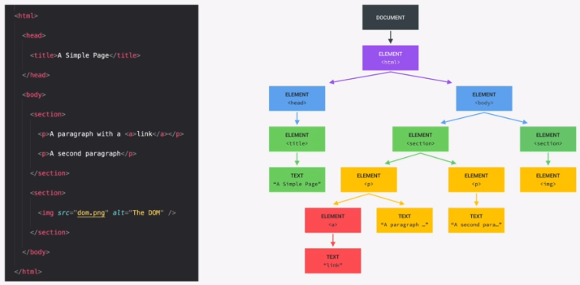
What is the DOM?
We are going to make JavaScript Interact with the elements on the page using DOM manipulation.
DOM stands for Document Object Model and it is basically a structured representation of the html document. The DOM can be considered a connection point between HTML and JavaScript.
The DOM is represented in tree structure and is automatically created by the browser.

Slide 89


We can interact with each of the HTML elements in JavaScript.
There is a special element in the DOM called the document which is the root and the entry point into the tree structure and we need it to start selecting elements.
HTML usually has two child elements, Head and Body so they are siblings to the document.
As we move deeper into the tree we see that the relationship is child to parent so for example the head html tag has child element of title. Elements also have sibling relationships.
Whatever is in the html document also has to be in the DOM. The DOM is a complete representation of the HTML document.
DOM methods & Properties NOT part of JavaScript
JAVASCRIPT
DOM methods & properties for DOM manipulation. For example document.querySelector
X
JavaScript is simply a dialect of ECMAScript
The DOM methods and properties are part of web APIs which the browser implements and that we can access from our JavaScript code. APIs are libraries that are written and available for us to use in the browser.

Slide 90
'use strict';
We can inspect a html element's text content using document.querySelector and .textContent.
Note that we identify the element by it’s class like in CSS, in this case .message.
console.log(document.querySelector('.message').textContent);
Using querySelector and .textContent we can manipulate the textContent of the class message.
document.querySelector('.message').textContent = 'Correct Number! 🎈';
console.log(document.querySelector('.message').textContent);
We can also manipulate other elements of the DOM by querySelect the class and setting the textContent.
document.querySelector('.number').textContent = '13';
console.log(document.querySelector('.number').textContent);
document.querySelector('.score').textContent = '10';
console.log(document.querySelector('.score').textContent);
Class ‘guess’ is an input so what we want to querySelect is the .value of that input property. We can also manipulate value.
document.querySelector('.guess').value = 23;
console.log(document.querySelector('.guess').value);
<section class="left">
<input type="number" class="guess" />
<button class="btn check">Check!</button>
</section>

Slide 91
Now we can make our application actually do something when we click on the page. For that we can use an event listener so that JavaScript reacts to the event.
In the below code snippet we querySelect the element by its class name then add an event listener to it.
The event listener is an inbuilt function that takes two parameters, We have to specify what type of event, in this case a click. The we specify a function that we want it to execute, in this case a simple console log of the value of another element, the guess element.
Note that the function within the event Listener will only be executed if the ‘.check’ element is clicked.
We can also do some DOM manipulation within the function within the event listener, In this case we change the text Content of another element called ‘.message’.
document.querySelector('.check').addEventListener('click', function () {
console.log(document.querySelector('.guess').value);
});
document.querySelector('.check').addEventListener('click', function () {
console.log(document.querySelector('.guess').value);
document.querySelector('.message').textContent = 'Correct Number! 🎈';
});

Slide 92
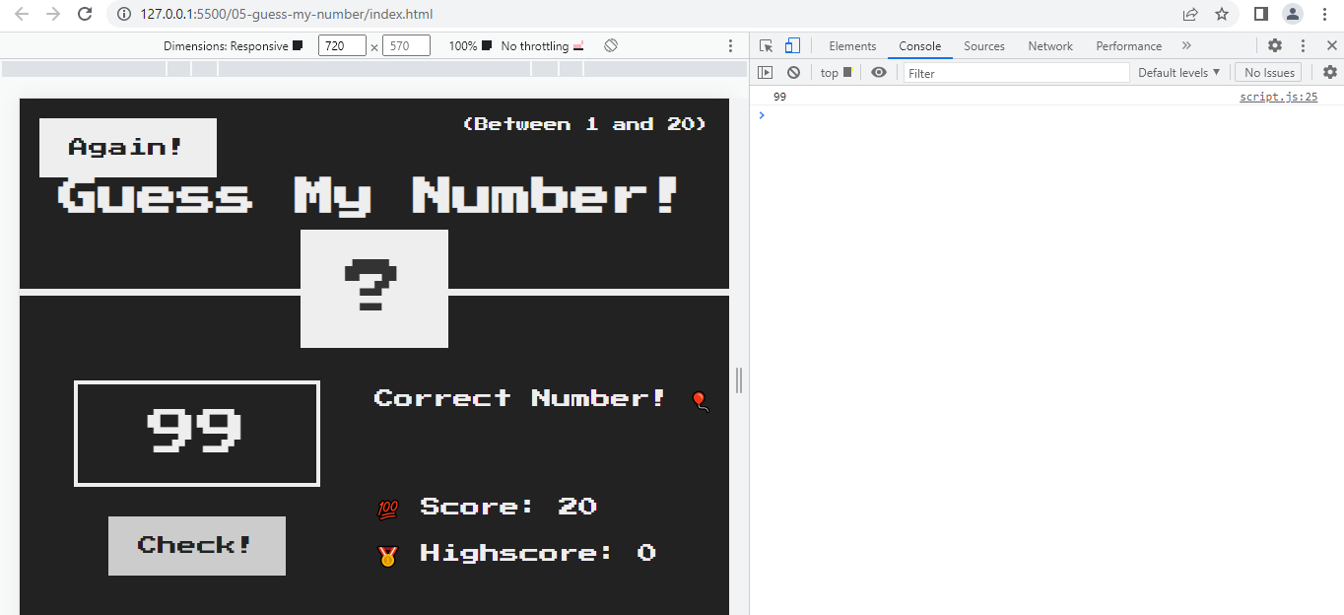
The event listener is attached to the element with class ‘.check’
Once the event listener is triggered with a click, the function within the event listener console logs the value of the input with class ‘.guess’. The DOM manipulation of class ‘.message’ also occurs.

Slide 93
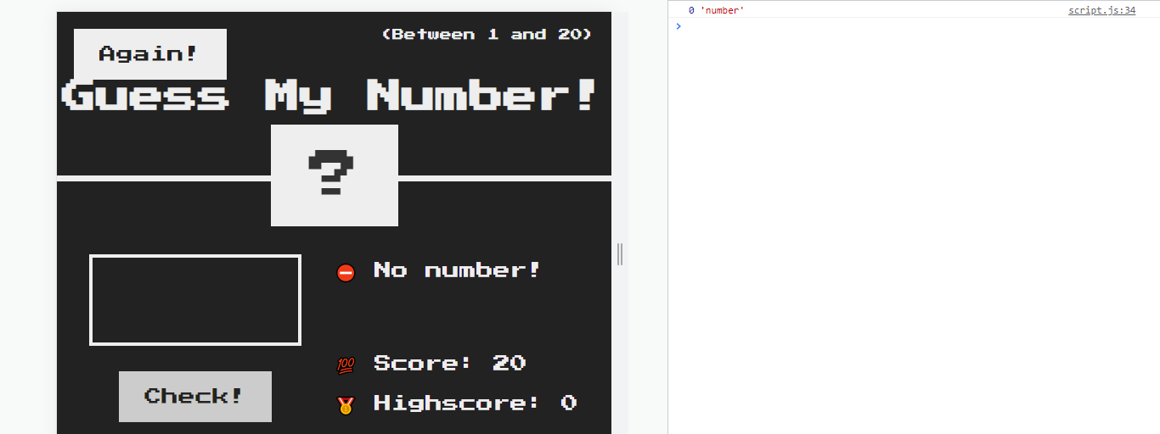
Now lets store the input value as a variable called guess. Note that most inputs, by default have a data type of string so we will need to convert the variable to a number for it to be useful later.
document.querySelector('.check').addEventListener('click', function () {
const guess = Number(document.querySelector('.guess').value);
console.log(guess, typeof guess);
But what if a user has not entered a number before triggering the event listener?. Here we check for a null of the variable guess and DOM manipulate the ‘.message’ element to say No number!
if (!guess) {
document.querySelector('.message').textContent = '⛔ No number!';
}
});

Slide 94
IMPLEMENT GAME LOGIC:
Define the secret random number:
Math.Random() will produce a random number between zero and 1.
To get a decimal number between 0 and 20 we can multiply by 20.
Now we can remove the decimal part by truncating the number using Math.trunc().
But this will give a number between zero and 19 when what we want is a number between 1 and 20 so we can just add 1 to it.
const secretNumber = Math.trunc(Math.random() * 20) + 1;
document.querySelector('.number').textContent = secretNumber;
document.querySelector('.check').addEventListener('click', function () {
const guess = Number(document.querySelector('.guess').value);
if (!guess) {
document.querySelector('.message').textContent = '⛔ No number!';
} else if (guess === secretNumber) {
document.querySelector('.message').textContent = '🏆 Correct number!';
}
});
If the user guesses the secret number we want a success message of ‘correct number’

Slide 95
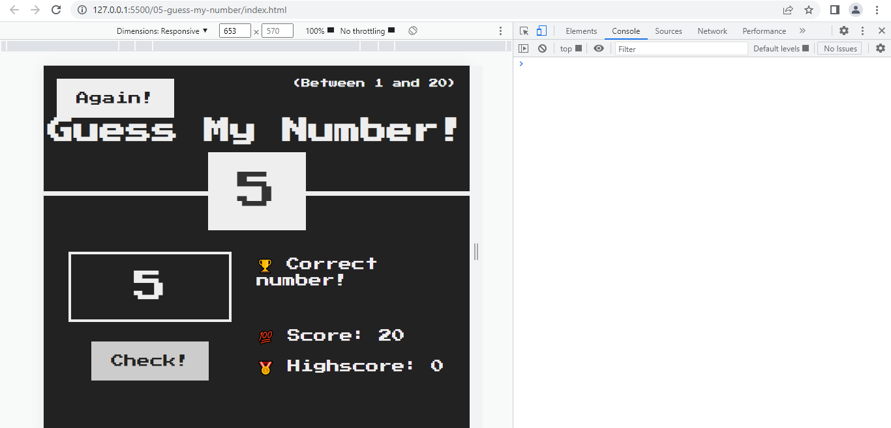
Here we are DOM manipulating the element with class ‘number’ to change the text content to variable secret number for testing purposes.
When we input 5 and trigger the event listener function with a click, The if statement first checks that variable guess is not empty/null. With the if Else we check if the guess is equal to the sectret number and dom manipulate the element ‘.message’ to say correct number if true.

Slide 96
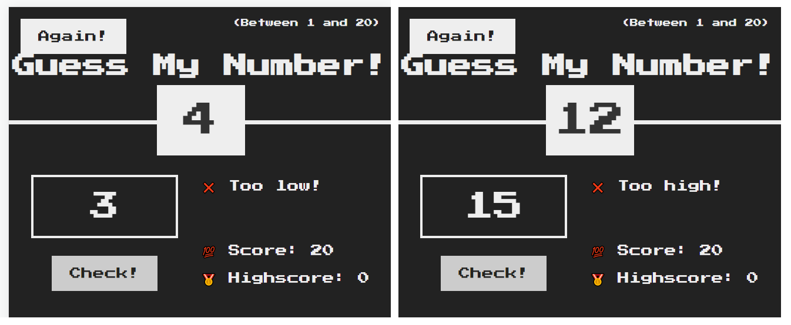
Now lets handle the scenarios for when the guess is bigger or smaller than the secret number.
const secretNumber = Math.trunc(Math.random() * 20) + 1;
document.querySelector('.number').textContent = secretNumber;
document.querySelector('.check').addEventListener('click', function () {
const guess = Number(document.querySelector('.guess').value);
if (!guess) {
document.querySelector('.message').textContent = '⛔ No number!';
} else if (guess === secretNumber) {
document.querySelector('.message').textContent = '🏆 Correct number!';
} else if (guess > secretNumber) {
document.querySelector('.message').textContent = '❌ Too high!';
} else if (guess < secretNumber) {
document.querySelector('.message').textContent = '❌ Too low!';
}
});

Slide 97
Now lets implement the score where the score starts at 20 and decreases by 1 each time an incorrect guess is made. We want to recalculate the score and update the element score with the new value for an incorrect guess.
const secretNumber = Math.trunc(Math.random() * 20) + 1;
let score = 20;
document.querySelector('.number').textContent = secretNumber;
document.querySelector('.check').addEventListener('click', function () {
const guess = Number(document.querySelector('.guess').value);
if (!guess) {
document.querySelector('.message').textContent = '⛔ No number!';
} else if (guess === secretNumber) {
document.querySelector('.message').textContent = '🏆 Correct number!';
} else if (guess > secretNumber) {
document.querySelector('.message').textContent = '❌ Too high!';
score--;
document.querySelector('.score').textContent = score;
} else if (guess < secretNumber) {
document.querySelector('.message').textContent = '❌ Too low!';
score--;
document.querySelector('.score').textContent = score;
}
});

Slide 98
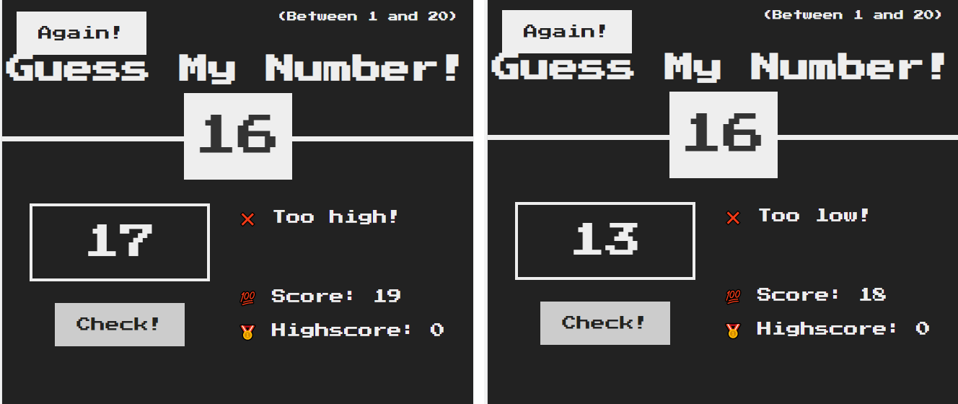
Each time an incorrect guess is made, the score is decreased by 1.
However, if we keep clicking the score will decrease by 1. lets say that we guess incorrectly more than 20 times then the score will be a negative number. What we need is some logic that says if score is above zero then allow guessing. Else DOM manipulate ‘.message’ to you loose and set the score to zero.

Slide 99
const secretNumber = Math.trunc(Math.random() * 20) + 1;
let score = 20;
document.querySelector('.check').addEventListener('click', function () {
const guess = Number(document.querySelector('.guess').value);
if (!guess) {
document.querySelector('.message').textContent = '⛔ No number!';
} else if (guess === secretNumber) {
document.querySelector('.message').textContent = '🏆 Correct number!';
} else if (guess > secretNumber) {
if (score > 1) {
document.querySelector('.message').textContent = '❌ Too high!';
score--;
document.querySelector('.score').textContent = score;
} else {
document.querySelector('.message').textContent = '🔥You lost the Game!';
document.querySelector('.score').textContent = 0;
}
} else if (guess < secretNumber) {
if (score > 1) {
document.querySelector('.message').textContent = '❌ Too low!';
score--;
document.querySelector('.score').textContent = score;
} else {
document.querySelector('.message').textContent = '🔥You lost the Game!';
document.querySelector('.score').textContent = 0;
}
}
});

Slide 100
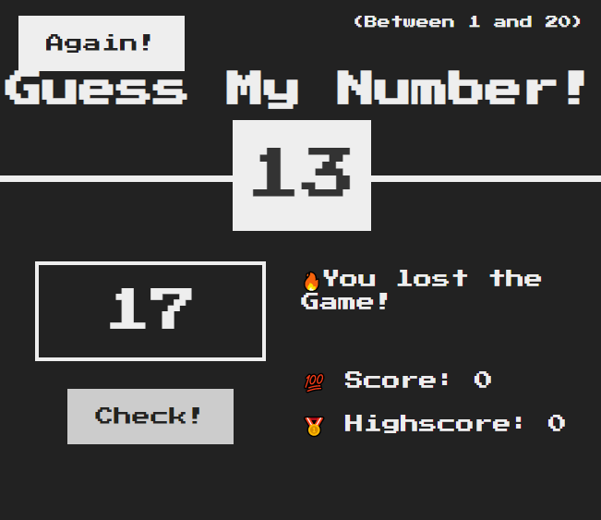
Now the game only lets us guess if the score is above zero, otherwise it will change the ‘.message’ to you loose and set the score to zero.

Slide 101
Manipulating CSS styles using JavaScript.
When the player wins the game we want the background colour of the whole screen to change to green. We also want to make the element .number wider when the player wins and display the secret number.
const secretNumber = Math.trunc(Math.random() * 20) + 1;
let score = 20;
document.querySelector('.check').addEventListener('click', function () {
const guess = Number(document.querySelector('.guess').value);
// When there is no input
if (!guess) {
document.querySelector('.message').textContent = '⛔ No number!';
// When player wins
} else if (guess === secretNumber) {
document.querySelector('.message').textContent = '🏆 Correct number!’;
document.querySelector('.number').textContent = secretNumber;
document.querySelector('body').style.backgroundColor = '#60b347';
document.querySelector('.number').style.width = '30rem’;
Note 1: when css style property has a two word name like background-color in javascript it becomes backgroundColor. We remove the hyphen and use camel case.
Note 2: The style property value must always be a string, i.e. within quotes.

Slide 102
// When guess is too high
} else if (guess > secretNumber) {
if (score > 1) {
document.querySelector('.message').textContent = '❌ Too high!';
score--;
document.querySelector('.score').textContent = score;
} else {
document.querySelector('.message').textContent = '🔥You lost the Game!';
document.querySelector('.score').textContent = 0;
}
// WHen guess is too low
} else if (guess < secretNumber) {
if (score > 1) {
document.querySelector('.message').textContent = '❌ Too low!';
score--;
document.querySelector('.score').textContent = score;
} else {
document.querySelector('.message').textContent = '🔥You lost the Game!';
document.querySelector('.score').textContent = 0;
}
}
});

Slide 103
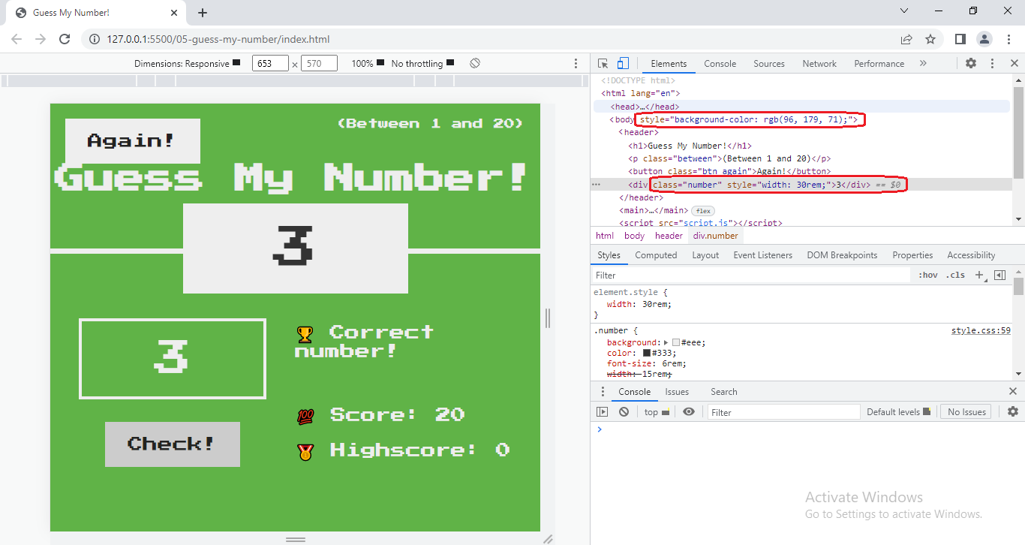
Note that when we change CSS style in JavaScript, It does not modify the CSS file but applies the changes as inline style to the html element in the DOM.

Slide 104
CODING CHALLENGE 1: Implement a game reset function, so the player can make a new guess.
1. Select the element with the 'again' class and attach a click event handler.
2. In the handler function, restore initial values of the score and SecretNumber variables.
3. Restore the initial conditions of the message, number, score and guess input field.
4. Also restore the original background colour (#222) and number width (15rem);
let secretNumber = Math.trunc(Math.random() * 20) + 1;
let score = 20;
document.querySelector('.check').addEventListener('click', function () {
const guess = Number(document.querySelector('.guess').value);
// When there is no input
if (!guess) {
document.querySelector('.message').textContent = '⛔ No number!';
// When player wins
} else if (guess === secretNumber) {
document.querySelector('.message').textContent = '🏆 Correct number!';
document.querySelector('.number').textContent = secretNumber;
document.querySelector('body').style.backgroundColor = '#60b347';
document.querySelector('.number').style.width = '30rem';

Slide 105
// When guess is too high
} else if (guess > secretNumber) {
if (score > 1) {
document.querySelector('.message').textContent = '❌ Too high!';
score--;
document.querySelector('.score').textContent = score;
} else {
document.querySelector('.message').textContent = '🔥You lost the Game!';
document.querySelector('.score').textContent = 0;
}
// When guess is too low
} else if (guess < secretNumber) {
if (score > 1) {
document.querySelector('.message').textContent = '❌ Too low!';
score--;
document.querySelector('.score').textContent = score;
} else {
document.querySelector('.message').textContent = '🔥You lost the Game!';
document.querySelector('.score').textContent = 0;
}
}
});
document.querySelector('.again').addEventListener('click', function () {
secretNumber = Math.trunc(Math.random() * 20) + 1;
let score = 20;
document.querySelector('.message').textContent = 'Start guessing...';
document.querySelector('.score').textContent = score;
document.querySelector('.number').textContent = '?';
document.querySelector('.guess').value = '';
document.querySelector('body').style.backgroundColor = '#222';
document.querySelector('.number').style.width = '15rem';
});

Slide 106
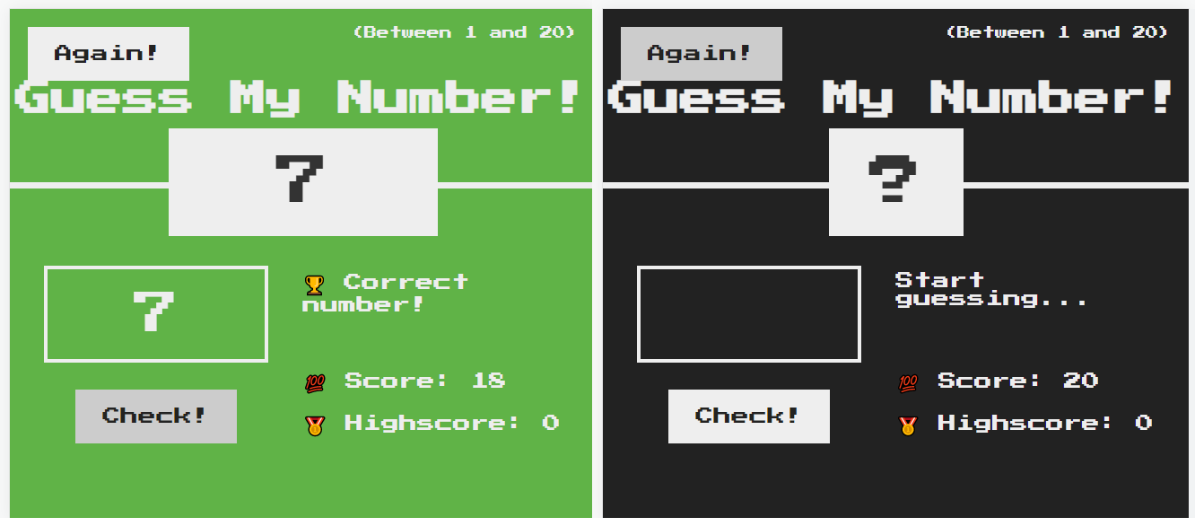
document.querySelector('.again').addEventListener('click', function () {
secretNumber = Math.trunc(Math.random() * 20) + 1;
score = 20;
document.querySelector('.message').textContent = 'Start guessing...';
document.querySelector('.score').textContent = score;
document.querySelector('.number').textContent = '?';
document.querySelector('.guess').value = '';
document.querySelector('body').style.backgroundColor = '#222';
document.querySelector('.number').style.width = '15rem';
});

Slide 107
IMPLEMENT HIGH SCORE FUNCTION: The highscore value is the highest score achieved over multiple games. i.e. first game score 10, second game score 15, third game score 17. the highscore would be 17.
let secretNumber = Math.trunc(Math.random() * 20) + 1;
let score = 20;
let highscore = 0;
document.querySelector('.check').addEventListener('click', function () {
const guess = Number(document.querySelector('.guess').value);
// When there is no input
if (!guess) {
document.querySelector('.message').textContent = '⛔ No number!';
// When player wins
} else if (guess === secretNumber) {
document.querySelector('.message').textContent = '🏆 Correct number!';
document.querySelector('.number').textContent = secretNumber;
document.querySelector('body').style.backgroundColor = '#60b347';
document.querySelector('.number').style.width = '30rem';
if (score > highscore) {
highscore = score;
document.querySelector('.highscore').textContent = highscore;
}

Slide 108
// When guess is too high
} else if (guess > secretNumber) {
if (score > 1) {
document.querySelector('.message').textContent = '❌ Too high!';
score--;
document.querySelector('.score').textContent = score;
} else {
document.querySelector('.message').textContent = '🔥You lost the Game!';
document.querySelector('.score').textContent = 0;
}
// When guess is too low
} else if (guess < secretNumber) {
if (score > 1) {
document.querySelector('.message').textContent = '❌ Too low!';
score--;
document.querySelector('.score').textContent = score;
} else {
document.querySelector('.message').textContent = '🔥You lost the Game!';
document.querySelector('.score').textContent = 0;
}
}
});

Slide 109
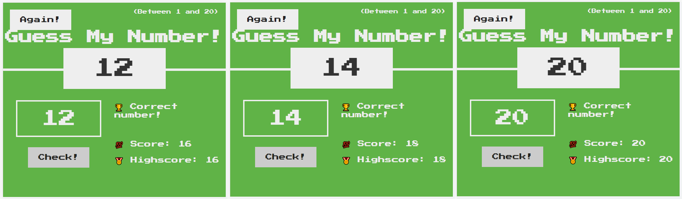
document.querySelector('.again').addEventListener('click', function () {
secretNumber = Math.trunc(Math.random() * 20) + 1;
score = 20;
document.querySelector('.message').textContent = 'Start guessing...';
document.querySelector('.score').textContent = score;
document.querySelector('.number').textContent = '?';
document.querySelector('.guess').value = '';
document.querySelector('body').style.backgroundColor = '#222';
document.querySelector('.number').style.width = '15rem';
});
Now the highscore changes if in subsequent rounds the player scores more than before.

Slide 110
Refactoring out code: The dry principle
Looking over the code we have sections that are almost duplicate code. We can tidy this up by reducing duplicate code. The advantage of this is that if we change something like an element class then we would have to change it in multiple places in the code and it can become a nightmare of bugs. We do refactoring to eliminate duplicate code and clean it up.
// When guess is too high
} else if (guess > secretNumber) {
if (score > 1) {
document.querySelector('.message').textContent = '❌ Too high!';
score--;
document.querySelector('.score').textContent = score;
} else {
document.querySelector('.message').textContent = '🔥You lost the Game!';
document.querySelector('.score').textContent = 0;
}
// When guess is too low
} else if (guess < secretNumber) {
if (score > 1) {
document.querySelector('.message').textContent = '❌ Too low!';
score--;
document.querySelector('.score').textContent = score;
} else {
document.querySelector('.message').textContent = '🔥You lost the Game!';
document.querySelector('.score').textContent = 0;
}
}
});
Step 1 is to identify duplicate or almost identical code.
If the guess is too high or the guess is too low are basically the same code. What we can really refactor this to is if the guess is not equal to secretNumber.

Slide 111
This part of the code stays the same
let secretNumber = Math.trunc(Math.random() * 20) + 1;
let score = 20;
let highscore = 0;
document.querySelector('.check').addEventListener('click', function () {
const guess = Number(document.querySelector('.guess').value);
// When there is no input
if (!guess) {
document.querySelector('.message').textContent = '⛔ No number!';
// When player wins
} else if (guess === secretNumber) {
document.querySelector('.message').textContent = '🏆 Correct number!';
document.querySelector('.number').textContent = secretNumber;
document.querySelector('body').style.backgroundColor = '#60b347';
document.querySelector('.number').style.width = '30rem';
if (score > highscore) {
highscore = score;
document.querySelector('.highscore').textContent = highscore;
}

Slide 112
// When guess is not equal to secretNumber
} else if (guess !== secretNumber) {
if (score > 1) {
document.querySelector('.message').textContent =
guess > secretNumber ? '❌ Too high!' : '❌ Too low!';
score--;
document.querySelector('.score').textContent = score;
} else {
document.querySelector('.message').textContent = '🔥You lost the Game!';
document.querySelector('.score').textContent = 0;
}
}
});
document.querySelector('.again').addEventListener('click', function () {
secretNumber = Math.trunc(Math.random() * 20) + 1;
score = 20;
document.querySelector('.message').textContent = 'Start guessing...';
document.querySelector('.score').textContent = score;
document.querySelector('.number').textContent = '?';
document.querySelector('.guess').value = '';
document.querySelector('body').style.backgroundColor = '#222';
document.querySelector('.number').style.width = '15rem';
});
Here we can reduce the guess not equal to secretNumber to a ternary operator to change the message. The rest of the code is the same.

Slide 113
let secretNumber = Math.trunc(Math.random() * 20) + 1;
let score = 20;
let highscore = 0;
const displayMessage = function (message) {
document.querySelector('.message').textContent = message;
};
document.querySelector('.check').addEventListener('click', function () {
const guess = Number(document.querySelector('.guess').value);
// When there is no input
if (!guess) {
displayMessage('⛔ No number!');
// When player wins
} else if (guess === secretNumber) {
displayMessage('🏆 Correct number!');
document.querySelector('.number').textContent = secretNumber;
document.querySelector('body').style.backgroundColor = '#60b347';
document.querySelector('.number').style.width = '30rem’;
if (score > highscore) {
highscore = score;
document.querySelector('.highscore').textContent = highscore;
}
Step 2 is to identify duplicate or almost identical lines of code and consider putting it in a function and call that function multiple times when we need it.
Call the function
Call the function

Slide 114
if (score > highscore) {
highscore = score;
document.querySelector('.highscore').textContent = highscore;
}
// When guess is not equal to secretNumber
} else if (guess !== secretNumber) {
if (score > 1) {
displayMessage(guess > secretNumber ? '❌ Too high!' : '❌ Too low!');
score--;
document.querySelector('.score').textContent = score;
} else {
displayMessage('🔥You lost the Game!');
document.querySelector('.score').textContent = 0;
}
}
});
document.querySelector('.again').addEventListener('click', function () {
secretNumber = Math.trunc(Math.random() * 20) + 1;
score = 20;
displayMessage('Start guessing...');
document.querySelector('.score').textContent = score;
document.querySelector('.number').textContent = '?';
document.querySelector('.guess').value = '';
document.querySelector('body').style.backgroundColor = '#222';
document.querySelector('.number').style.width = '15rem';
});
Call the
function
Call the function
Call the function

Slide 115
JavaScript in the browser: DOM and Events Fundamentals – Pop up Modal Window

Slide 116
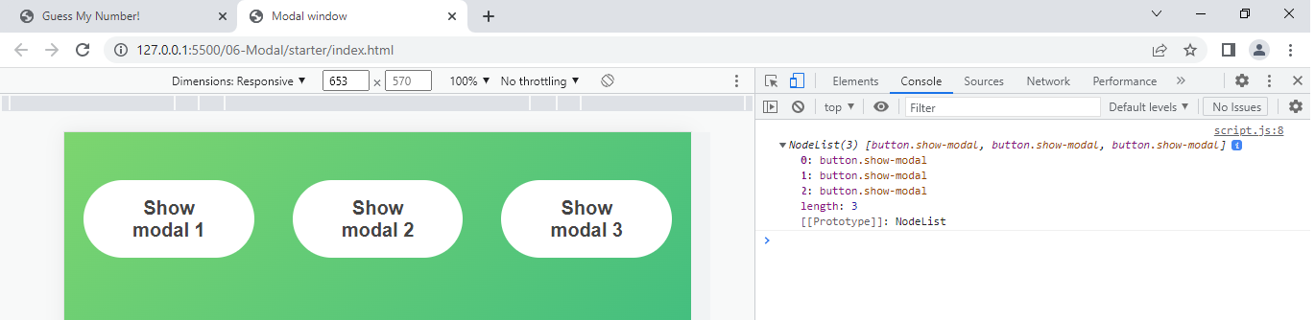
Project: Modal Window.
We first start by defining all the elements we want to manipulate as variables. Note how in the HTML we have three modal buttons so when selecting multiple elements by class we need to use querySelectorAll.
'use strict';
const modal = document.querySelector('.modal');
const overlay = document.querySelector(‘.overlay');
const btnCloseModal = document.querySelector(‘.close-modal');
const btnsOpenModel = document.querySelectorAll(‘.show-modal');
console.log(btnsOpenModel);
If we console log this we get a nodelist which is like an array.

Slide 117
'use strict';
const modal = document.querySelector('.modal');
const overlay = document.querySelector('.overlay');
const btnCloseModal = document.querySelector('.close-modal');
const btnsOpenModel = document.querySelectorAll('.show-modal');
console.log(btnsOpenModel);
for (let i = 0; i < btnsOpenModel.length; i++)
btnsOpenModel[i].addEventListener('click', function () {
console.log('button clicked');
modal.classList.remove('hidden');
overlay.classList.remove('hidden');
});
btnCloseModal.addEventListener('click', function () {
modal.classList.add('hidden');
overlay.classList.add('hidden');
});
overlay.addEventListener('click', function () {
modal.classList.add('hidden');
overlay.classList.add('hidden');
});
We create a for loop to decide what happens to each of the buttons.
And then add an event listener for clicks of the button. Within the event listener we want to remove the hidden class for two elements.
The modal can be closed by either clicking on the overlay outside of the modal or using the close button in the modal.

Slide 118
Refine the close modal function with a named function.
const modal = document.querySelector('.modal');
const overlay = document.querySelector('.overlay');
const btnCloseModal = document.querySelector('.close-modal');
const btnsOpenModel = document.querySelectorAll('.show-modal');
console.log(btnsOpenModel);
for (let i = 0; i < btnsOpenModel.length; i++)
btnsOpenModel[i].addEventListener('click', function () {
console.log('button clicked');
modal.classList.remove('hidden');
overlay.classList.remove('hidden');
});
const closeModal = function () {
modal.classList.add('hidden’); Named Function
overlay.classList.add('hidden');
};
btnCloseModal.addEventListener('click', closeModal); Call Named Function in
overlay.addEventListener('click', closeModal); Event Handler

Slide 119
Refine the open modal function with a named function.
const modal = document.querySelector('.modal');
const overlay = document.querySelector('.overlay');
const btnCloseModal = document.querySelector('.close-modal');
const btnsOpenModel = document.querySelectorAll('.show-modal');
const openModal = function () {
console.log('button clicked');
modal.classList.remove('hidden’); Named Function
overlay.classList.remove('hidden');
};
const closeModal = function () {
modal.classList.add('hidden');
overlay.classList.add('hidden');
};
for (let i = 0; i < btnsOpenModel.length; i++) Call Named Function in
btnsOpenModel[i].addEventListener('click', openModal); Event Handler
btnCloseModal.addEventListener('click', closeModal);
overlay.addEventListener('click', closeModal);

Slide 120
Key press events are global so they normally happen on the whole document and have three varieties: Keyup, Keydown, Keypress.
Keydown: is when we strike a key
keyup: is when we lift off a key
Keypress: Depreciated - event is fired when a key that produces a character value is pressed down
document.addEventListener('keydown', function (e) {
console.log('A key was pressed');
console.log(e);
});
The event listener for a key press event stores the key value in the function so we can call it e for event and console log it

Slide 121
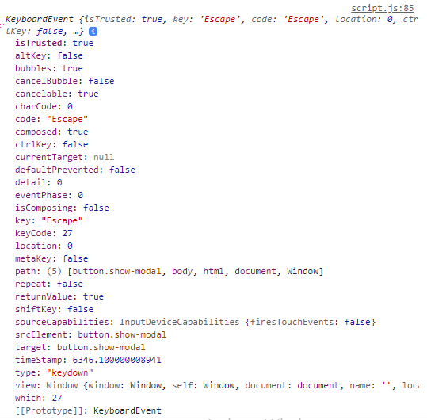
Here we see a property of key which holds the value of “escape” because I pressed the escape key
We want to execute the close modal function if the modal is visible, i.e. does not contain the class of ‘hidden’ and if the e property of “key” is Escape.
document.addEventListener('keydown', function (e) {
if (e.key === 'Escape' && !modal.classList.contains('hidden')) {
closeModal();
}
});

Slide 122
JavaScript in the browser: DOM and Events Fundamentals – Pig Game

Slide 123

Project: Pig Game.

Slide 124
'use strict';
// Selecting elements
const score0El = document.querySelector('#score--0');
const score1El = document.querySelector('#score--1');
const diceEl = document.querySelector('.dice');
const btnNew = document.querySelector('.btn--new');
const btnRoll = document.querySelector('.btn--roll');
const btnHold = document.querySelector('.btn--hold');
// Setting intitial values for elements
score0El.textContent = 0;
score1El.textContent = 0;
diceEl.classList.add('hidden');
// Rolling dice functionality
btnRoll.addEventListener('click' function() {
// 1. Generate random dice roll number
// 2. Display dice
// 3. Check for rolled 1: if true, switch to other player
})
First we define the variables that we are going to use.
Then we define some initial values for the elements
And we can make a start on the roll dice functionality by first defining what we want it to do.

Slide 125
// Selecting elements
const score0El = document.querySelector('#score--0');
const score1El = document.querySelector('#score--1');
const current0El = document.querySelector('#current--0');
const current1El = document.querySelector('#current--1');
const diceEl = document.querySelector('.dice');
const btnNew = document.querySelector('.btn--new');
const btnRoll = document.querySelector('.btn--roll');
const btnHold = document.querySelector('.btn--hold');
const Player0 = document.querySelector('#name--0');
const Player1 = document.querySelector('#name--1');
// Starting conditions
score0El.textContent = 0;
score1El.textContent = 0;
diceEl.classList.add('hidden');
let currentScore = 0;

Slide 126
// Rolling dice functionality
btnRoll.addEventListener('click', function () {
// 1. Generate random dice roll number
const dice = Math.trunc(Math.random() * 6) + 1;
console.log(dice);
// 2. Display dice
diceEl.classList.remove('hidden');
diceEl.src = `dice-${dice}.png`;
// 3. Check for rolled 1:
if (dice !== 1) {
// Add dice to current score
currentScore += dice;
current0El.textContent = currentScore; // Change later
} else {
// Switch to other player
}
});
If the dice roll is not 1 then we need to add the dice rolled value to the current score and update the current score on screen.

Slide 127

Now when the player clicks the roll dice button a random dice value is selected which is continually added to current score and updating the current element. Note that the image of the dice changes depending on the value because the filename for the image is dice-(value).png.

Slide 128
Switching the Active player
// Selecting elements
const player0El = document.querySelector('.player--0');
const player1El = document.querySelector('.player--1');
const score0El = document.querySelector('#score--0');
const score1El = document.querySelector('#score--1');
const current0El = document.querySelector('#current--0');
const current1El = document.querySelector('#current--1');
const diceEl = document.querySelector('.dice');
const btnNew = document.querySelector('.btn--new');
const btnRoll = document.querySelector('.btn--roll');
const btnHold = document.querySelector('.btn--hold');
// Starting conditions
score0El.textContent = 0;
score1El.textContent = 0;
diceEl.classList.add('hidden');
const scores = [0, 0];
let currentScore = 0;
let activePlayer = 0;
We define the variables for the two players.
We define a new immutable variable for active player and set it to zero. ( the active player is either zero or one)

Slide 129
// Rolling dice functionality
btnRoll.addEventListener('click', function () {
// 1. Generate random dice roll number
const dice = Math.trunc(Math.random() * 6) + 1;
console.log(dice);
// 2. Display dice
diceEl.classList.remove('hidden');
diceEl.src = `dice-${dice}.png`;
// 3. Check for rolled 1:
if (dice !== 1) {
// Add dice to current score
currentScore += dice;
document.getElementById(`current--${activePlayer}`).textContent = currentScore;
} else {
// Switch to other player
document.getElementById(`current--${activePlayer}`).textContent = 0;
currentScore = 0;
activePlayer = activePlayer === 0 ? 1 : 0;
player0El.classList.toggle('player--active');
player1El.classList.toggle('player--active');
}
});
When the player switches the current score needs to be reset to zero.
We can also toggle the class list to change the background-color of to show the current player. Toggle just means if it has class ‘player—active’ remove it. If it does not have class ‘player—active’ add it.

Slide 130

Now when the dice lands on 1 the active player changes, the score currentScore resets to zero and the background-colour flips to the other player.

Slide 131
Holding the current Score part 1
// Selecting elements
const player0El = document.querySelector('.player--0');
const player1El = document.querySelector('.player--1');
const score0El = document.querySelector('#score--0');
const score1El = document.querySelector('#score--1');
const current0El = document.querySelector('#current--0');
const current1El = document.querySelector('#current--1');
const diceEl = document.querySelector('.dice');
const btnNew = document.querySelector('.btn--new');
const btnRoll = document.querySelector('.btn--roll');
const btnHold = document.querySelector('.btn--hold');
// Starting conditions
score0El.textContent = 0;
score1El.textContent = 0;
diceEl.classList.add('hidden');
const scores = [0, 0];
let currentScore = 0;
let activePlayer = 0;
2)
2) We have an array of scores that contains two items. Scores[0] holds the score for player 0 and score[1] holds the score for player 1. Note that the position in the array is also the player

Slide 132
// Switch player function
const switchPlayer = function () {
document.getElementById(`current--${activePlayer}`).textContent = 0;
currentScore = 0;
activePlayer = activePlayer === 0 ? 1 : 0;
console.log(`active--player = ${activePlayer}`);
player0El.classList.toggle('player--active');
player1El.classList.toggle('player--active');
};
// Rolling dice functionality
btnRoll.addEventListener('click', function () {
// 1. Generate random dice roll number
const dice = Math.trunc(Math.random() * 6) + 1;
console.log(dice);
// 2. Display dice
diceEl.classList.remove('hidden');
diceEl.src = `dice-${dice}.png`;
// 3. Check for rolled 1:
if (dice !== 1) {
// Add dice to current score
currentScore += dice;
document.getElementById(`current--${activePlayer}`).textContent = currentScore;
} else {

Slide 133
// Switch to other player
switchPlayer();
}
});
btnHold.addEventListener('click', function () {
// 1. Add current score to active players score
scores[activePlayer] += currentScore;
console.log(scores);
document.getElementById(`score--${activePlayer}`).textContent = scores[activePlayer];
// 2. Check if player's score is >= 100
// Finish the Game
// Switch to the other player
switchPlayer();
});
5)
1) We add an event listener to the hold button and define the actions that we want this function to do.
1)
3)
4)
3) As the active player is either 0 or 1 we can use this to identify the position in the scores array and add the current score to that position value.
5)
4) We also need to update the score element of the active player.
5) Now when the hols is clicked we also want to switch player. But this is code we have used before so we put that code in a function and call it.

Slide 134

Now when the hold button is clicked the current value of the active player is added to the scores array.

Slide 135
Holding the current Score part 2
// Selecting elements
const player0El = document.querySelector('.player--0');
const player1El = document.querySelector('.player--1');
const score0El = document.querySelector('#score--0');
const score1El = document.querySelector('#score--1');
const current0El = document.querySelector('#current--0');
const current1El = document.querySelector('#current--1');
const diceEl = document.querySelector('.dice');
const btnNew = document.querySelector('.btn--new');
const btnRoll = document.querySelector('.btn--roll');
const btnHold = document.querySelector('.btn--hold');
// Starting conditions
score0El.textContent = 0;
score1El.textContent = 0;
diceEl.classList.add('hidden');
const scores = [0, 0];
let currentScore = 0;
let activePlayer = 0;

Slide 136
// Switch player function
const switchPlayer = function () {
document.getElementById(`current--${activePlayer}`).textContent = 0;
currentScore = 0;
activePlayer = activePlayer === 0 ? 1 : 0;
console.log(`active--player = ${activePlayer}`);
player0El.classList.toggle('player--active');
player1El.classList.toggle('player--active');
};
// Rolling dice functionality
btnRoll.addEventListener('click', function () {
// 1. Generate random dice roll number
const dice = Math.trunc(Math.random() * 6) + 1;
console.log(dice);
// 2. Display dice
diceEl.classList.remove('hidden');
diceEl.src = `dice-${dice}.png`;
// 3. Check for rolled 1:
if (dice !== 1) {
// Add dice to current score
currentScore += dice;
document.getElementById(`current--${activePlayer}`).textContent =
currentScore;

Slide 137
} else {
// Switch to other player
switchPlayer();
}
});
btnHold.addEventListener('click', function () {
// 1. Add current score to active players score
scores[activePlayer] += currentScore;
console.log(scores);
document.getElementById(`score--${activePlayer}`).textContent =
scores[activePlayer];
// 2. Check if player's score is >= 100
if (scores[activePlayer] >= 100) {
// Finish the Game
document.querySelector(`.player--${activePlayer}`).classList.add('player--winner');
document.querySelector(`.player--${activePlayer}`).classList.remove('player--active');
} else {
// Switch to the other player
switchPlayer();
}
});
When the active player’s core is greater than or equal to 100 we want to finish the game by adding a player--winner class and removing the player--active class.

Slide 138

Player-winner class added and player—active class removed.

Slide 139

However, We can still continue to play the game until both players have player-winner class! This needs to be fixed!

Slide 140
Holding the current Score part 2
// Selecting elements
const player0El = document.querySelector('.player--0');
const player1El = document.querySelector('.player--1');
const score0El = document.querySelector('#score--0');
const score1El = document.querySelector('#score--1');
const current0El = document.querySelector('#current--0');
const current1El = document.querySelector('#current--1');
const diceEl = document.querySelector('.dice');
const btnNew = document.querySelector('.btn--new');
const btnRoll = document.querySelector('.btn--roll');
const btnHold = document.querySelector('.btn--hold');
// Starting conditions
score0El.textContent = 0;
score1El.textContent = 0;
diceEl.classList.add('hidden');
const scores = [0, 0];
let currentScore = 0;
let activePlayer = 0;
let playing = true;
1) We add a Boolean variable called playing to hold a value of true if the game is playing and false if the game has finished.
1)

Slide 141
// Switch player function
const switchPlayer = function () {
document.getElementById(`current--${activePlayer}`).textContent = 0;
currentScore = 0;
activePlayer = activePlayer === 0 ? 1 : 0;
console.log(`active--player = ${activePlayer}`);
player0El.classList.toggle('player--active');
player1El.classList.toggle('player--active');
};
// Rolling dice functionality
btnRoll.addEventListener('click', function () {
// Is game playing
if (playing) {
// 1. Generate random dice roll number
const dice = Math.trunc(Math.random() * 6) + 1;
console.log(dice);
// 2. Display dice
diceEl.classList.remove('hidden');
diceEl.src = `dice-${dice}.png`;
2)
2) We wrap all the code that we want to only run if the game is playing in a if (playing) clause. Note that because playing is a Boolean we do not need to say if (playing === true)

Slide 142
// 3. Check for rolled 1:
if (dice !== 1) {
// Add dice to current score
currentScore += dice;
document.getElementById(`current--${activePlayer}`).textContent =
currentScore;
} else {
// Switch to other player
switchPlayer();
}
} // End of If playing
});
btnHold.addEventListener('click', function () {
if (playing) {
// 1. Add current score to active players score
scores[activePlayer] += currentScore;
console.log(scores);
document.getElementById(`score--${activePlayer}`).textContent =
scores[activePlayer];
3) For the event listener that handles the hold button we also wrap it in an If (playing)
2)
3)

Slide 143
// 2. Check if player's score is >= 100
if (scores[activePlayer] >= 100) {
// Finish the Game
playing = false;
diceEl.classList.add('hidden');
btnRoll.classList.add('hidden');
btnHold.classList.add('hidden');
document
.querySelector(`.player--${activePlayer}`)
.classList.add('player--winner');
document
.querySelector(`.player--${activePlayer}`)
.classList.remove('player--active');
} else {
// Switch to the other player
switchPlayer();
}
} // End of if playing
});
4) If the current players scores are greater than or equal to 100 the we want to stop the game playing so we set playing to false.
4)
5)
5) We can also set the dice, button roll and button hold to hidden.
3)

Slide 144

Now the game can only have one winner. Once a players score reaches 100 then the dice, roll and hold buttons are hidden.

Slide 145
New Game Button
// Selecting elements
const player0El = document.querySelector('.player--0');
const player1El = document.querySelector('.player--1');
const score0El = document.querySelector('#score--0');
const score1El = document.querySelector('#score--1');
const current0El = document.querySelector('#current--0');
const current1El = document.querySelector('#current--1');
const diceEl = document.querySelector('.dice');
const btnNew = document.querySelector('.btn--new');
const btnRoll = document.querySelector('.btn--roll');
const btnHold = document.querySelector('.btn--hold');
// Scoping the variables
let scores, currentScore, activePlayer, playing;
2) Now that we have the starting game variables set to the correct values it makes no sense to declare the values for the variables do we can just define them in one line of code.

Slide 146
// Game initialise function
const init = function () {
// 1. reset scores array to zero.
scores = [0, 0];
// 2. reset current score to zero
currentScore = 0;
// 3. Set active player to o
activePlayer = 0;
// 4. reset playing to true
playing = true;
// 5. reset player scores to zer0
score0El.textContent = 0;
score1El.textContent = 0;
// 6. reset current player scores to zero
current0El.textContent = 0;
current1El.textContent = 0;
// 7. remove hidden class from btnRoll and BtnHold, hide dice
diceEl.classList.add('hidden');
btnRoll.classList.remove('hidden');
btnHold.classList.remove('hidden');
// 3. Remove player--winner class
player0El.classList.remove('player--winner');
player1El.classList.remove('player--winner');
// 4. Remove player--active class from player 1 and add it to player 0
player0El.classList.add('player--active');
player1El.classList.remove('player--active');
};
1) For the new game button to work we need to reset all the variables to values that they were at the start of the game. It makes sense to put this code in an initialise function.

Slide 147
3) We will run the initialise function after creating it so that values are set to the correct numbers straight away.
init();
// Switch player function
const switchPlayer = function () {
document.getElementById(`current--${activePlayer}`).textContent = 0;
currentScore = 0;
activePlayer = activePlayer === 0 ? 1 : 0;
console.log(`active--player = ${activePlayer}`);
player0El.classList.toggle('player--active');
player1El.classList.toggle('player--active');
};
// Rolling dice functionality
btnRoll.addEventListener('click', function () {
// Is game playing
if (playing) {
// 1. Generate random dice roll number
const dice = Math.trunc(Math.random() * 6) + 1;
console.log(dice);
// 2. Display dice
diceEl.classList.remove('hidden');
diceEl.src = `dice-${dice}.png`;

Slide 148
// 3. Check for rolled 1:
if (dice !== 1) {
// Add dice to current score
currentScore += dice;
document.getElementById(`current--${activePlayer}`).textContent =
currentScore;
} else {
// Switch to other player
switchPlayer();
}
} // End of If playing
});
btnHold.addEventListener('click', function () {
if (playing) {
// 1. Add current score to active players score
scores[activePlayer] += currentScore;
console.log(scores);
document.getElementById(`score--${activePlayer}`).textContent =
scores[activePlayer];

Slide 149
// 2. Check if player's score is >= 100
if (scores[activePlayer] >= 100) {
// Finish the Game
playing = false;
diceEl.classList.add('hidden');
btnRoll.classList.add('hidden');
btnHold.classList.add('hidden');
document
.querySelector(`.player--${activePlayer}`)
.classList.add('player--winner');
document
.querySelector(`.player--${activePlayer}`)
.classList.remove('player--active');
} else {
// Switch to the other player
switchPlayer();
}
} // End of if playing
});
btnNew.addEventListener('click', init);
4) Now the event listener for the new game button just calls the initialise function when it is clicked.

Slide 150
How JavaScript works behind the Scenes.

Slide 151




High-Level
JavaScript high level overview
Garbage Collected
Interpreted or Just-in-time Compiled
Multi-Paradigm
Memory ← Computer Resources → CPU
Prototype-based Object-Orientated
C+ language
Javascript
Python
First Class Functions
Dynamic
Low-Level
High-Level
Single Threaded
Developer has to manage resources manually
Developer DOES NOT have to worry, Everything happens automatically
Non-Blocking Event Loop

Slide 152

High-Level
Garbage Collected
JavaScript has automatic Garbage-Collection which cleans the memory from time to time so we do not have to do it manually in the code.
Interpreted or Just-in-time Compiled
Multi-Paradigm
Prototype-based Object-Orientated
First Class Functions
Dynamic
Memory ← Computer Resources → CPU
Single Threaded
Non-Blocking Event Loop

Slide 153

High-Level
Garbage Collected
Interpreted or Just-in-time Compiled
Multi-Paradigm
Prototype-based Object-Orientated
First Class Functions
Dynamic
JavaScript is an interpreted or just-in-time complied code. I.e. It converts human readable JavaScript code in to machine readable code i.e. 1s and 0s.
Single Threaded
Non-Blocking Event Loop

Slide 154
High-Level
Paradigm: An approach and mindset of structuring code, which will direct your coding style and technique
Garbage Collected
Interpreted or Just-in-time Compiled
This is what we have been using so far in this course
Multi-Paradigm
1
Procedural Programming
Prototype-based Object-Orientated
2
Object-Orientated Programming (OOP)
3
Functional-Programming (FP):
First Class Functions
Dynamic
JavaScript is very versatile and flexible and can support any of the three paradigm´s
Single Threaded
Non-Blocking Event Loop

Slide 155

High-Level
Almost everything in JavaScript is an object (except for primitive values like strings or numbers etc)
Garbage Collected
Arrays are just objects.
We can use push method on arrays because of prototype inheritance.
We create arrays from array blueprint which is called a prototype.
The prototype contains all the methods we can use on it so we can reuse methods for all prototypes such as arrays.
Interpreted or Just-in-time Compiled
Multi-Paradigm
Prototype-based Object-Orientated
First Class Functions
Prototype
Dynamic
Our array inherits methods from Prototype
Single Threaded
Built from Prototype
Non-Blocking Event Loop

Slide 156

High-Level
In a language with First-Class Functions, Functions are simply treated as variables. We can pass them into other functions and return them from functions.
Garbage Collected
Interpreted or Just-in-time Compiled
We have already used a first class function when we passed the close modal function into the event listener function.
Not all languages have this ability.
Multi-Paradigm
Prototype-based Object-Orientated
Passing a function into a function as an argument – First-Class Functions!
First Class Functions
Dynamic
Single Threaded
Non-Blocking Event Loop

Slide 157



High-Level
Dynamically-typed Language:
Garbage Collected
No Data type definitions: Types become known at runtime.
Interpreted or Just-in-time Compiled
Data type of variable is automatically changed.
Multi-Paradigm
Prototype-based Object-Orientated
First Class Functions
Many other programming languages insist on manually assigned datatypes.
Dynamic
Single Threaded
Non-Blocking Event Loop

Slide 158
High-Level
Concurrency model: How the JavaScript Engine handles multiple tasks happening at the same time.
Garbage Collected
JavaScript runs in a single Thread so it can only do one thing at a time. ( A Thread is like a set of instructions that run in a computer’s CPU.)
Interpreted or Just-in-time Compiled
A long running task would therefore block the thread but we want non-blocking behaviour.
Multi-Paradigm
By using an Event loop. This takes long running tasks and executes them in the background then puts them back in the main thread once they are finished.
Prototype-based Object-Orientated
First Class Functions
Dynamic
Single Threaded
Non-Blocking Event Loop

Slide 159






JavaScript Engine and Runtime
A JavaScript engine is a program that executes JavaScript code. Below are examples of Engines.
Google V8 - Chrome and NodeJS
Nitro - Apple
Spider Monkey - Firefox.
Chakra Core - Microsoft Edge.
Any JavaScript Engine will include a call stack and a heap.
Execution Context
Objects in Memory
Where our code is executed.
Where our Objects are stored.
Call Stack Heap

Slide 160
Compilation vs Interpretation
Compilation: Entire code is converted into machine code at once, and written to a binary file that can be executed by a computer.
Source Code
Step 1:
Compilation
Portable File: Machine Code
Step 2:
Execution
Running Program
Interpretation: Interpreter runs through the source code and executes it line by line.
Source Code
Step 1:
Execution line by line
Running Program
JavaScript used to be a compilation language but the problem is that they are much more slower so it is now a mix between interpretation and compilation which is called just in time. The execution happens just after the compilation.

Slide 161

Modern Just-In-Time Compilation of Javascript
JavaScript Engine
Parsing means reading the code and splitting it up into known pieces such as variables to make an Abstract Syntax tree.
Parsing
AST
Compilation means taking the Abstract Syntax Tree and converting it to machine code.
Just-in-time compilation
Compilation
In the beginning the Engine creates a very basic un-optimised version of the code to the get the program running then in a background thread it optimises the code for better efficiency and updates the compilation.
AST
Optimisation
Happens in Call Stack
Execution
It then gets executes right away because modern JavaScript is Just-in-time.

Slide 162
JavaScript Runtime in the Browser
Functionalities provided to the engine accessible on windows object
Web APIs
Engine
DOM
TIMERS
Fetch API
…..
The call-back function is passed to the stack so that it can be executed.
CALLBACK QUEUE
Click
……
Data
timer
Click
Call Stack Heap
Example: Call-back function from DOM event Listener.
The EVENT LOOP is the non-blocking mechanism that takes call-back functions to the call stack.

Slide 163
JavaScript Runtime in the NodeJS
NodeJS uses C++ bindings instead of Web APIs
C++ Bindings and Thread Pool
Engine
The call-back function is passed to the stack so that it can be executed.
CALLBACK QUEUE
Click
……
Data
timer
Click
Call Stack Heap
The EVENT LOOP is the non-blocking mechanism that takes call-back functions to the call stack.

Slide 164

What is an Execution Context?
Execution Context:
Environment in which a piece of JavaScript is executed. Stores all the necessary information for some code to be executed.
Top level code is code that is not inside any function, i.e a variable declaration.
Compilation
Human Readable code:
Creation of Global Execution Context (for top level Code)
Exactly one Global Execution Context (EC). Default context, created for code that is not inside any function.
Execution of Top Level Code (Inside Global EC)
The computer CPU processes the code it receives.
Execution of Functions and waiting for Callbacks
One Execution context per function. Fr each function call a new EC is created.
The code within the function will only be executed when that function is called so it is NOT top level code
All together make the call stack

Slide 165

Execution Context in detail
Literally the function code!
GLOBAL
Generated during creation phase right before execution
Name = ‘Jonas’
First (function)
Second (function)
X (unknown)
Execution context:
Variable Environment
1
Need to run first()first!
let, const and Var declarations
Functions
First()
Arguments Objects
NOT in arrow functions.
Arrow functions do not have the arguments object or the this keyword
a = 1
b = unknown
2
Scope Chain
(The scope chain consists of references to variables that are outside of the current function)
Need to run second()first!
(Technically values only become known during execution.)
second()
c = 2
arguments = [7, 9]
3
This keyword
Array of passed Arguments. Available in all regular functions (except arrow functions)

Slide 166
The Call Stack
Engine
Execution Context
Execution Context
Execution Context
Execution Context
Execution Context
Place where the execution Context’s get stacked on top of each other to keep track of where we are in the execution.
Call Stack Heap

Slide 167
The Call Stack
JavaScript Engine
3) Now the first function is paused while the second function is executed. First will resume when second returns
second()
2) The first gets its own EC and gets put in the call stack
First()
1) The Global EC gets put in the call stack first
GLOBAL
Call Stack
4) Now const x can be calculated because first and second functions have been executed.
Once all functions are executed they are popped of the call stack and the stack remains in a waiting state until new EC’s are passed in or the program is terminated (browser closed!)

Slide 168



The Scope Chain
Scoping: How our programs variables are organised and accessed. Where do variables live or where we can access a certain variable, and where not?
Lexical Scoping: Scoping is controlled by placement of functions and blocks in the code. For example a function that is written inside another function has access to the variables of the parent function.
Scope: Space or environment in which a certain variable is declared (Variable environment in case of functions). There is Global Scope, Function Scope and Block Scope.
Scope of a variable: Region of a code where a certain variable can be accessed.
Global Scope
Function Scope
Block Scope (ES6)
Outside of any function or block.
Variables are only accessible inside block.
Variables declared in Global scope are accessible everywhere.
Variables are accessible only inside function, NOT outside.
HOWEVER, this only applies to let and const variables.
Also called local scope.
Functions are also block scoped (only in strict mode)

Slide 169

The Scope Chain
GLOBAL SCOPE
myName = ‘Jonas’
Variables not in current scope
first() SCOPE
VARIABLE LOOKUP IN THE SCOPE CHAIN
age = 30
myName = ‘Jonas’
second() SCOPE
job = ‘Teacher’
How can the second function access the variables myName and age that are out of it’s scope?
age = 30
Child functions have access to the variables of parent functions.
The first function has access to its parent global scope variable of myName.
myName = ‘Jonas’
Scopes look up to find missing variables. They never look down. i.e. first scope will never get access the job variable in the second scope. Global scope cannot access any first or second scope varibles.

Slide 170
GLOBAL SCOPE
Block scoped variables are not accessible outside of the block
myName = ‘Jonas’
Let and const are block scoped
first() SCOPE
age = 30
myName = ‘Jonas’
If block SCOPE
second() SCOPE
decade = 3
job = ‘Teacher’
age = 30
Var Millennial = true
Var variables are function scoped, not block scoped.
myName = ‘Jonas’

Slide 171

The Scope Chain vs Call Stack
Scoping has nothing to do with the call stack. Each function call has an Execution context in the call stack which is filled with the variables. The variables are formed when the function is called, not if it is scoped. Note that in this diagram const c is not accessible to the third function.

Slide 172
Scoping summary
Scoping asks the question: “where do variables live?” or “where can we access a certain variable, and where not?”
There are three types of scope in Javascript, Global Scope, scopes defined by Functions and scopes defined by Blocks.
Only let and cosnt variables are block scoped, Variables declared with var end up in the closest function scope.
In JavaScript we have lexical scoping so the rules of where we can access variables are based on exactly where in the code functions and blocks are written.
Every scope always has access to all the variables from its outer scopes. This is the scope chain!
When a variable is not in the current scope, the engine looks up in the scope chain until it finds the variable it is looking for. This is called variable lookup.
The scope chain is a one way street: a scope will never, ever have access the variables in an inner scope.
The scope chain in a certain scope is equal to adding together all the variable environments of all the parent scopes.
The scope chain has nothing to so with the order in which functions were called. It does not affect the scope chain at all!

Slide 173
Hoisting in JavaScript
Hoisting: Makes some types of variables accessible/usable in the code before they actually declared. “Variables lifted to the top of the scope”.
Behind the scenes
Before Execution: Code is scanned for variable declarations, and for each new variable; a new property is created in the variable environment object.
 | Hoisted | Initial Value | Scope
Function Declarations | YES | Actual Function | Block _{*1}
var Variables | YES | Undefined | Function
let and const Variables | NO _{*2} | <uninitialized>, TDZ _{*3} | Block
Function expressions and arrows | Depends if using var or let/const variables _{*4}
_{*1} In strict mode, otherwise scope is function.
_{*2} Technically yes, but not in practice.
_{*3} Temporal dead zone.
_{*4} If function expressions and arrows are created using var then they assume the characteristics of var, i.e. they are hoisted, are undefined and have function scope. If they are created using let or const then they are not hoisted, are uninitialized, TDZ and have block scope.

Slide 174

Temporal Dead Zone
The variable job is a const so it is scoped as block and is so only accessible from the if block where it is defined.
There exists a temporal dead zone where the variable is defined but cannot be used. In this temporal dead zone it is as if the variable does not even exist.
Reference error: cannot access ‘job’ before initialization.
If we try to access a variable, x, that is not even created we get a different error message.
Reference error: x is not defined.
JavaScript knows about the variable job, it is in the variable environment but in a state of uninitialized. Once JavaScript reaches the line of code where ‘job’ is declared then it is removed from the temporal dead zone and initialized.
In conclusion, const and let variables each get their own temporal dead zone that starts at the beginning of the scope and ends where they are declared.
Why TDZ? The temporal dead zone makes it easier to avoid and catch errors: accessing variables before declaration is bad practice and should be avoided. The TDZ makes this more obvious with an error message.
Why Hoisting? Hoisting allows using functions before actual declaration var hoisting is a by-product of this because it var was originally the only way to declare variables.

Slide 175


3 variables are defined using var, let and const.
In console log if we look at the window property. Window is the global object of the JavaScript browser. Scrolling down some way we get to x = 1. The var defined variable is showing up in the window but not let or const.
Variables created with let and const so not show up on the window property. In some cases this can have implications.

Slide 176

This Keyword
This keyword/Variable: Special variable that is created for every execution context (every function). Takes the value of (points to) the “owner” of the function in which this keyword is used.
This is NOT static: It depends on how the function is called, and its value is only assigned when the function is actually called.
METHOD: this = <Object that is calling the method>
Inside the method we are using the this keyword. The object calling the method is Jonas. As the object called Jonas contains year, this will now use the value of 1989 from Jonas object.
SIMPLE FUNCTION CALL: this = undefined
In strict mode otherwise it will point to the global object which in the case of the browser is the window object. This can be very problematic and another good reason to always use strict mode.
CalcAge is the method.
ARROW FUNCTIONS: this = <This of surrounding function (lexical this)>
Arrow functions do not get their own this keyword but inherit it from their parent function or surrounding function.
EVENT LISTENER: this = <DOM element that the listener is attached to>
Simple. This on an event listener just points to the DOM element that the event listener is attached to.
NOTE: This does not point to the function itself, and also NOT its variable environment.

Slide 177


Primitive vs Object (primitive vs Reference type)
In this scenario we have some primitives to define age and new age. After age is set to a different value we can see that new age still holds the value of age because the age was set to a different value after new age was defined.
Now lets do something similar with objects.
However this time the age of me is now set to the value of friend.age.

Slide 178
Primitive Types
Reference Types
PRIMATIVE
Engine
OBJECTS
Number
Object Literals
String
Arrays
Boolean
Functions
Undefined
Many More…
Null
Symbol
All our reference types get stored in the memory heap
Call Stack Heap
BigInt
Primitives get stored in the call stack because they are part of the execution contexts where they are defined.

Slide 179


PRIMATIVE TYPES
JAVASCRIPT ENGINE
Identifier Address Values
Address Values
age 0001 30
{
name: 'Jonas',
age: 30,
}
D30F
REFERENCE TYPES
oldAge 0002 31
Reference to memory address in heap
me 0003 D30F
27
friend
CALL STACK
HEAP
A primitive type is stored in the computer’s memory in the JavaScript engine in the Call stack. The identifier points to an address which holds the value. Old Age does not create a new memory address because the value is the same. When we redefine the age value, a new memory address is created to hold the value because the value at a certain memory address is immutable.
Reference types could be too large to go in the memory stack so go in the heap where an address is created for each reference type which holds the values. Variable me in the call stack has an address which holds the address for the reference type in the heap.
When friend is created it also points to the memory of me which contains the same address to the heap where the object is stored. When friend changes a property of the object it changes in the heap, thus when the me object now has altered values for age as well.
ONLY PRIMATIVE CONST VARIABLES ARE IMMUTABLE, REFERENCE TYPES CAN BE CHANGED!

Slide 180
Data Structures, Modern Operators & Strings.

Slide 181
De-structuring an Array
const arr = [2, 3, 4];
const a = arr[0];
const b = arr[1];
const c = arr[2];
const [x, y, z] = arr;
console.log(a, b, c);
console.log(x, y, z);
An array that holds values 2, 3, and 4. We can de-structure it by declaring a const variable for each position in the array, but this is not very efficient.
We can also de-structure an array like this, declaring all the variables in one line.
Note that de-structuring an array does not destroy it, we are only reading what is in the array.

Slide 182
const restaurant = {
name: 'Classico Italiano',
location: 'Via Angelo Tavanti 23, Firenze, Italy',
categories: ['Italian', 'Pizzeria', 'Vegetarian', 'Organic'],
starterMenu: ['Focaccia', 'Bruschetta', 'Garlic Bread', 'Caprese Salad'],
mainMenu: ['Pizza', 'Pasta', 'Risotto'],
openingHours: {
thu: {
open: 12,
close: 22,
},
fri: {
open: 11,
close: 23,
},
sat: {
open: 0, // Open 24 hours
close: 24,
},
},
};
const [first, second] = restaurant.categories;
console.log(first, second);
Here we have an object that contains strings and arrays and we can de-structure it in a similar way.
catagories: is an array within the object of restaurant. We can de-structure it by selecting only the elements we want, i,.e. the first and second positions.

Slide 183
const [first, , second] = restaurant.categories;
console.log(first, second);
catagories: is an array within the object of restaurant. But lets say we want to take the element from the first and third position in the array. We can just skip the second position by leaving an empty space delimited by a coma. In this case we would get ‘Italian Vegetarian’.
let [main, , secondary] = restaurant.categories;
console.log(main, secondary);
const temp = main;
main = secondary;
secondary = temp;
console.log(main, secondary);
But lets say we want to swap the contents of restaurant.categories position 0 and 2 in the array so that Italian Vegetarian becomes Vegetarian Italian?
We can use main and secondary to name the variables then assign one of them to another const, temp so that we can perform a switch.
let [main, , secondary] = restaurant.categories;
console.log(main, secondary);
[main, , secondary] = [secondary, , main];
console.log(main, secondary);
But we do not even have to assign a variable to do this, we can simply define the main and secondary with a let then swap them in an array.

Slide 184
const restaurant = {
name: 'Classico Italiano',
location: 'Via Angelo Tavanti 23, Firenze, Italy',
categories: ['Italian', 'Pizzeria', 'Vegetarian', 'Organic'],
starterMenu: ['Focaccia', 'Bruschetta', 'Garlic Bread', 'Caprese Salad'],
mainMenu: ['Pizza', 'Pasta', 'Risotto'],
order: function (starterIndex, mainIndex) {
return [this.starterMenu[starterIndex], this.mainMenu[mainIndex]];
},
openingHours: {
thu: {
open: 12,
close: 22,
},
fri: {
open: 11,
close: 23,
},
sat: {
open: 0, // Open 24 hours
close: 24,
},
},
};
Within the object of restaurant we now have a function called order that takes two parameters, starterIndex and MainIndex.
The function returns an array with the corresponding item from the position in starterMenu and the corresponding item from the position in the array MainMenu.

Slide 185
console.log(restaurant.order(2, 0));
(2) ['Garlic Bread', 'Pizza']
0: "Garlic Bread"
1: "Pizza"
length: 2
[[Prototype]]: Array(0)
const [starter, mainCourse] = restaurant.order(2, 0);
console.log(starter, mainCourse);
Now when we call the function order within the restaurant object and specify the index positions it returns us an array of the two values.
We can simply de-structure that to get an output of Garlic Bread Pizza.
const nested = [2, 4, [5, 6]];
const [i, , j] = nested;
console.log(i, j);
2 (2) [5, 6]
0: 5
1: 6
length: 2
[[Prototype]]: Array(0)
const [i, , [j, k]] = nested;
console.log(i, j, k);
So what if we want values 2, 5 and 6 where 5 and 6 are inside a nested array?
We get a number then an array.
But this is not very useful. What we have to do is de-structuring within de-structuring.
Now we get an output of 2 5 6.

Slide 186
Here we have an array with two elements of values 8 and 9. But lets say that this array is not known to us and we do not know the length and we try and de-structure it to get three elements from it. The third element is undefined because of course it does not exist.
const [p, q, r] = [8, 9];
console.log(p, q, r);
8 9 undefined
const [p = 1, q = 1, r = 1] = [8, 9];
console.log(p, q, r);
8 9 1
We can assign default values in the de-structuring so that if a value is undefined then it will assume the default value. In this case the default value is 1.

Slide 187
De-structuring an Object
const { name, openingHours, categories } = restaurant;
console.log(name, openingHours, categories);
Classico Italiano {thu: {…}, fri: {…}, sat: {…}}
fri: {open: 11, close: 23}
sat: {open: 0, close: 24}
thu: {open: 12, close: 22}
[[Prototype]]: Object (4) ['Italian', 'Pizzeria', 'Vegetarian', 'Organic']
De-structuring an object is similar to de-structuring an array except we use curly braces (because that is what we use to create an object!)
const {
name: restaurantName,
openingHours: hours,
categories: tags,
} = restaurant;
console.log(restaurantName, hours, tags);
We can de-structure an object giving different names to the items and we get the same output as above.

Slide 188
const { menu = [], starterMenu: starters = [] } = restaurant;
console.log(menu, starters);
[]
(4) ['Focaccia', 'Bruschetta', 'Garlic Bread', 'Caprese Salad']
0: "Focaccia"
1: "Bruschetta"
2: "Garlic Bread"
3: "Caprese Salad"
length: 4
[[Prototype]]: Array(0)
Here we are trying to find the property of menu from the restaurant object but it does not exist so we give it a default value of an empty array, equally for property StarterMenu we rename it to starters and give it a default value of an empty array.
From the console.log output we see that ‘menu’ has just returned an empty array because ‘menu’ does not exist in the restaurant object. ‘starters’ has given us the contents of the property starterMenu which is an array.
let a = 111;
let b = 999;
const obj = { a: 23, b: 7, c: 14 };
({ a, b } = obj);
console.log(a, b);
Here we are manually defining the object and reassigning values for a and b.
Note that when we deconstruct an object the syntax is:
{ a, b } = object but this does not work because JavaScript expects an object declaration when a line starts with { so we have to wrap the whole structuring assignment in normal brackets.

Slide 189
const restaurant = {
name: 'Classico Italiano',
location: 'Via Angelo Tavanti 23, Firenze, Italy',
categories: ['Italian', 'Pizzeria', 'Vegetarian', 'Organic'],
starterMenu: ['Focaccia', 'Bruschetta', 'Garlic Bread', 'Caprese Salad'],
mainMenu: ['Pizza', 'Pasta', 'Risotto'],
openingHours: {
thu: {
open: 12,
close: 22,
},
fri: {
open: 11,
close: 23,
},
sat: {
open: 0, // Open 24 hours
close: 24,
},
},
};
OpeningHours is an object that contains nested objects of thu, fri and sat.
How do we de-structure it?

Slide 190
const { openingHours } = restaurant;
const { fri } = openingHours;
console.log(fri);
{open: 11, close: 23}
close: 23
open: 11
[[Prototype]]: Object
const {
fri: { open, close },
} = openingHours;
console.log(open, close);
11 23
const {
fri: { open: o, close: c },
} = openingHours;
console.log(o, c);
11 23
Here we destructure openingHours from the object restaurant then destructure fri from object OpeningHours.
This logs us an object with two items in it.
We can perform nested de-structuring to extract just the values of the nested object.
We can also reassign the names of the variables. For example rename open to just o and rename close to just c.

Slide 191
const restaurant = {
name: 'Classico Italiano',
location: 'Via Angelo Tavanti 23, Firenze, Italy',
categories: ['Italian', 'Pizzeria', 'Vegetarian', 'Organic'],
starterMenu: ['Focaccia', 'Bruschetta', 'Garlic Bread', 'Caprese Salad'],
mainMenu: ['Pizza', 'Pasta', 'Risotto'],
order: function (starterIndex, mainIndex) {
return [this.starterMenu[starterIndex], this.mainMenu[mainIndex]];
},
orderDelivery: function ({ starterIndex, mainIndex, time, address }) {
console.log(
`Order received! ${this.starterMenu[starterIndex]} and ${this.mainMenu[mainIndex]} will be delivered to ${address} at ${time}`
);
},
};
restaurant.orderDelivery({
time: '23:30',
address: 'via del Sole, 21',
mainIndex: 2,
starterIndex: 2,
});
Order received! Garlic Bread and Risotto will be delivered to via del Sole, 21 at 23:30
2) The orderDelivery function performs de-structuring based on the values passed in from the external object.
1) Here we are passing in an object into the order delivery function that contains 2 values from the restaurant object to lookup.

Slide 192
const restaurant = {
name: 'Classico Italiano',
location: 'Via Angelo Tavanti 23, Firenze, Italy',
categories: ['Italian', 'Pizzeria', 'Vegetarian', 'Organic'],
starterMenu: ['Focaccia', 'Bruschetta', 'Garlic Bread', 'Caprese Salad'],
mainMenu: ['Pizza', 'Pasta', 'Risotto'],
order: function (starterIndex, mainIndex) {
return [this.starterMenu[starterIndex], this.mainMenu[mainIndex]];
},
orderDelivery: function ({
starterIndex = 1, mainIndex = 1, time = '20:00', address,}) {
console.log(
`Order received! ${this.starterMenu[starterIndex]} and ${this.mainMenu[mainIndex]} will be delivered to ${address} at ${time}`
);
},
};
restaurant.orderDelivery({
address: 'via del Sole, 21',
starterIndex: 2,
});
Order received! Garlic Bread and Pasta will be delivered to via del Sole, 21 at 20:00
2) The orderDelivery function performs de-structuring based on the values passed in from the external object, but this time with default values.
1) Here we are passing in an object into the order delivery but this time it is missing two parameters.

Slide 193
The Spread Operator (...)
In this scenario we want to take the values out of array, arr, and put them in badNewArr after 1 and 2. We can do this manually but this does not scale well for large arrays.
const arr = [7, 8, 9];
const badNewArr = [1, 2, arr[0], arr[1], arr[2]];
console.log(badNewArr);
(5) [1, 2, 7, 8, 9]
const goodNewArr = [1, 2, ...arr];
console.log(goodNewArr);
(5) [1, 2, 7, 8, 9]
console.log(...goodNewArr);
1 2 7 8 9
const newArr = [1, 2, arr];
console.log(newArr);
(3) [1, 2, Array(3)]
0: 1
1: 2
2: (3) [7, 8, 9]
length: 3
[[Prototype]]: Array(0)
A better solution is the use the spread operator (…array name) which is three dots followed by the array we want to insert into the new array. This takes care of arrays of any length.
We can use the spread operator to expand an array for writing it.
If we do not use the spread operator then we get a nested array, i.e. an array within an array.
The spread operator unpacks the array being inserted and places the values in one by one in order as if doing it manually.
We can use the spread operator whenever we would type multiple values separated by comas.

Slide 194
const restaurant = {
name: 'Classico Italiano',
location: 'Via Angelo Tavanti 23, Firenze, Italy',
categories: ['Italian', 'Pizzeria', 'Vegetarian', 'Organic'],
starterMenu: ['Focaccia', 'Bruschetta', 'Garlic Bread', 'Caprese Salad'],
mainMenu: ['Pizza', 'Pasta', 'Risotto'],
};
const newMenu = [...restaurant.mainMenu, 'Gnocchi'];
console.log(newMenu);
The spread operator can be used to build a new array by appending new items to an existing array.
The spread operator is like de-structuring but it takes ALL the elements out of the array and it does not create variables.
const mainMenuCopy = [...restaurant.mainMenu];
console.log(mainMenuCopy);
(3) ['Pizza', 'Pasta', 'Risotto']
Another use of the spread operator is to create a copy of an array.
const menu = [...restaurant.starterMenu, ...restaurant.mainMenu];
console.log(menu);
(7) ['Focaccia', 'Bruschetta', 'Garlic Bread', 'Caprese Salad', 'Pizza', 'Pasta', 'Risotto']
The spread operator can also be used to join two arrays into a new array.

Slide 195
const str = 'jonas';
const letters = [...str, ' ', 's.'];
console.log(letters);
console.log(...str);
(7) ['j', 'o', 'n', 'a', 's', ' ','s.’]
j o n a s
The spread operator works on all itterables: Arrays, Strings, Maps, Sets, NOT Objects

Slide 196
const restaurant = {
name: 'Classico Italiano',
location: 'Via Angelo Tavanti 23, Firenze, Italy',
categories: ['Italian', 'Pizzeria', 'Vegetarian', 'Organic'],
starterMenu: ['Focaccia', 'Bruschetta', 'Garlic Bread', 'Caprese Salad'],
mainMenu: ['Pizza', 'Pasta', 'Risotto’],
orderPasta: function (ing1, ing2, ing3) {
console.log(
`here is your delicious pasta with ${ing1}, ${ing2} and ${ing3}`
);
},
};
const ingredients = [
prompt("let's make pasta! Ingredient 1?"),
prompt('Ingredient 2?'),
prompt('Ingredient 3?'),
];
console.log(ingredients);
restaurant.orderPasta(ingredients[0], ingredients[1], ingredients[2]);
restaurant.orderPasta(...ingredients);
1) The Restaurant object has a simple function to order pasta. It takes an input of three ingredients!
2) Const ingredients is an array that is filled by the prompt pop-ups to type in the three ingredients!
(3) ['tomato', 'basil', 'bacon']
3) We can call order pasta function passing in our ingredients one by one or use the spread operator
here is your delicious pasta with tomato, basil and bacon

Slide 197
const restaurant = {
name: 'Classico Italiano',
location: 'Via Angelo Tavanti 23, Firenze, Italy',
categories: ['Italian', 'Pizzeria', 'Vegetarian', 'Organic'],
starterMenu: ['Focaccia', 'Bruschetta', 'Garlic Bread', 'Caprese Salad'],
mainMenu: ['Pizza', 'Pasta', 'Risotto'],
};
const newRestaurant = { foundedIn: 1998, ...restaurant, founder: 'Guiseppe' };
console.log(newRestaurant);
{foundedIn: 1998, name: 'Classico Italiano', location: 'Via Angelo Tavanti 23, Firenze, Italy', categories: Array(4), starterMenu: Array(4), …}
categories: (4) ['Italian', 'Pizzeria', 'Vegetarian', 'Organic']
foundedIn: 1998
founder: "Guiseppe"
location: "Via Angelo Tavanti 23, Firenze, Italy"
mainMenu: (3) ['Pizza', 'Pasta', 'Risotto']
name: "Classico Italiano"
starterMenu: (4) ['Focaccia', 'Bruschetta', 'Garlic Bread', 'Caprese Salad']
[[Prototype]]: Object
Since 2016 ES6 release the spread operator works on Objects.

Slide 198
const restaurant = {
name: 'Classico Italiano',
location: 'Via Angelo Tavanti 23, Firenze, Italy',
categories: ['Italian', 'Pizzeria', 'Vegetarian', 'Organic'],
starterMenu: ['Focaccia', 'Bruschetta', 'Garlic Bread', 'Caprese Salad'],
mainMenu: ['Pizza', 'Pasta', 'Risotto'],
};
const restaurantCopy = { ...restaurant };
restaurantCopy.name = 'ristorante Roma';
console.log(restaurantCopy.name);
console.log(restaurant.name);
ristorante Roma
Classico Italiano
The spread operator can be used to make a deep clone of an object. We can modify the clone without changing the data in the original object.

Slide 199
Rest Pattern and Parameters
SPREAD operator. it is on the RIGHT side of the =
const arr = [1, 2, ...[3, 4]];
console.log(arr);
(4) [1, 2, 3, 4]
0: 1
1: 2
2: 3
3: 4
length: 4
[[Prototype]]: Array(0)
REST pattern. It is on the LEFT side of the =
const [a, b, ...others] = [1, 2, 3, 4, 5];
console.log(a, b, others);
1 2 (3) [3, 4, 5]
0: 3
1: 4
2: 5
length: 3
[[Prototype]]: Array(0)
The rest pattern has the same syntax as the spread operator using the three dots, except it does the opposite.
The spread operator is used to unpack and array. In this example we are using it to unpack the array of 3 and 4. The spread operator is used on the right side of assignment operator (the =).
The rest pattern does the opposite, it is used to pack an array. In this example we are packing the unused values into a new array called others. The Rest pattern is used on the left hand side of the assignment operator (the =).

Slide 200
const restaurant = {
name: 'Classico Italiano',
location: 'Via Angelo Tavanti 23, Firenze, Italy',
categories: ['Italian', 'Pizzeria', 'Vegetarian', 'Organic'],
starterMenu: ['Focaccia', 'Bruschetta', 'Garlic Bread', 'Caprese Salad'],
mainMenu: ['Pizza', 'Pasta', 'Risotto'],
};
const [pizza, , rissoto, ...otherFood] = [
...restaurant.mainMenu,
...restaurant.starterMenu,];
console.log(pizza, rissoto, otherFood);
Pizza Risotto (4) ['Focaccia', 'Bruschetta', 'Garlic Bread', 'Caprese Salad']
0: "Focaccia"
1: "Bruschetta"
2: "Garlic Bread"
3: "Caprese Salad"
length: 4
[[Prototype]]: Array(0)
In this example on the Right hand side we are using the spread operator to de-structure the mainMenu and starterMenu arrays.
On the left hand side we are using the rest pattern to construct an array of all other foods from mainMenu and starterMenu that are not pizza or risotto.
Note that the rest pattern should always be the last in the array otherwise JavaScript will not know how to structure the array and produce an error: Uncaught SyntaxError: Rest element must be last element
There must only be one rest pattern in one de-structuring assignment.

Slide 201
const restaurant = {
name: 'Classico Italiano',
location: 'Via Angelo Tavanti 23, Firenze, Italy',
categories: ['Italian', 'Pizzeria', 'Vegetarian', 'Organic'],
starterMenu: ['Focaccia', 'Bruschetta', 'Garlic Bread', 'Caprese Salad'],
mainMenu: ['Pizza', 'Pasta', 'Risotto'],
openingHours: {
thu: {
open: 12,
close: 22,
},
fri: {
open: 11,
close: 23,
},
sat: {
open: 0, // Open 24 hours
close: 24,
},
},
};
const { sat, ...weekdays } = restaurant.openingHours;
console.log(weekdays);
In this example on the left hand side we are using the rest pattern to construct a new object called weekdays that only has thu and fri in it.
{thu: {…}, fri: {…}}
fri: {open: 11, close: 23}
thu: {open: 12, close: 22}
[[Prototype]]: Object

Slide 202
const add = function (...numbers) {
console.log(numbers);
};
add(2, 3);
add(5, 3, 7, 2);
add(8, 2, 5, 3, 2, 1, 4);
(2) [2, 3]
(4) [5, 3, 7, 2]
(7) [8, 2, 5, 3, 2, 1, 4]
const add2 = function (...numbers2) {
let sum = 0;
for (let i = 0; i < numbers2.length; i++) sum += numbers2[i];
console.log(sum);
};
add2(2, 3);
add2(5, 3, 7, 2);
add2(8, 2, 5, 3, 2, 1, 4);
5
17
25
const x = [23, 5, 7];
add2(...x);
35
Here we are using the rest pattern to pack a set of numbers into an array called numbers.
We can iterate through each array in a loop to get the sums.
We can use the rest pattern to pass a known array into the add2 function.

Slide 203
const restaurant = {
name: 'Classico Italiano',
location: 'Via Angelo Tavanti 23, Firenze, Italy',
categories: ['Italian', 'Pizzeria', 'Vegetarian', 'Organic'],
starterMenu: ['Focaccia', 'Bruschetta', 'Garlic Bread', 'Caprese Salad'],
mainMenu: ['Pizza', 'Pasta', 'Risotto'],
openingHours: {
thu: {
open: 12,
close: 22,
},
fri: {
open: 11,
close: 23,
},
sat: {
open: 0, // Open 24 hours
close: 24,
},
},
orderPizza: function (mainIngredient, ...otherIngredients) {
console.log(mainIngredient);
console.log(otherIngredients);
},
};
Here we are using the rest pattern to pack a set of ingredients into an array within the orderPizza function. The pizza must have one ingredient then an array of however many ingredients.

Slide 204
restaurant.orderPizza('mushroom', 'Onions', 'olives', 'spinach’);
Mushroom
(3) ['Onions', 'olives', 'spinach']
0: "Onions"
1: "olives"
2: "spinach"
length: 3
[[Prototype]]: Array(0)
We pass into the function a list of ingredients with the first becoming the mainIngredient and the rest becoming an array of otherIngredients.
restaurant.orderPizza('tomatoes’);
Tomatoes
[]length:
0[[Prototype]]: Array(0)
If We only pass in one item into the function the otherIngredients will be an empty array.

Slide 205
Short Circuiting (&& and ||)
And (&&), OR (||) operators will return any datatype, not just Boolean and perform short circuiting.
In this example we are asking 3 (number datatype ) OR Jonas (string Datatype).
The or operator will return the first truthy value which is three. It is short circuiting to the first truthy value. JavaScript is not even looking at the operand of Jonas.
console.log(3 || 'Jonas’);
(returns 3)
console.log('' || 'Jonas’);
console.log(true || 0);
console.log(undefined || null);
console.log(undefined || 0 || '' || 'Hello' || 23 || null);
It returns Jonas because ‘ ‘ is a falsy value.
It returns true because 0 is a falsy value.
Undefined is a falsy value so it goes to null which is also a falsy value.
It returns Hello because it is the first truthy value it finds.

Slide 206
const restaurant = {
name: 'Classico Italiano',
location: 'Via Angelo Tavanti 23, Firenze, Italy',
categories: ['Italian', 'Pizzeria', 'Vegetarian', 'Organic'],
starterMenu: ['Focaccia', 'Bruschetta', 'Garlic Bread', 'Caprese Salad'],
mainMenu: ['Pizza', 'Pasta', 'Risotto'],
};
const guests1 = restaurant.numGuests ? restaurant.numGuests : 10;
console.log(guests1);
restaurant.numGuests2 = 23;
const guests2 = restaurant.numGuests2 ? restaurant.numGuests2 : 10;
console.log(guests2);
const restaurant = {
name: 'Classico Italiano',
location: 'Via Angelo Tavanti 23, Firenze, Italy',
categories: ['Italian', 'Pizzeria', 'Vegetarian', 'Organic'],
starterMenu: ['Focaccia', 'Bruschetta', 'Garlic Bread', 'Caprese Salad'],
mainMenu: ['Pizza', 'Pasta', 'Risotto'],
};
const guests3 = restaurant.numGuests || 10;
console.log(guests3);
Using a ternary statement to check if numGuests exists in an object.
However we could just use the or operator because numGuests is falsy so it will chose 10.

Slide 207
const restaurant = {
name: 'Classico Italiano',
location: 'Via Angelo Tavanti 23, Firenze, Italy',
categories: ['Italian', 'Pizzeria', 'Vegetarian', 'Organic'],
starterMenu: ['Focaccia', 'Bruschetta', 'Garlic Bread', 'Caprese Salad'],
mainMenu: ['Pizza', 'Pasta', 'Risotto'],
};
restaurant.numGuests2 = 0;
const guests2 = restaurant.numGuests2 ? restaurant.numGuests2 : 10;
console.log(guests2);
const guests3 = restaurant.numGuests || 10;
Both the ternary statement and the OR statement will now return 10 because restaurant.numGuests is set to zero which is a falsy value.

Slide 208
console.log(0 && 'Jonas’);
Jonas
console.log(7 && 'Jonas’);
Jonas
console.log('Hello' && 23 && null && 'Jonas’);
null
The and operator works in the exact opposite way to the or operator and it will short circuit to the first falsy value without evaluation any other operands.

Slide 209
const restaurant = {
name: 'Classico Italiano',
location: 'Via Angelo Tavanti 23, Firenze, Italy',
categories: ['Italian', 'Pizzeria', 'Vegetarian', 'Organic'],
starterMenu: ['Focaccia', 'Bruschetta', 'Garlic Bread', 'Caprese Salad'],
mainMenu: ['Pizza', 'Pasta', 'Risotto'],
orderPizza: function (mainIngredient, ...otherIngredients) {
console.log(mainIngredient);
console.log(otherIngredients);
},
};
if (restaurant.orderPizza) {
restaurant.orderPizza('mushrooms', 'spinach');
}
restaurant.orderPizza && restaurant.orderPizza('mushrooms', 'spinach');
We can use an if condition to check if the orderPizza function exists and only call it if it exists.
We can shorten our code by using an && to replace the if condition

Slide 210
Nullish coalescing Operator (??)
const restaurant = {
name: 'Classico Italiano',
location: 'Via Angelo Tavanti 23, Firenze, Italy',
categories: ['Italian', 'Pizzeria', 'Vegetarian', 'Organic'],
starterMenu: ['Focaccia', 'Bruschetta', 'Garlic Bread', 'Caprese Salad'],
mainMenu: ['Pizza', 'Pasta', 'Risotto'],
orderPizza: function (mainIngredient, ...otherIngredients) {
console.log(mainIngredient);
console.log(otherIngredients);
},
};
restaurant.numGuests2 = 0;
const guestsCorrect = restaurant.numGuests2 ?? 10;
console.log(guestsCorrect);
The nullish coalescing operator takes an empty string or zero to be truthy values so using the ?? Will cause them to short circuit rather than skipping over to the next value. This solves the problem of when we want to use zero as a truthy value, i.e. number of guests is zero.

Slide 211
Logical Assignment Operators
const rest1 = {
name: 'Capri',
numGuests: 20,
};
const rest2 = {
name: 'La Piazza',
owner: 'Giovanni Rossi',
};
rest1.numGuests = rest1.numGuests || 10;
rest2.numGuests = rest2.numGuests || 10;
console.log(rest1);
console.log(rest2);
In this example we have two objects for restaurants with different properties and we want to find out the number of guests each restaurants can accommodate.
Rest1 is providing numGuests in the object but Rest 2 is not so we need to use a || to assign a default value.
Note how for rest2 the numGuests is set to 10 because it first looked in rest2.numGuests but did not find it so the || or operator skips to the next value of 10 and finds that to be truthy so uses it.
{name: 'Capri', numGuests: 20}
{name: 'La Piazza', owner: 'Giovanni Rossi', numGuests: 10}
rest1.numGuests ||= 10;
rest2.numGuests ||= 10;
A cleaner way of writing this code is to use the OR assignment operator of ||=

Slide 212
const rest1 = {
name: 'Capri',
numGuests: 0,
};
const rest2 = {
name: 'La Piazza',
owner: 'Giovanni Rossi',
};
rest1.numGuests ||= 10;
rest2.numGuests ||= 10;
console.log(rest1);
console.log(rest2);
This works well except where numGuests is zero which is a falsy value and so would return 10.
{name: 'Capri', numGuests: 10}
{name: 'La Piazza', owner: 'Giovanni Rossi', numGuests: 10}
rest1.numGuests ??= 10;
rest2.numGuests ??= 10;
console.log(rest1);
console.log(rest2);
The solution as already mentioned is the Nullish Coalescing operator! The Nullish Coalescing operator will asign a value if the value is Null or undefined.
{name: 'Capri', numGuests: 0}
{name: 'La Piazza', owner: 'Giovanni Rossi', numGuests: 10}

Slide 213
const rest1 = {
name: 'Capri',
numGuests: 0,
};
const rest2 = {
name: 'La Piazza',
owner: 'Giovanni Rossi',
};
rest1.owner = rest1.owner && '<ANONYMOUS>';
rest2.owner = rest2.owner && '<ANONYMOUS>';
console.log(rest1);
console.log(rest2);
With the && we are short circuiting to find the first falsy value. In this case owner of restaurant one does not exist in the object rest1 and so is falsy and does not return anything. In the case of rest2 the owner is present and therefore true so it skips over the first value of rest.owner and lands on the last option of <ANONYMOUS>
{name: 'Capri', numGuests: 0}
{name: 'La Piazza', owner: '<ANONYMOUS>'}
rest1.owner &&= '<ANONYMOUS>';
rest2.owner &&= '<ANONYMOUS>';
A cleaner way of writing this code is to use the AND assignment operator of &&=
{name: 'Capri', numGuests: 0}
{name: 'La Piazza', owner: '<ANONYMOUS>'}

Slide 214
Looping Arrays: The for of loop
const restaurant = {
name: 'Classico Italiano',
location: 'Via Angelo Tavanti 23, Firenze, Italy',
categories: ['Italian', 'Pizzeria', 'Vegetarian', 'Organic'],
starterMenu: ['Focaccia', 'Bruschetta', 'Garlic Bread', 'Caprese Salad'],
mainMenu: ['Pizza', 'Pasta', 'Risotto'],
};
const menu = [...restaurant.starterMenu, ...restaurant.mainMenu];
for (const item of menu) console.log(item);
Focaccia script.js:770 Bruschetta script.js:770
Garlic Bread script.js:770
Caprese Salad script.js:770
Pizza script.js:770
Pasta script.js:770 Risotto script.js:770
We create a variable called menu from starterMenu and mainMenu.
We want to loop through all menu items and the traditional method would be to use a for loop setting parameters for i (let i = 0; i < menu.length; i++) but we can also use the for of loop.

Slide 215
for (const item of menu.entries()) {
console.log(item);
}
To get an output of the index and the item we need to use the entries function.
The entries function actually created an array out of each item that contains the index in position 0 then the item in position 1
We can use the entries function to create a more beautiful output like you would see in a menu but better still would be to use de-structuring.
(2) [0, 'Focaccia’]
0: 0
1: "Focaccia"length:
2[[Prototype]]: Array(0)
(2) [1, 'Bruschetta’]
(2) [2, 'Garlic Bread’]
(2) [3, 'Caprese Salad’]
(2) [4, 'Pizza’]
(2) [5, 'Pasta’]
(2) [6, 'Risotto']
for (const item of menu.entries()) {
console.log(`${item[0] + 1}:${item[1]}`);
}
for (const [i, el] of menu.entries()) {
console.log(`${i + 1}:${el}`);
}
1:Focaccias
2:Bruschetta
3:Garlic Bread
4:Caprese Salad
5:Pizza
6:Pasta
7:Risotto

Slide 216
ES6 Enhanced object literals
const openingHours = {
thu: {
open: 12,
close: 22,
},
fri: {
open: 11,
close: 23,
},
sat: {
open: 0, // Open 24 hours
close: 24,
},
};
const restaurant = {
name: 'Classico Italiano',
location: 'Via Angelo Tavanti 23, Firenze, Italy',
categories: ['Italian', 'Pizzeria', 'Vegetarian', 'Organic'],
starterMenu: ['Focaccia', 'Bruschetta', 'Garlic Bread', 'Caprese Salad'],
mainMenu: ['Pizza', 'Pasta', 'Risotto'],
// before ES6 Enhanced object litorals
openingHours: openingHours,
};
Here the opening hours is a separate variable object to the restaurant variable object.
Before ES6 enhancements to include openingHours in the restaurant object it would be written like this.

Slide 217
const openingHours = {
thu: {
open: 12,
close: 22,
},
fri: {
open: 11,
close: 23,
},
sat: {
open: 0, // Open 24 hours
close: 24,
},
};
const restaurant = {
name: 'Classico Italiano',
location: 'Via Angelo Tavanti 23, Firenze, Italy',
categories: ['Italian', 'Pizzeria', 'Vegetarian', 'Organic'],
starterMenu: ['Focaccia', 'Bruschetta', 'Garlic Bread', 'Caprese Salad'],
mainMenu: ['Pizza', 'Pasta', 'Risotto'],
// After ES6 Enhanced object litorals
openingHours,
};
after ES6 enhancements we only need to write the name of the object variable to include it.

Slide 218
const restaurant = {
name: 'Classico Italiano',
location: 'Via Angelo Tavanti 23, Firenze, Italy',
categories: ['Italian', 'Pizzeria', 'Vegetarian', 'Organic'],
starterMenu: ['Focaccia', 'Bruschetta', 'Garlic Bread', 'Caprese Salad'],
mainMenu: ['Pizza', 'Pasta', 'Risotto’],
Pre ES6 Enhancements the syntax is property: method i.e. function() order: function (starterIndex, mainIndex) {
return [this.starterMenu[starterIndex], this.mainMenu[mainIndex]];
},
ES6 Enhancements the syntax is simpler. We remove the colon and the word function order(starterIndex, mainIndex) {
return [this.starterMenu[starterIndex], this.mainMenu[mainIndex]];
},
orderDelivery: function ({ starterIndex, mainIndex, time, address }) {
console.log(
`Order recieved! ${this.starterMenu[starterIndex]} and ${this.mainMenu[mainIndex]} will be delivered to ${address} at ${time}`
);
},
};

Slide 219
const weekdays = ['mon', 'tue', 'wed', 'thu', 'fri', 'sat', 'sun'];
const openingHours = {
[weekdays[3]]: {
open: 12,
close: 22,
},
[weekdays[4]]: {
open: 11,
close: 23,
},
[`day-${2 + 4}`]: {
open: 0, // Open 24 hours
close: 12 + 12,
},
};
console.log(openingHours);
ES& enhancement include being able to compute properties in an object.
{thu: {…}, fri: {…}, day-6: {…}}
day-6: {open: 0, close: 24}
fri: {open: 11, close: 23}
thu: {open: 12, close: 22}
[[Prototype]]: Object

Slide 220
Optional Chaining (?)
const restaurant = {
name: 'Classico Italiano',
location: 'Via Angelo Tavanti 23, Firenze, Italy',
categories: ['Italian', 'Pizzeria', 'Vegetarian', 'Organic'],
starterMenu: ['Focaccia', 'Bruschetta', 'Garlic Bread', 'Caprese Salad'],
mainMenu: ['Pizza', 'Pasta', 'Risotto'],
openingHours: {
thu: {
open: 12,
close: 22,
},
fri: {
open: 11,
close: 23,
},
sat: {
open: 0, // Open 24 hours
close: 24,
},
},
};
console.log(restaurant.openingHours.mon);
console.log(restaurant.openingHours.mon.open);
Lets say that restaurant is an API feed and we want to get openingHours for a Monday on the object.
Restaurant.openingHours.mon does not exist so this will return undefined.
Restaurant.openingHours.mon.open will return a javascript error of Uncaught TypeError: Cannot read properties of undefined (reading 'open’) because it does not exist.

Slide 221
const restaurant = {
name: 'Classico Italiano',
location: 'Via Angelo Tavanti 23, Firenze, Italy',
categories: ['Italian', 'Pizzeria', 'Vegetarian', 'Organic'],
starterMenu: ['Focaccia', 'Bruschetta', 'Garlic Bread', 'Caprese Salad'],
mainMenu: ['Pizza', 'Pasta', 'Risotto'],
openingHours: {
thu: {
open: 12,
close: 22,
},
fri: {
open: 11,
close: 23,
},
sat: {
open: 0, // Open 24 hours
close: 24,
},
},
};
if (restaurant.openingHours.mon) console.log(restaurant.openingHours.mon.open);
if (restaurant.openingHours.thu) console.log(restaurant.openingHours.thu.open);
I could use an If to check if property exists before calling it but this is a lot of code for something really simple, especially if we write it for each day of the week!

Slide 222
const restaurant = {
name: 'Classico Italiano',
location: 'Via Angelo Tavanti 23, Firenze, Italy',
categories: ['Italian', 'Pizzeria', 'Vegetarian', 'Organic'],
starterMenu: ['Focaccia', 'Bruschetta', 'Garlic Bread', 'Caprese Salad'],
mainMenu: ['Pizza', 'Pasta', 'Risotto'],
openingHours: {
thu: {
open: 12,
close: 22,
},
fri: {
open: 11,
close: 23,
},
sat: {
open: 0, // Open 24 hours
close: 24,
},
},
};
console.log(restaurant.openingHours.mon?.open);
console.log(restaurant.openingHours?.mon?.open);
console.log(restaurant.openingHours.thu?.open);
Optional chaining is a feature introduced in ES2020 and allows us to use a question mark as a nullish operator.
Everything before the question mark is queried as existing, i.e. not null and it immediately returns undefined if what is before the question mark does not exist.
If what is before the question mark is not null then it reads what is after the question mark and returns the values.

Slide 223
const restaurant = {
name: 'Classico Italiano',
location: 'Via Angelo Tavanti 23, Firenze, Italy',
categories: ['Italian', 'Pizzeria', 'Vegetarian', 'Organic'],
starterMenu: ['Focaccia', 'Bruschetta', 'Garlic Bread', 'Caprese Salad'],
mainMenu: ['Pizza', 'Pasta', 'Risotto'],
openingHours: {
thu: {
open: 12,
close: 22,
},
fri: {
open: 11,
close: 23,
},
sat: {
open: 0, // Open 24 hours
close: 24,
},
},
};
On mon we are open at Closed
On tue we are open at Closed
On wed we are open at Closed
On thu we are open at 12
On fri we are open at 11
On sat we are open at 0
On sun we are open at Closed
A practical solution using optional chaining is to use a for of loop on an array of days and get the opening hour for each day from the restaurant object.
The null coalescing operator can be used to return opening hour or ‘closed’ for each pass through the loop.
const days = ['mon', 'tue', 'wed', 'thu', 'fri', 'sat', 'sun'];
for (const day of days) {
const open = restaurant.openingHours?.[day]?.open ?? 'Closed';
console.log(`On ${day} we are open at ${open}`);
}

Slide 224
const restaurant = {
name: 'Classico Italiano',
location: 'Via Angelo Tavanti 23, Firenze, Italy',
categories: ['Italian', 'Pizzeria', 'Vegetarian', 'Organic'],
starterMenu: ['Focaccia', 'Bruschetta', 'Garlic Bread', 'Caprese Salad'],
mainMenu: ['Pizza', 'Pasta', 'Risotto'],
order: function (starterIndex, mainIndex) {
return [this.starterMenu[starterIndex], this.mainMenu[mainIndex]];
},
orderDelivery: function ({
starterIndex = 1,
mainIndex = 1,
time = '20:00',
address,
}) {
console.log(
`Order recieved! ${this.starterMenu[starterIndex]} and ${this.mainMenu[mainIndex]} will be delivered to ${address} at ${time}`
);
},
};
console.log(restaurant.order?.(0, 1) ?? 'method does not exist’);
console.log(restaurant.orderRisotto?.(0, 1) ?? 'method does not exist');
The optional chaining operator can be used to check if a method exists before calling it.

Slide 225
We can use optional chaining to check if an object inside an array exists and use the nullish coalescing operator to return something else if it does not exists.
This is a really useful short hand way of writing what would be a 2 line if else statement.
const users = [{ name: 'Jonas', email: 'hello@jonas.io' }];
console.log(users[0]?.name ?? 'user array empty');
if (users.length > 0) console.log(users[0].name);
else console.log('user array empty');

Slide 226

Looping objects: Object keys, Values & Entries
const weekdays = ['mon', 'tue', 'wed', 'thu', 'fri', 'sat', 'sun'];
const openingHours = {
[weekdays[3]]: {
open: 12,
close: 22,
},
[weekdays[4]]: {
open: 11,
close: 23,
},
[weekdays[5]]: {
open: 0, // Open 24 hours
close: 24,
},
};
const properties = Object.keys(openingHours);
console.log(properties);
PROPERTY NAMES
We can look at the object keys for opening hours

Slide 227



let openStr = `We are open on ${properties.length} days: `;
for (const day of Object.keys(openingHours)) {
openStr += `${day}, `;
}
console.log(openStr);
const values = Object.values(openingHours);
console.log(values);
const entries = Object.entries(openingHours);
console.log(entries);
for (const [key, { open, close }] of entries) {
console.log(`On ${key} we open at ${open} and close at ${close}`);
}
We can loop over the object.keys adding to the string with each iteration of the loop.
Now we can look at the values of the object.
The object entries will put each item into an array.
We can iterate over the entries arrays using de-structuring in the for each loop to break out the open and close values of the object.

Slide 228



Sets
const ordersSet = new Set([
'Pasta',
'Pizza',
'Pizza',
'Rissoto',
'Pasta',
'Pizza',
]);
console.log(ordersSet);
A set is similar to an array except it cannot contain duplicate values. Above we are manually defining the set but it has three duplicates of pizza. Note that when it is console logged does not show the duplicates. Like an array its elements are itterables, but unlike an array it’s order is irrelevant.
We can determine how many items are in a set with the property of size. Note how this differs from an array where we would use length.
console.log(ordersSet.size);
console.log(ordersSet.has('Pizza'));
console.log(ordersSet.has('Bread’));
ordersSet.add('Garlic Bread');
ordersSet.add('Garlic Bread');
console.log(ordersSet);
We can check if a value is in the set. This will return a true or false value.
We can add values to a set. Note that only one Garlic Bread will be added to the set because a set cannot contain duplicates.
ordersSet.delete('Risotto');
console.log(ordersSet);
We can delete values from a set.

Slide 229



console.log(ordersSet[0]);
How can we get values out of a set? Like in an array by selecting the index? No. Sets do not have indexes. As sets contain unique values all we really want to do is check if a value exists in the set using the has method. For all other applications we would use an array or an object.
undefined
ordersSet.clear();
console.log(ordersSet);
We can delete all values from a set.
Sets are itterable so we can loop over the set.
for (const order of ordersSet) console.log(order);
const staff = ['Waiter', 'Chef', 'Waiter', 'Manager', 'Chef', 'Waiter'];
const staffUnique = [...new Set(staff)];
console.log(staffUnique);
A set (along with the spread operator) is a good tool for converting an array of non unique values into an array of unique values, I.e. a restaurant has an array of staff, multiple people in the same position.
console.log(
new Set(['Waiter', 'Chef', 'Waiter', 'Manager', 'Chef', 'Waiter']).size
);
console.log(new Set('jonasschmedtmann').size);
We can use a set to find the number of unique positions in an array.
Or to find the number of letter in a string.

Slide 230


Maps
Maps are data structures to map values to keys but unlike arrays where keys have to be strings, map keys can have any data type such as objects or even arrays.
We define a new empty map called ‘rest’ and can use the set method to assign key value pairs to the map where the key can be any data type, for example ‘name’ is a string, ‘1’ is an integer.
const rest = new Map();
rest.set('name', 'Classico Italiano');
rest.set(1, 'Firenze, Italy');
console.log(rest.set(2, 'Lisbon, Portugal'));
rest
.set('categories', ['Italian', 'Pizzeria', 'Vegetarian', 'Organic'])
.set('open', 11)
.set('close', 23)
.set(true, 'We are open :D')
.set(false, 'We are closed:(');
console.log(rest.get('name'));
console.log(rest.get(true));
console.log(rest.get(1));
We can continue adding in key value pairs into the map where ‘catagories’ is a string and the values are an array.
Open and close are keys of strings.
We can even add boolian keys that have string values.

Slide 231



const time = 21;
console.log(rest.get(time > rest.get('open') && time < rest.get('close')));
We can use the has property to check if a key exists. This will return true or false.
We can also delete key value pairs from a map by specifying the key.
console.log(rest.has('catagories’));
rest.delete(2);
console.log(rest);
We can get the size of the map, in this case 7 because there are 7 key value pairs in the map.
We can also empty a map with a clear method.
console.log(rest.size);
rest.clear();
console.log(rest);

Slide 232

rest.set([1, 2], 'test');
console.log(rest);
console.log(rest.get([1, 2]));
We can also set a key as an array in a map! But if we try and get the value with get and put in the array values it will return undefined.
const arr = [1, 2];
rest.set(arr, 'test');
console.log(rest);
console.log(rest.get(arr));
However we can define the array as a variable and set the values then use the name of the array in the map set method.
Now we can set the key name as the array and call the value. In this case it returns test.
rest.set(document.querySelector('h1'), 'Heading');
console.log(rest);
We can also set a key as an object. In this case we are using query select to get the object properties of the h1 tag.

Slide 233

Maps: Iteration
const question = new Map([
['question', 'what is the best programming language in the world?'],
[1, 'C'],
[2, 'java'],
[3, 'javascript'],
['correct', 3],
[true, 'correct🏆'],
[false, 'try again!'],
]);
console.log(question);
Using set to define the key value pairs in a map can be cumbersome if the map has a lot of data in it.
A more streamlined method is to define the key value pairs as an array with the first item in the array being the key and the second item being the value.

Slide 234


const weekdays = ['mon', 'tue', 'wed', 'thu', 'fri', 'sat', 'sun'];
const openingHours = {
[weekdays[3]]: {
open: 12,
close: 22,
},
[weekdays[4]]: {
open: 11,
close: 23,
},
[weekdays[5]]: {
open: 0, // Open 24 hours
close: 24,
},
};
console.log(Object.entries(openingHours));
const hoursMap = new Map(Object.entries(openingHours));
console.log(hoursMap);
The map data structure shown previously is similar to an object.
Which is why an Object can be converted to a map.

Slide 235

console.log(question.get('question'));
for (const [key, value] of question) {
if (typeof key === 'number') console.log(`Answer ${key}: ${value}`);
}
A map is itterable. In this example we can iterate through the array and if the key datatype is a number we can console log key and value.
We can use a prompt to get a value of 1, 2 or 3 from the user and store it in variable ‘answer’.
const answer = Number(prompt('your answer'));
console.log(answer);
console.log(question.get(question.get('correct') === answer));
We can use the get method for the map to get the value of the correct answer. Using the power of Boolean values we can console log the correct or incorrect messages.

Slide 236



console.log([...question]);
We can convert a map back into an array, a multidimensional array, using the spread operator.
The below methods are also available and can be used to dump the keys or values into an array with the spread operator.
console.log(question.entries());
console.log([...question.keys()]);
console.log([...question.values()]);

Slide 237
What data structure to use? Array, Object, Set, Map
1
From the program itself: Data written directly in source code (eg. Status messages)
Data Sources:
2
From the UI: Data inputted by the user of from the DOM (eg. Tasks in a to-do app)
3
From External Sources: Data fetched for example from a web API (eg recipe object)
Application Programming Interface
For example we can use a web API to get weather data from a third-party weather provider, or movies currently showing at a cinema etc.. When we get the data we store it in a data structure.
Data Structure ?
Keys let us describe data values
Simple list?
Arrays or Sets
Objects or Maps
Key/Value Pairs?

Slide 238

Object
Data from a web API usually comes in a special data format called JSON which is similar to the JavaScript object format. The JSON recipe objects below contains an array of recopies. Each value of the array is an object with key value pairs.
Array
Object

Slide 239




Array
Set
Use when you need ordered list of values (might contain duplicates)
Use when you need to work with unique values
Use when high performance is really important
Use when you need to manipulate data.
Use to remove duplicates from arrays
Object
Map
More “traditional” key/value store (“abused” objects)
Better performance
Keys can have any data type
Easier to write and access objects with . And []
Easy to iterate
Use when you need to include functions (methods)
Easy to compute size
Use when working with JSON (can convert to map)
Use when you simply need to map key to values
Use when you need keys that are not strings

Slide 240



Working with Strings – part 1
const airline = 'TAP Air Portugal';
const plane = 'A320';
console.log(plane[0]);
console.log(plane[1]);
console.log(plane[2]);
console.log('B737'[0]);
console.log(airline.length);
console.log('B737'.length);
console.log(airline.indexOf('r'));
console.log(airline.lastIndexOf('r'));
console.log(airline.indexOf('Portugal’));
console.log(airline.slice(4));
console.log(airline.slice(4, 7));
Two variables are defined with values set as strings.
A string can be broken down by position.
A string has properties of length
IndexOf finds the first occurrence of. In this case the letter r first appears in the seventh position. LastIndexof finds the last occurrence of. WE can even use this to find whole words, In this case ‘Portugal’ starts at position 8 or starts at the 9th character of the string.
The slice method can be used to chop a string starting at the indicated position. In this case splicing at position 4 chop at the 5th character.
We can also use splice to specify a starting and ending position.

Slide 241





console.log(airline.slice(0, airline.indexOf(' ')));
Lets say that we want to get the first word but we do not know how many characters long it is – we can use indexOf to find the first space.
console.log(airline.slice(airline.lastIndexOf(' ') + 1));
To get the last word of the string where we do not know where it starts and begins we just need to slice it one position after the last space.
console.log(airline.slice(airline.indexOf(' ') + 1, airline.lastIndexOf(' ')));
We can even combine the two to get the middle words from a string.
console.log(airline.slice(-2));
Slice and be used to extract the last two characters from a string
console.log(airline.slice(1, -2));
And to extract from position 1 until before the last two characters

Slide 242


const checkMiddleSeat = function (seat) {
const s = seat.slice(-1);
if (s === 'B' || s === 'E') console.log('You got the middle seat😮');
else console.log('You got lucky 😊');
};
checkMiddleSeat('11B');
checkMiddleSeat('23C');
checkMiddleSeat('3E');
An airline has seats that are numbered with row number then letter for the column or position. I.e. 11A, 11B, 11C, Isle, 11D, 11E, 11F. Where B and E are middle seats.
Strings are just primitives so why are we able to call a method such as slice on a primitive? Well behind the scenes, JavaScript is will convert a string primitive to a string object then call the method on the string object. This is called boxing.
console.log(new String('jonas'));
Here we can see that the string looks a little bit like an object.
When JavaScript has finished performing a method on a primitive it will convert it back from an object to a string in the background

Slide 243

Working with Strings – part 2
console.log(airline.toLowerCase());
console.log(airline.toUpperCase());
We can change the case of a string to lowercase or uppercase.
const passenger = 'jOnAS';
const passengerLower = passenger.toLowerCase();
const passengerCorrect = passengerLower[0].toUpperCase() + assengerLower.slice(1);
console.log(passengerCorrect);
Lets say that the passenger has entered their name in incorrectly at the time of booking. We can use a combination of toLowerCase and splice to correct this.
const email = 'hello@jonas.io';
const loginEmail = ' Hello@jonas.io \n';
const lowerEmail = loginEmail.toLowerCase();
const trimmedEmail = lowerEmail.trim();
console.log(trimmedEmail);
const normalisedEmail = loginEmail.toLowerCase().trim();
console.log(normalisedEmail);
Lets say that the passenger has entered their login email incorrectly at the time of booking by adding a space at the beginning, a capital letter and a return at the end. We can use a combination of toLowerCase and trim to correct this.
This can be performed with one line of code by calling the trim method on the toLowerCase. Trim removes whitespace.

Slide 244


const priceGB = '288,97£';
const priceUS = priceGB.replace('£', '$').replace(',', '.');
console.log(priceUS);
Replace can be used to switch out characters or words in a string. In this example we are replacing the coma with a dot and the pound sign with a dollar sign.
const announcement = 'All passengers come to barding door 23. Boarding door 23!';
console.log(announcement.replace('door', 'gate'));
Notice how replace only replaces the first instance. Coming soon to javascript will be a replaceAll method – Now working – added in 2022 release.
console.log(announcement.replaceAll('door', 'gate'));
console.log(announcement.replace(/door/g, 'gate'));
We can also use a regular expression to replace door. In this example we put the word door between forward slashes instead of quotes and a g for global after the last forward slash.

Slide 245




const airplane = 'A320neo';
console.log(airplane.includes('A320'));
console.log(airplane.includes('Boeing'));
const aircraft = 'Airbus A320neo';
console.log(aircraft.startsWith('Air'));
console.log(aircraft.startsWith('Ab'));
if (aircraft.startsWith('Airbus') && aircraft.endsWith('neo')) {
console.log('Part of the NEW Airbus Family');
}
There are several methods that work with Booleans such as includes, startsWith and endsWith.
const checkBaggage = function (items) {
const baggage = items.toLowerCase();
if (baggage.includes('knife') || baggage.includes('gun')) {
console.log('You are not allowed on board');
} else {
console.log('Welcome aboard');
}
};
checkBaggage('I have a laptop, some Food and a pocket Knife');
checkBaggage('I have socks and a camera');
checkBaggage('Got some snacks and a gun for protection');
We can use includes in a function to check a string. Note that we put the string to lowercase first to eliminate the problem of user capitalisation errors.

Slide 246



Working with Strings – part 3
console.log('a+very+nice+string'.split('+'));
console.log('Jonas Schmedtmann'.split(' '));
The split method can be used to split a string into an array of components when we specify what character we want to use to split.
const [firstName, LastName] = 'Jonas Schmedtmann'.split(' ');
const newName = ['Mr.', firstName, LastName.toUpperCase()].join(' ');
console.log(newName);
We can use de-structuring to put the split string into an array then build a new string based on the values in that array. The opposite of split is join where we again specify what we want to use in the join.
const capitalseName = function (name) {
const names = name.split(' ');
const namesUpper = [];
for (const n of names) {
namesUpper.push(n[0].toUpperCase() + n.slice(1));
}
console.log(namesUpper.join(' '));
};
capitalseName('jessica ann smith davies');
capitalseName('jonas schmedtmann');
We can also write a function to capitalise the first letter of a persons names.

Slide 247

const capitalseName = function (name) {
const names = name.split(' ');
const namesUpper = [];
for (const n of names) {
// namesUpper.push(n[0].toUpperCase() + n.slice(1));
namesUpper.push(n.replace(n[0], n[0].toUpperCase()));
}
console.log(namesUpper.join(' '));
};
capitalseName('jessica ann smith davies');
capitalseName('jonas schmedtmann');
We could use slice or replace to change the first letter of each name to upper case
const message = 'Go to Gate 23!';
console.log(message.padStart(20, '+'));
console.log('Jonas'.padStart(20, '+'));
console.log(message.padStart(20, '+').padEnd(30, '+'));
console.log('Jonas'.padStart(20, '+').padEnd(30, '+'));
padStart and padEnd can be used to add padding to the start and end of a string where the first number is the desired length of the string and the second parameter is the characters we want to pad with.

Slide 248



const maskCreditCard = function (number) {
const str = number + '';
const lastFour = str.slice(-4);
return lastFour.padStart(str.length, '*');
};
console.log(maskCreditCard('4321765469762144'));
console.log(maskCreditCard('432176546976217886544'));
console.log(maskCreditCard('43217654697625675817886544'));
A real world application of padding would be to mast all but the last four digits of a credit card number.
The repeat method will just repeat a string as many times as we specify. In this case 5.
const messageRepeat = 'Bad Wather... All departures delayed... ';
console.log(messageRepeat.repeat(5));
const planesInLine = function (n) {
console.log(`There are ${n} planes in line ${'✈'.repeat(n)}`);
};
planesInLine(4);
planesInLine(10);
The repeat method can be used in a function.
All the different methods for strings can be found in the left hand pane of this page
https://developer.mozilla.org/en-US/docs/Web/JavaScript/Reference/Global_Objects/String/replace

Slide 249
A Closer look at functions

Slide 250


const bookings = [];
const createBooking = function (
flightNum,
numPassengers = 1,
price = 199 * numPassengers
) {
// ES5 method of setting default parameters
// numPassengers = NumPassengers || 1;
// price = price || 199;
const booking = {
flightNum,
numPassengers,
price,
};
console.log(booking);
bookings.push(booking);
};
createBooking('LH123');
createBooking('LH123', 2, 800);
createBooking('LH123', 2);
createBooking('LH123', 5);
createBooking('LH123', undefined, 1000);
Default Parameters
Here is a simple function that creates a booking object and pushes it into an array.
Note how the function create bookings takes three parameters of flight number, numPassengers and price. The NumPassengers has a default value defined as 1. The Price has a default value of 199 x numPassengers. This works because NumPassengers is defined before price in the parameter list of the function.

Slide 251

How passing arguments works: Value vs Reference
3) Now we have a flight number defined and a passenger object.
const flight = 'LH234';
const jonas = {
name: 'Jonas Schmedtmann',
passport: 2349346893,
};
const checkIn = function (flightNum, passenger) {
flightNum = 'LH999';
passenger.name = 'Mr. ' + passenger.name;
if (passenger.passport === 2349346893) {
alert('Checked in');
} else {
alert('Wrong passport!');
}
};
checkIn(flight, jonas);
console.log(flight);
console.log(jonas);
1) This is a checkIn function that takes flightNum and passenger as parameters.
2) If the passport is correct then the passenger is checked in.
4) Note how the flight number is LH234 and not LH999 as defined in the function.
This is because of the way JavaScript treats primitives. The flight is copied from the variable and passed into the flightNum parameter.
5) When we pass in an object (jonas) to a function it is also affected by this change because when we pass an object we just send a reference to the location in the memory heap.
6) When we are manipulating the passenger object we are also manipulating the jonas object and whatever we do to passenger will also be done to the Jonas object because they are the same thing in the memory heap.

Slide 252

7) We need to be careful with this JavaScript behaviour because it can have unforeseen consequences in large codebases.
8) Now we have a newPassport function which is manipulating the same object of Jonas to change the passport number.
const newPassport = function (person) {
person.passport = Math.trunc(Math.random() * 100000000000);
};
newPassport(jonas);
checkIn(flight, jonas);
9) Now because we are manipulating the Jonas object the passport number is different to the one expected.
There are two terms here: passing by value or pass by reference.
When we pass a primitive such as a string we are passing a value. When we pass an object we are using a reference to a memory location in the stack.
However, JavaScript does NOT have pass by reference even though we are passing in the memory location of the object in the stack. We are actually passing in a value which contains the reference to that memory location.

Slide 253





First class and High-Order functions
First Class Functions
High-Order Functions
JavaScript treats functions as first-class citizens
A function that receives another function as an argument, that returns a new function or both.
This means functions are simply values
Functions are just another “type” of Object
This is only possible because of first-class functions.
- Store functions in variables or properties
- Functions that receive another function
High order function
Callback function
- Pass functions as arguments to OTHER functions
- Functions that return a function
- Return a function FROM a function
- Call method on a function

Slide 254

Functions Accepting Callback Functions
// This function coverts a string to one word all lowercase
const oneWord = function (str) {
return str.replace(/ /g, '').toLowerCase();
};
// This function converts the first word of a string to upper case
const upperFirstWord = function (str) {
const [first, ...others] = str.split(' ');
return [first.toUpperCase(), ...others].join(' ');
};
// Transformer function
const transformer = function (str, fn) {
console.log(`Original string: ${str}`);
console.log(`Transformed string: ${fn(str)}`);
console.log(`Transformed by: ${fn.name}`);
};
transformer('JavaScript is the best!', upperFirstWord);
transformer('JavaScript is the best!', oneWord);
First Class function
First Class function
High order function
2) In the transformer function we are calling the function that was passed into it.
Callback function
1) Here we are calling the transformer function which accepts two parameters, a string and the function which we want to apply to the string. At this point the upperFirstWord function is not doing anything we are just simply passing the name of the function as a parameter.

Slide 255


// An event listener that calls the high5 function
const high5 = function () {
console.log('👋');
};
document.body.addEventListener('click', high5);
['jonas', 'Marta', 'Adam'].forEach(high5);
First Class function
The document.body is listening for a click and calls the high5 function when it detects that click.
High order built in JavaScript function
Callback function
The JavaScript built it function forEach is calling the high5 function for each item in the array.
Call back functions are used all the time in JavaScript, they help us follow the DRY principle of do not Repeat yourself! Because we can split the code up into reusable parts.
Callback functions allow us to create abstractions. Abstraction means we hide the detail about some code implementation, i.e convert to one word, because we do not care about that detail. We can now think about implementation at a higher level, i.e. transformer is just concerned with the console.log and delegating the string translation to other functions.

Slide 256

Functions Returning other Functions
A very simple greet function that takes a parameter of greeting such as hi or hello etc. It returns a function that receives an argument of name and console logs the results.
const greet = function (greeting) {
return function (name) {
console.log(`${greeting} ${name}`);
};
};
const greeterHey = greet('hey');
greeterHey('Jonas');
greeterHey('Steven');
greet('hello')('Jonas’);
const greetArr = greeting => name => console.log(`${greeting} ${name}`);
greetArr('Hi')('Jonas');
we can call the function from a variable and pass in a value of 'hey' to the greet function.
we can then call this variable and pass in a parameter which gets passed into the returned function. This is because of JavaScript closures. see later lessons.
We can do this all in one go by calling the function of greet and pass in a parameter of 'hello', Because this is a function we can pass in another parameter for the return function i.e. ‘Jonas'.
This can be written as an arrow function. The greetArr function takes a parameter of greeting. this function returns a function so we have an arrow function within an arrow function. This is a shorter but more confusing way of writing a function that returns a function.

Slide 257

The call and Apply Methods
const lufthansa = {
airline: 'Lufthansa',
iataCode: 'LH',
bookings: [],
// book: function() {}
book(flightNum, name) {
console.log(
`${name} booked a flight on ${this.airline} flight ${this.iataCode}${flightNum}`
);
this.bookings.push({ flight: `${this.iataCode}${flightNum}`, name });
},
};
lufthansa.book(239, 'Jonas Schmedtmann');
lufthansa.book(635, 'John Smith');
console.log(lufthansa);
const eurowings = {
airline: 'Eurowings',
iataCode: 'EW',
bookings: [],
};
The object has a function called book which compiles a string and pushes it onto the bookings array.
Now we want the eurowings object to use the same function of book. We could copy it and put it in the eurowings object but that would be bad practice.

Slide 258


We will take the method of book and store it in an external variable. However it does not work.
const book = lufthansa.book;
book(23, 'Sarah Williams');
This is because the book function here is just a regular function call and it does not know what to do with the this keyword which now points to undefined.
book.call(eurowings, 23, 'Sarah Williams');
console.log(eurowings);
book.call(lufthansa, 239, 'Mary Cooper');
console.log(lufthansa);
The solution is to use the call method on book function.
const swiss = {
airline: 'Swiss Air Lines',
iataCode: 'LX',
bookings: [],
};
book.call(swiss, 583, 'Mary Cooper');
We can add another airline that can call the book method withing the Lufthansa object. Note that the object properties must all be the same for this to work. i.e. airline, iataCode and bookings array.

Slide 259

const flightData = [583, 'George Cooper'];
book.apply(swiss, flightData);
console.log(swiss);
book.call(swiss, ...flightData);
The apply method does exactly the same as the call method but apply does not take a list of parameters but an array.
The apply method does not get used much because we can now use the spread operator to break out the values from the array before using the call method.

Slide 260


The bind Method
Bind allows us to manually set the this keyword for any function call. However bind does not immediately call the method, instead returning a new function where the this keyword is found so it is set to whatever value we pass into bind.
const bookEW = book.bind(eurowings);
const bookLH = book.bind(lufthansa);
const bookLX = book.bind(swiss);
bookEW(23, 'Steven Williams');
Note that unlike the call method we do not need to pass in the this keyword, i.e. lufthansa, eurowings, swiss etc. We just pass the flight number and passenger name.
const bookEW23 = book.bind(eurowings, 23);
bookEW23('Jonas Schmedtmann');
bookEW23('Martha Cooper');
But we can take this a step further and not just bind the airline but also bind the flight number so that only the passenger name argument is needed.
This is a common pattern called partial application where we are pre-defining some of the parameters we need to pass.

Slide 261

Here we can add a new property to the Lufthansa object called planes and set the value to 300.
We can also create a new function within the Lufthansa object to buy new planes. This function will increment the number of planes by 1 and console.log the planes value.
lufthansa.planes = 300;
lufthansa.buyPlane = function () {
this.planes++;
console.log(this.plnaes);
};
document.querySelector('.buy').addEventListener('click', lufthansa.buyPlane);
An event listener is added to the class of buy and on click it will call the Lufthansa function of buy planes. However it does not work and returns undefined.
This is because the this keyword is set dynamically so in the case of an event listener it is set to the button which is the object calling the function.
lufthansa.planes = 300;
lufthansa.buyPlane = function () {
console.log(this);
this.planes++;
console.log(this.planes);
};
document.querySelector('.buy').addEventListener('click', lufthansa.buyPlane.bind(lufthansa));
But we need the this keyword to point to the function so we will have to manually set it.
To solve this problem we bind the this keyword to the Lufthansa object.

Slide 262


const addTax = (rate, value) => value + value * rate;
console.log(addTax(0.1, 200));
const addVAT = addTax.bind(null, 0.23);
console.log(addVAT(100));
console.log(addVAT(23));
We have a basic arrow function that adds a tax to some value
we can use the bid function to preset the value of tax. We always bind to the this keyword but in this function the this keyword is not even present so we set this to null. the second parameter of 0.23 os binding the tax rate to 23%. The order of the arguments is important because the tax is the first argument in the addTax function.
const addTaxRate = function (rate) {
return function (value) {
return value + value * rate;
};
};
const addVAT2 = addTaxRate(0.23);
console.log(addVAT2(100));
console.log(addVAT2(23));
The above can be rewritten as a function that returns a function.

Slide 263


Immediately Invoked Function Expressions (IIFE)
const runOnce = function () {
console.log('This will never run again!');
};
runOnce();
an IIFE is a function that is immediately executed only once.
We could write this as a normal function but this function can be called multiple times.
function () {
console.log('This will never run again!');
}
We can do this by writing the expression without assigning it to any variable. However JavaScript will throw an error.
(function () {
console.log('This function will run only once!');
})();
But we can trick javascript by wrapping the function in parenthesis () then calling it at the end with ();
(() => console.log('This will ALSO never run again!'))();
This can be written as an arrow function again wrapping the function in parenthesis () then calling it at the end with ();

Slide 264


(function () {
console.log('This function has private variables!');
const isPrivate = 23;
})();
console.log(isPrivate);
But why was IIFE invented?
Anything inside a function is private with local scope to that function.
{
const isPrivate = 23;
var notPrivate = 46;
}
console.log(notPrivate);
console.log(isPrivate);
Scope also depends if a variable is defined as var or let/const. See eariler lessons about scope.

Slide 265

Closures
The function secureBooking creates the closure. Closure is something that we do not explicitly use.
It is called secureBooking because the passengerCount variable is something that cannot be manipulated from the outside.
const secureBooking = function () {
let passengerCount = 0;
return function () {
passengerCount++;
console.log(`${passengerCount} passengers`);
};
};
const booker = secureBooking();
booker();
booker();
booker();
The secureBooking function returns a function that increments the passengerCount by 1.
Now we have a booker variable that calls secureBooking function which returns a new function that is stored in the booker variable.

Slide 266

2) When secureBooking is run it is added to the call stack with all of its variables
secdureBooking ( ) EC
4) The SecureBooking execution context disappears of the stack because it's job is done.
passengerCount = 0
3) Now the global scope has the booker variable which contains a function.
Variable Environment
Global Scope
secureBooking ( ) EC
secureBooking = <f>
booker = <f>
passengerCount = 0
Global Execution Context
secureBooking ( ) Scope
secureBooking = <f>
passengerCount = 0
…………………………...………
CALL STACK
secureBooking = <f>
booker = <f>
Order in which functions were called (from bottom to top)
SCOPE CHAIN
1) The code is running in the global execution context and currently only has the secureBooking Function.
Order in which functions are written in the code (from top to bottom)

Slide 267
6) When booker is run it is added to the call stack with no variables
secdureBooking ( ) EC
Global Scope
passengerCount = 0
secureBooking = <f>
booker = <f>
8) How will the booker function access the passenger count variable that is not in the call stack?
Variable Environment
secureBooking ( ) Scope
passengerCount = 0
booker ( ) EC
…………………………...………
<empty>
secureBooking = <f>
booker = <f>
Global Execution Context
Booker ( ) Scope
secureBooking = <f>
<empty>
…………………………...………
CALL STACK
secureBooking = <f>
7) Booker is simply a child scope of the global scope
booker = <f>
SCOPE CHAIN
5) Now we can call the booker function three times but how does it execute secureBooking when it has gone from the call stack?

Slide 268
10) booker was created in the EC of secureBooking which was popped of the call stack previously.
secdureBooking ( ) EC
Global Scope
passengerCount = 0
secureBooking = <f>
booker = <f>
Variable Environment
secureBooking ( ) Scope
passengerCount = 0
booker ( ) EC
…………………………...………
<empty>
passengerCount = 0
secureBooking = <f>
booker = <f>
Global Execution Context
CLOSURE
Booker ( ) Scope
secureBooking = <f>
11) The closure is the variable environment attached to the function exactly as it was at the time and place the function was created. The scope chain is preserved through the closure.
<empty>
…………………………...………
CALL STACK
secureBooking = <f>
booker = <f>
9) Closure: Any function always has access the variable environment to which the function was created.
SCOPE CHAIN

Slide 269
12) We can say that the booker function closed over its parent scope.
Global Scope
secureBooking = <f>
booker = <f>
Variable Environment
secureBooking ( ) Scope
passengerCount = 0
booker ( ) EC
…………………………...………
<empty>
passengerCount = 0
secureBooking = <f>
booker = <f>
Global Execution Context
CLOSURE
Booker ( ) Scope
secureBooking = <f>
13) The booker function has access to the varibale environment of secureBooking because it closed over the variable environment of secureBooking. This Variable Environment will stay with the booker function forever. It will carry it around and be able to use it forever.
<empty>
…………………………...………
CALL STACK
secureBooking = <f>
booker = <f>
SCOPE CHAIN
14) The closure is the variable environment attached to the execution context at the time of execution. The scope chain is preserved through the closure. The variable environment keeps living in the JS engine even though the execution context has been destroyed.

Slide 270
16) passengerCount is incremented by 1 and the booker drops off the execution context
booker ( ) EC
Global Scope
<empty>
secureBooking = <f>
booker = <f>
Variable Environment
secureBooking ( ) Scope
passengerCount = 0
booker ( ) EC
…………………………...………
<empty>
passengerCount = 1
secureBooking = <f>
booker = <f>
Global Execution Context
CLOSURE
Booker ( ) Scope
secureBooking = <f>
Priority over scope chain
<empty>
…………………………...………
CALL STACK
secureBooking = <f>
17) this cycle repeat for each time the booker function is called.
booker = <f>
SCOPE CHAIN
15) The booker function attempts to increase the passengerCount variable but it is not in the current scope. It looks in the closure to find the variable. In fact the closure has priority over the scope chain, it looks at the closure first.

Slide 271
A closure is the closed-over variable environment of the execution context in which a function was created, even after that execution context is gone.
A closure gives a function access to all the variables of its parent function, even after that parent function has returned. The function keeps a reference to it's outer scope, which preserves the scope chain throughout time.
A closure makes sure that a function does not loose connection to variables that existed at the function's birthplace.
A closure is like a backpack that a function carries around wherever it goes. This backpack contains all the variables that were present in the environment where the function was created.
NOTE: We do not have to create closures manually. This is a JavaScript feature that happens automatically. WE cannot even access closed over variables explicitly. a closure is not a tangible JavaScript object.

Slide 272

console.dir(booker);
Console.dir will show us the closure of a function. Here we see that under scopes the passengerCount from secureBooking is the closure. Note that what appears here in double square brackets is not accessible but purely for diagnostic purposes.

Slide 273



More Closures Examples
let f;
const g = function () {
const a = 23;
f = function () {
console.log(a * 2);
};
};
const h = function () {
const b = 777;
f = function () {
console.log(b * 2);
};
};
g();
f();
console.dir(f);
// re-assigning f function
h();
f();
console.dir(f);
f function closes over the execution context of the g function to pick up it´s variable environment to access the a variable a.
f function now closes over the execution context of the h function to pick up it´s variable environment to access the a variable b.

Slide 274

const boardPassengers = function (n, wait) {
const perGroup = n / 3;
setTimeout(function () {
console.log(`We are now boarding all ${n} passengers`);
console.log(`There are 3 groups, each with ${perGroup} passengers`);
}, wait * 1000);
console.log(`Will start boarding in ${wait} seconds`);
};
const perGroup = 1000;
boardPassengers(180, 3);
A timer is another great example where we do not need to return a function to see an example of closure.
The boardPassenger function takes n number of passengers who have to wait before boarding.
The timeout function is accessing n, wait and perGroup as a closure.
Note how the closure is taking priority over the global scope. The const perGroup is defined within the boardPassengers and is calculated from n which is passed in (deriving a value of 60 passengers.) The Global scope for perGroup is defined outside of the function and set to 1000.

Slide 275
Working with Arrays

Slide 276






Simple Array Methods
let arr = ['a', 'b', 'c', 'd', 'e'];
console.log(arr.slice(2));
console.log(arr.slice(2, 4));
console.log(arr.slice(-2));
console.log(arr.slice(-1));
console.log(arr.slice(1, -2));
console.log(arr.slice());
Slice: We can take a slice of an array without mutating the original
We can specify the end position of where we want the slice to stop. Position 4 corresponds to e because an array counts from zero. The end position is not included in the slice.
A negative number will start splicing from the end of the array, i.e. 2 positions back.
-1 will always get us the last item in the array.
We can also slice from the middle of the array choosing starting position and ending position as a negative number.
We can use slice to create a shallow copy of the array by not specifying a starting or ending position.

Slide 277





Splice will mutate the original array and is destructive. We can see after the splice that everything after position 2 has been removed.
console.log(arr.splice(2));
console.log(arr);
console.log(arr.splice(-1))
console.log(arr);
console.log(arr.splice(1, 2));
console.log(arr);
const arr2 = ['j', 'i', 'h', 'g', 'f'];
console.log(arr2.reverse());
console.log(arr2);
let arr1 = ['a', 'b', 'c', 'd', 'e'];
let arr3 = ['j', 'i', 'h', 'g', 'f'];
const letters = arr1.concat(arr3);
console.log(letters);
console.log([...arr1, ...arr3]);
-1 will remove the last element from the array.
We can specify a starting and ending position of elements to remove from the array.
Reverse will reorder the array in reverse
Note that reverse does mutate the original array.
Concat method will join two arrays where we specify the array that we want to concatenate and the array we want to pass in.
Equally, the spread operator can be used to achieve the same result as concat.

Slide 278




console.log(letters.join(' - ‘));
console.log(letters.join('---'));
The join method will join all the elements in an array into a string and we can specify what we ant between each element.
The new at method (from ES22)
const arr4 = [23, 11, 64];
console.log(arr4[0]);
console.log(arr4.at(0));
console.log(arr4[arr4.length - 1]);
console.log(arr4.slice(-1)[0]);
console.log(arr4.at(-1));
console.log(arr4.at(-2));
console.log('jonas'.at(0));
console.log('jonas'.at(-1));
The at method is the same as using a square bracket to denote the position in the array.
We can calculate the last element of the array when we do not know how long the array is using array length or slicing at -1 and reading position zero of this new array.
At is useful now because we just take the element at position -1. at(-2) will get us the second from last element.
The at method also works for strings. We can use it to get the first or last letter of a string.

Slide 279

Looping arrays: forEach method
const movements = [200, 450, -400, 3000, -650, -130, 70, 1300];
for (const movement of movements) {
if (movement > 0) {
console.log(`you depositied ${movement}`);
} else {
console.log(`You withdrew ${Math.abs(movement)}`);
}
}
console.log('----- FOREACH -----');
movements.forEach(function (movement) {
if (movement > 0) {
console.log(`you depositied ${movement}`);
} else {
console.log(`You withdrew ${Math.abs(movement)}`);
}
});
the forEach method is a high order function that has a callback function as an anonymous function.
each iteration through the array the anonymous function is called with a the value corresponding to the position in the array.

Slide 280


for (const [i, movement] of movements.entries()) {
if (movement > 0) {
console.log(`Movement ${i + 1}: you depositied ${movement}`);
} else {
console.log(`Movement ${i + 1}: you withdrew ${Math.abs(movement)}`);
}
}
console.log('----- FOREACH -----');
movements.forEach(function (movement, index, array) {
if (movement > 0) {
console.log(`Movement ${index + 1}: you depositied ${movement}`);
} else {
console.log(`Movement ${index + 1}: you withdrew ${Math.abs(movement)}`);
}
});
The forEach method passes the element, index and array so we can use that to construct our strings.
Note that in the real world we would abbreviate index to i and array to arr.

Slide 281


forEach method with Sets and maps
const currencies = new Map([
['USD', 'United States dollar'],
['EUR', 'Euro'],
['GBP', 'Pound sterling'],
]);
currencies.forEach(function (value, key, map) {
console.log(`${key}: ${value}`);
});
The forEach method on a map passes the value, key and map, so we can use that to construct our strings.
const currenciesUnique = new Set(['USD', 'GBP', 'EUR', 'USD', 'EUR','EUR']);
console.log(currenciesUnique);
currenciesUnique.forEach(function (value, key, map) {
console.log(`${key}: ${value}`);
});
The first console log shows that the set has taken out duplicate values because a set is an array that does not have duplicate values. Notice in the forEach loop we are using the same three parameters of value, key and map even though sets do not have keys. This is to allow convention in the forEach.
currenciesUnique.forEach(function (value, _, map) {
console.log(`${value}: ${value}`);
});
We can remove the key and replace it with underscore. Underscore is a throwaway variable which is a variable that is unnecessary.
Because there is no key we only have value in the string.

Slide 282

Bankist project – minimalist banking
Demo: https://bankish.netlify.app

Slide 283
const account1 = {
owner: 'Jonas Schmedtmann',
movements: [200, 450, -400, 3000, -650, -130, 70, 1300],
interestRate: 1.2, // %
pin: 1111,
};
const account2 = {
owner: 'Jessica Davis',
movements: [5000, 3400, -150, -790, -3210, -1000, 8500, -30],
interestRate: 1.5,
pin: 2222,
};
const account3 = {
owner: 'Steven Thomas Williams',
movements: [200, -200, 340, -300, -20, 50, 400, -460],
interestRate: 0.7,
pin: 3333,
};
const account4 = {
owner: 'Sarah Smith',
movements: [430, 1000, 700, 50, 90],
interestRate: 1,
pin: 4444,
};
const accounts = [account1, account2, account3, account4];
User objects for people that have a bankist account

Slide 284
DOM objects
const labelWelcome = document.querySelector('.welcome');
const labelDate = document.querySelector('.date');
const labelBalance = document.querySelector('.balance__value');
const labelSumIn = document.querySelector('.summary__value--in');
const labelSumOut = document.querySelector('.summary__value--out');
const labelSumInterest = document.querySelector('.summary__value--interest');
const labelTimer = document.querySelector('.timer');
const containerApp = document.querySelector('.app');
const containerMovements = document.querySelector('.movements');
const btnLogin = document.querySelector('.login__btn');
const btnTransfer = document.querySelector('.form__btn--transfer');
const btnLoan = document.querySelector('.form__btn--loan');
const btnClose = document.querySelector('.form__btn--close');
const btnSort = document.querySelector('.btn--sort');
const inputLoginUsername = document.querySelector('.login__input--user');
const inputLoginPin = document.querySelector('.login__input--pin');
const inputTransferTo = document.querySelector('.form__input--to');
const inputTransferAmount = document.querySelector('.form__input--amount');
const inputLoanAmount = document.querySelector('.form__input--loan-amount');
const inputCloseUsername = document.querySelector('.form__input--user');
const inputClosePin = document.querySelector('.form__input--pin');

Slide 285
Creating DOM elements
https://developer.mozilla.org/en-US/docs/Web/API/Element/insertAdjacentHTML
Using innerHTML means that any JavaScript references to the descendants of element will be removed.
const displayMovements = function (movements) {
containerMovements.innerHTML = '';
movements.forEach(function (mov, i) {
const type = mov > 0 ? 'deposit' : 'withdrawal';
const html = `
<div class="movements__row">
<div class="movements__type movements__type--${type}">${i + 1} ${type}</div>
<div class="movements__date">3 days ago</div>
<div class="movements__value">${mov}</div>
</div>
`;
containerMovements.insertAdjacentHTML('afterBegin', html);
});
};
displayMovements(account1.movements);
Using Template literals to build a block of HTML for each row of movements
When you use insertAdjacentHTML, adding additional content will not corrupt the existing JS references and the existing nodes are not altered. We are using it here to forEach loop over the array and add a html block ‘movements__row’ for each iteration.

Slide 286
Data Transformations: Map, Filter, Reduce
Map
Filter
Reduce
3
1
4
3
2
Original array
3
1
4
3
2
Original array
3
1
4
3
2
Original array
MAP
FILTER
REDUCE
Current * 2
Example
Current > 2
Example
Acc + Current
Example
6
2
8
6
4
New array
3
4
3
New array
13
map is similar to the forEach method but creates a brand new array. IT maps the original values of an array to a new array.
We have an accumulator variable and as we loop through the array we add on the values.
Filter is used to filter for certain elements in the array.
filter returns a new array containing the array elements that passed a specific test condition.
reduce boils ("reduces") all array elements down to one single value (e.g adding all elements together)
Map returns a new array containing the results of applying an operation on all original array elements.
Reduce returns a single value, not an array.

Slide 287


const eurToUsd = 1.1;
const movements = [200, 450, -400, 3000, -650, -130, 70, 1300];
const movementsUSD = movements.map(function (mov) {
return mov * eurToUsd;
});
console.log(movements);
console.log(movementsUSD);
The MAP method
We use an anonymous call back function to return a new array of values of movements * eurToUsd.
Note how the original movements array was not mutated but conserved.
const movementsUSDfor = [];
for (const mov of movements) movementsUSDfor.push(mov * eurToUsd);
console.log(movementsUSDfor);
The same could be achieved by a for loop but it has more steps: 1) initialise blank array, 2) loop over array and perform calculation, 3) push new value into array.
const movementsUSDarr = movements.map(mov => mov * eurToUsd);
console.log(movementsUSDarr);
This can be further reduced to an arrow function.

Slide 288

const createUsernames = function (accs) {
accs.forEach(function (acc) {
acc.username = acc.owner
.toLowerCase()
.split(' ')
.map(name => name[0])
.join('');
});
};
createUsernames(accounts);
console.log(accounts);
We use the map method within a forEach loop to create a new array of usernames by taking the initial letter of owner from the accounts objects.

Slide 289



The FILTER method
const movements = [200, 450, -400, 3000, -650, -130, 70, 1300];
const deposits = movements.filter(function (mov) {
return mov > 0;
});
console.log(movements);
console.log(deposits);
We use the filter method to select only the values from movements that are positive i.e. deposits.
The same could be achieved by a for loop but it has more steps:
initialise blank array,
loop over array and perform calculation,
push new value into array.
const depositsFor = [];
for (const mov of movements) if (mov > 0) depositsFor.push(mov);
console.log(depositsFor);
const withdrawals = movements.filter(mov => mov < 0);
console.log(movements);
console.log(withdrawals);
Same can be done to get a withdrawals array, This time using an arrow function.

Slide 290

The REDUCE method
1) The reduce method takes the usual 3 parameters of current, iteration and array but also has the additional value of the accumulator (acc)
const balance = movements.reduce(function (acc, cur, i, arr) {
console.log(`iteration ${i}: ${acc}`);
return acc + cur;
}, 0);
console.log(balance);
3) The accumulator value we set here. In this case we want to start from a value of zero.
2) For each iteration through the loop we want to increment the accumulator by the current value (cur) and return that new value so that the acc is updated for the next iteration in the loop.
let balance2 = 0;
for (const mov of movements) balance2 += mov;
console.log(balance2);
This could also be achieved with a for loop but it is a bit more cumbersome because we have to first define a balance variable outside of the loop and increment it with each iteration.
const balance3 = movements.reduce((acc, cur) => acc + cur, 0);
console.log(balance3);
Same can be done to get balance, this time using an arrow function.

Slide 291
const movements = [200, 450, -400, 3000, -650, -130, 70, 1300];
const max = movements.reduce((acc, mov) => {
if (acc > mov) return acc;
else return mov;
}, movements[0]);
console.log(max);
The reduce method can also be used to find the maximum value in an array.
The accumulator starts at the first value in the array. As we iterate over it we are performing the logic of updating the accumulator if the current value is greater that the accumulator. In this example it finds the maximum value of 3000.
const min = movements.reduce((acc, mov) => {
if (acc < mov) return acc;
else return mov;
}, movements[0]);
console.log(min);
The reduce method can also be used to find the minimum value in an array.

Slide 292

The Magic of Chaining Methods
We are taking an array of movements and selecting the deposits (positive values) then converting them to USD.
const movements = [200, 450, -400, 3000, -650, -130, 70, 1300];
const eurToUsd = 1.1;
const totalDepositsUSD = movements
.filter(mov => mov > 0)
.map(mov => mov * eurToUsd)
.reduce((acc, mov) => acc + mov, 0);
console.log(totalDepositsUSD);
This could be done as a series of individual functions but that would be very lengthy verbose code.
We can chain methods. First we use filter method to pick from the movements array all values greater than zero. Next in the chain we use map method to transform the values into USD. Finally we use reduce to calculate the total. All in one function.
We can change any methods as long as they return an array. Note how reduce returns a single value so it must be last in the chain.
const totalDepositsUSD = movements
.filter(mov => mov < 0)
.map((mov, i, arr) => {
console.log(arr);
return mov * eurToUsd;
})
.reduce((acc, mov) => acc + mov, 0);
console.log(totalDepositsUSD);
Chaining methods presents diagnostic challenges if we get an unexpected result. In this scenario there is a code error which returns a negative value when deposits should be positive values.
To diagnose it we can break it in half and console log the results of the filter operation which is the array being used for the map operation.
Now the error is seen, the filter is selecting values les than zero not greater than zero!

Slide 293
const calcDisplaySummary = function (movements) {
const incomes = movements
.filter(mov => mov > 0)
.reduce((acc, mov) => acc + mov, 0);
labelSumIn.textContent = `${incomes}€`;
const out = movements
.filter(mov => mov < 0)
.reduce((acc, mov) => acc + mov, 0);
labelSumOut.textContent = `${Math.abs(out)}€`;
const interest = movements
.filter(mov => mov > 0)
.map(deposit => (deposit * 1.2) / 100)
.filter((int, i, arr) => {
console.log(arr);
return int >= 1;
})
.reduce((acc, int) => acc + int, 0);
labelSumInterest.textContent = `${interest}€`;
};
calcDisplaySummary(account1.movements);
Here we can chain multiple methods in a function to create three constants for total incomes, total outgoings and total interest.
The Math.abs method takes the absolute number rather than the negative number.
The second filter method only takes interest values of 1 or more to be added into the array for the reduce method. A decimal value of less than 1 will not get added to the interest.
Chaining methods is very powerful but should only be used where absolutely necessary because a large array of values could cause a large memory overhead when working with arrays.
It is bad practice to chain methods that mutate the array such as slice.

Slide 294


The Find Method
We can use the find method to find one element in the array based on a condition.
const movements = [200, 450, -400, 3000, -650, -130, 70, 1300];
const firstWithdrawal = movements.find(mov => mov < 0);
console.log(movements);
console.log(firstWithdrawal);
The find method is similar to the filter method but does not return an array, it returns a value based on the first instance where the condition is met in the array.
In this case -400 is the first instance in the array where mov < 0.
console.log(accounts);
We can use the find method to find an object in out accounts array
const account = accounts.find(acc => acc.owner === 'Jessica Davis’);
console.log(account);

Slide 295
The login system is triggered with an event handler click event. Note that the function has (e) in it.
let currentAccount;
btnLogin.addEventListener('click', function (e) {
// Prevent form from submitting
e.preventDefault();
currentAccount = accounts.find(
acc => acc.username === inputLoginUsername.value
);
console.log(currentAccount);
if (currentAccount?.pin === Number(inputLoginPin.value)) {
// Display UI and welcom message
labelWelcome.textContent = `Welcome back, ${currentAccount.owner.split(' ')[0]}`;
// clear input fields
inputLoginUsername.value = inputLoginPin.value = '';
inputLoginPin.blur();
// Display Movements
containerApp.style.opacity = 100;
displayMovements(currentAccount.movements);
// Display balance
calcDisplayBalance(currentAccount.movements);
// Display Summary
calcDisplaySummary(currentAccount.movements);
}
});
This is used to override html default behaviour. The username and pin are part of a form element and when a button is pressed in form the default behaviour is to reload the page. We disable this default behaviour.
If the pin is equal to the pin stored in the accounts object then the below functions are called to update the screen contents. Note the optional chaining.

Slide 296
const calcDisplaySummary = function (acc) {
const incomes = acc.movements
.filter(mov => mov > 0)
.reduce((acc, mov) => acc + mov, 0);
labelSumIn.textContent = `${incomes}€`;
const out = acc.movements
.filter(mov => mov < 0)
.reduce((acc, mov) => acc + mov, 0);
labelSumOut.textContent = `${Math.abs(out)}€`;
const interest = acc.movements
.filter(mov => mov > 0)
.map(deposit => (deposit * acc.interestRate) / 100)
.filter((int, i, arr) => {
// console.log(arr);
return int >= 1;
})
.reduce((acc, int) => acc + int, 0);
labelSumInterest.textContent = `${interest}€`;
};
Because each account has a different interest rate we want to use that value from the object rather than a default value so we pass in the entire account object here.
Now we change this from a default value to the account interest rate.
When we call the calcDisplaySummary function as part of the login event listener we now pass in the CurrentAccount.
// Display Summary
calcDisplaySummary(currentAccount);

Slide 297

Implementing Transfers storing the balance
To perform a transfer from an account we would like to be able to get the balance value from the account object but before we only calculated the balance.
const calcDisplayBalance = function (movements) {
const balance = movements.reduce((acc, mov) => acc + mov, 0);
labelBalance.textContent = `${balance}€`;
};
const calcDisplayBalance = function (acc) {
acc.balance = acc.movements.reduce((acc, mov) => acc + mov, 0);
labelBalance.textContent = `${acc.balance}€`;
};
To perform a transfer from an account we would like to be able to get the balance value from the account object but we did not store this value when performing the calcDisplayBalance function.
We can modify this function to now take account as a parameter then add a new acc.balance to the account object. Now balance will be stored in the object rather than a variable.
calcDisplayBalance(currentAccount.movements);
When we now call this function we only have to pass in the currentAccount, not the movements.
calcDisplayBalance(currentAccount);
console.log(currentAccount);
Now balance is stored in the accounts object.

Slide 298
Implementing Transfers event Listener
1) We add an event listener to the transfer button and store the amount and receiver account as variables.
btnTransfer.addEventListener('click', function (e) {
e.preventDefault();
const amount = Number(inputTransferAmount.value);
const recieverAcc = accounts.find(acc => acc.username === inputTransferTo.value
);
//console.log(amount, recieverAcc);
// validity conditions for transfer
if (
amount > 0 &&
recieverAcc &&
currentAccount.balance >= amount &&
recieverAcc.username !== currentAccount.username
) {
// console.log('Transfer valid');
// Add a negative movement to the currentAccount
currentAccount.movements.push(-amount);
// Add a positive movement to the recieverAcc
recieverAcc.movements.push(amount);
}
});
2) We validate the transfer with a series of conditions. A) Is the amount greater than zero? B) Does the receiver account exist? C) is the current Account balance greater than the transfer amount? D) Is the receiver account different from the current account?
3) push the transfer amount to the current account movements array as a negative number.
Push the transfer amount to the receiver account movements array as a positive number.

Slide 299
Implementing Transfers Refresh values
// Display Movements
displayMovements(currentAccount.movements);
// Display balance
calcDisplayBalance(currentAccount);
// Display Summary
calcDisplaySummary(currentAccount);
updateUI(currentAccount);
We want to refresh the values for the current account on the screen after performing the transfer. WE could just call these functions again but that would be bad practice. What we need to do is re-factor these into a separate function.
We will do this by replacing these three function calls with one call to a function called updateUI.
const updateUI = function (acc) {
// Display Movements
displayMovements(currentAccount.movements);
// Display balance
calcDisplayBalance(currentAccount);
// Display Summary
calcDisplaySummary(currentAccount);
};
Now we have an udateUI function that we can call anywhere in our code when we want to refresh the screen values for the account.
………
// Add a positive movement to the recieverAcc
recieverAcc.movements.push(amount);
// Update UI
updateUI(currentAccount);
}
});
The last action to perform for the transfer event listener is to update the UI.

Slide 300


Implementing Transfers check values
We see that if a transfer of 100 to jd is performed the updateUI function works.
Also the account.movements array shows a -100 new amount.
The Jessica Davis account.movements shows a positive 100 new amount.
Final step is to clear the values in the transfer money block.
inputTransferAmount.value = inputTransferTo.value = '';

Slide 301



The findIndex method
The find index method is almost identical to the find method except that the findIndex returns the index whereas the find returns the value.
const account4 = {
owner: 'Sarah Smith',
movements: [430, 1000, 700, 50, 90],
interestRate: 1,
pin: 4444,
};
const accounts = [account1, account2, account3, account4];
A good use for the findIndex method is for account deletion where we can use the splice method to remove account4 from the array but we need to index – findIndex!
An event listener is created for the close button and the inputs are validated with an if statement.
btnClose.addEventListener('click', function (e) {
e.preventDefault();
if (
inputCloseUsername.value === currentAccount.username &&
Number(inputClosePin.value) === currentAccount.pin
) {
const index = accounts.findIndex(
acc => acc.username === currentAccount.username
);
console.log(index);
}
});
Index variable is defined and the findIndex method is used to find the object in the accounts array.
findIndex returns a value of 3 which corresponds to the Sarah Smith Object.

Slide 302

condition
const index = accounts.findIndex(
acc => acc.username === currentAccount.username
);
The find index method returns the index of the first element in the array which matches the condition.
Now we just add the actions to perform to delete the account from the accounts array.
Use splice to remove that index from the array.
Hide UI by setting containerApp opacity to zero.
btnClose.addEventListener('click', function (e) {
e.preventDefault();
if (
inputCloseUsername.value === currentAccount.username &&
Number(inputClosePin.value) === currentAccount.pin
) {
const index = accounts.findIndex(
acc => acc.username === currentAccount.username
);
// console.log(index);
// Delete Account
accounts.splice(index, 1);
// Hide UI
containerApp.style.opacity = 0;
console.log(accounts);
}
// clear input values
inputCloseUsername.value = inputClosePin.value = '';
});
Note how the accounts array now only has 3 users in it and Sarah Smith has been removed.
Last action is to clear the input values from the close form.

Slide 303


The Some and Every methods (ES6)
We can use includes metho to check if a value is in an array
const movements = [200, 450, -400, 3000, -650, -130, 70, 1300];
console.log(movements);
console.log(movements.includes(-130));
But includes can only really test for equality so includes will return true if any value in the array is exactly equal to -130. Some can be used to test for a condition.
const anyDeposits = movements.some(mov => mov > 0);
console.log(anyDeposits);
const depositsFifteen = movements.some(mov => mov > 1500);
console.log(depositsFifteen);
With some we can check for a condition such as greater than.
WE can use the some method in out Bankist project to implement the loan functionality where our virtual bank will only grant a loan if there is at least one deposit in the account that is equal to or greater than 10% of the user requested loan amount.

Slide 304

btnLoan.addEventListener('click', function (e) {
e.preventDefault();
const amount = Number(inputLoanAmount.value);
if (amount > 0 && currentAccount.movements.some(mov => mov >= amount * 0.1));
// add loan
currentAccount.movements.push(amount);
// update UI
updateUI(currentAccount);
// clear input value
inputLoanAmount.value = '';
console.log(currentAccount.movements);
});
We create an event listener for the loan button and put the amount into a variable.
We validate the amount in an if statement checking it is greater than zero. Also the some method is used to check if the loan amount is greater than 10% of any existing value in the movements array.
We perform three actions if amount passes validation: a) push loan amount to movements array. b) updateUI. c) clear input value.
A loan amount of 1000 was requested.
10% of 1000 is 100 so there must be an existing movement of 100 or more for some method condition to be met.

Slide 305

console.log(movements.every(mov => mov > 0));
console.log(account4.movements);
console.log(account4.movements.every(mov => mov > 0));
The every method returns true if every element in the array meets the condition.
For example in movements we have negative and positive values so these do not meet the condition of being greater than zero.
Account4.movements only has positive values above zero so does meet the condition.
We can also write the function separately and pass it as a function.
In this example the console.log functions are call-backs to the deposit function. They all reuse the same function of deposit.
const deposit = mov => mov > 0;
console.log(movements.some(deposit));
console.log(movements.every(deposit));
console.log(movements.filter(deposit));

Slide 306



The flat and flatMap methods (ES2019)
const arr = [[1, 2, 3], [4, 5, 6], 7, 8];
console.log(arr);
console.log(arr.flat());
The flat method will flatten the contents of nested arrays into one array.
const arrDeep = [[[1, 2], 3], [4, [5, 6]], 7, 8];
console.log(arrDeep);
console.log(arrDeep.flat());
The flat method only goes one level deep when flattening an array. Note how the nested arrays two levels down are still inside an array.
const arrDeep2 = [[[1, 2], 3], [4, [5, 6]], 7, 8];
console.log(arrDeep.flat(2));
We can specify the depth to flatten to reduce deep nested arrays to one array.

Slide 307


console.log(accounts);
const accountMovements = accounts.map(acc => acc.movements);
console.log(accountMovements);
We have an array of accounts which contains user objects. Within each user object is an array called movements. We want to extract the movements from each object and put it in a single nested array. Array.map will do this.
accounts
accountMovements
const allMovements = accountMovements.flat();
console.log(allMovements);
const overallBalance = allMovements.reduce((acc, mov) => acc + mov, 0);
console.log(overallBalance);
Array.flat can be used to flatten all the nested arrays into one and array.reduce can be used to total array values.

Slide 308
const totalMovments = accounts
.map(acc => acc.movements)
.flat()
.reduce((acc, mov) => acc + mov, 0);
console.log(totalMovments);
The methods of array.map, array.flat and array.reduce can be chained together to produce a single function that calculates the total of all the movements in all the accounts.
This is a pretty common use of map then flat.
const totalMovments2 = accounts
.flatMap(acc => acc.movements)
.reduce((acc, mov) => acc + mov, 0);
console.log(totalMovments2);
The methods of array.map and array.flat can be combined into one by using the method array.flatMap. Note however that flatMap only goes one level deep in nested arrays so if we need to flatten deep levels then we need to use the array.flat(n) and specify n as the number of layers.

Slide 309




Sorting Arrays
Array.sort will sort an array of strings alphabetically but it will mutate the original array.
// strings
const owners = ['Jonas', 'Zach', 'Adam', 'Martha'];
console.log(owners.sort());
console.log(owners);
// Numbers
const movements = [200, 450, -400, 3000, -650, -130, 70, 1300];
console.log(movements.sort());
console.log(movements);
Array.sort performed on an array of numbers will also sort the values alphabetically and mutate the original array.
movements.sort((a, b) => {
if (a > b) return 1;
if (a < b) return -1;
});
console.log(movements);
There is a workaround for sorting numerically using a compare callback function that that returns 1 or -1 within a loop depending if a is greater than b.
movements.sort((a, b) => {
if (a > b) return -1;
if (a < b) return 1;
});
console.log(movements);
And to reverse the sorting order we can simple swap the 1 and -1.

Slide 310
movements.sort((a, b) => a - b);
console.log(movements);
Sorting numerically can be simplified because if a is greater than b it will return a positive number. If a is less than b then it will return a negative number.
movements.sort((a, b) => b - a);
console.log(movements);
And to sort numerically from highest to lowest value we just invert a and b.
The array.sort method will not work on a mixed array of strings and numbers.
const displayMovements = function (movements) {
containerMovements.innerHTML = '';
movements.forEach(function (mov, i) {
const type = mov > 0 ? 'deposit' : 'withdrawal';
const html = `
<div class="movements__row">
<div class="movements__type movements__type--${type}">${i + 1} ${type}</div>
<div class="movements__date">3 days ago</div>
<div class="movements__value">${mov}€</div>
</div>
`;
containerMovements.insertAdjacentHTML('afterBegin', html);
});
};
The array.sort method is useful on our bankist project to sort deposits and withdrawals by value so we will modify the displayMovements function.

Slide 311
const displayMovements = function (movements, sort = false) {
containerMovements.innerHTML = ‘’;
const movs = sort ? movements.slice().sort((a, b) => a - b) : movements;
movs.forEach(function (mov, i) {
const type = mov > 0 ? 'deposit' : 'withdrawal';
const html = `
<div class="movements__row">
<div class="movements__type movements__type--${type}">${i + 1} ${type}</div>
<div class="movements__date">3 days ago</div>
<div class="movements__value">${mov}€</div>
</div>
`;
containerMovements.insertAdjacentHTML('afterBegin', html);
});
};
DisplayMovements function is modified to take an additional parameter called sort which is set to false.
Variable ‘movs’ is created so that if sort = true then it will make a copy of the movements array with slice then sort the order numerically.
Now we need to use the movs array that we just created rather than the movements array in the forEach loop.

Slide 312
We add an event listener to the sort button that calls the displayMovements function with the parameter of sort set to true.
btnSort.addEventListener('click', function (e) {
e.preventDefault();
displayMovements(currentAccount.movements, true);
});
Now the sort button at the bottom of the movements window performs a sort of values when clicked but if we click it again it does not undo the sort.
We can do this by defining a state variable outside of the sort button event listener And then inverting it after calling the sort function.
let sorted = false;
btnSort.addEventListener('click', function (e) {
e.preventDefault();
displayMovements(currentAccount.movements, !sorted);
sorted = !sorted;
});
This acts like a toggle where the sorted value is switched between false and true before and after calling the displayMovements function.

Slide 313





More ways of creating and filling Arrays
We can create new arrays by using one of the top two methods.
const arr = [1, 2, 3, 4, 5, 6, 7];
console.log(new Array(1, 2, 3, 4, 5, 6, 7));
const x = new Array(7);
console.log(x);
If we crate a new array with just one value of lets say 7 we would expect an array one item containing value seven but what we actually get is an array of seven empty items. This is a peculiarity of JavaScript.
Because we have an empty array we cannot use any methods on it except one – the fill method.
x.fill(1);
console.log(x);
Or
x.fill('cats');
console.log(x);
The fill method will populate all positions in the array with the value specified.
x.fill('cats', 1, 3);
console.log(x);
We can also add in two optional parameters like slice to specify where to start the fill and where to end the fill.
arr.fill(23, 2, 6);
console.log(arr);
Fill will mutate an existing array, for example to overwrite 23 to position 2 to 6.

Slide 314



const y = Array.from({ length: 7 }, () => 1);
console.log(y);
We can use the Array function with the from method and pass in an length object and a blank call back function that returns 1.
const z = Array.from({ lenght: 7 }, (cur, i) => i + 1);
console.log(z);
This time we can use the call back function to increment I by one on each iteration.
Because we are not using the cur parameter it is convention that we mark it with an underscore.
const z = Array.from({ length: 7 }, (_, i) => i + 1);
console.log(z);
Array.from was created to be able to build arrays from array like structures, i.e. itterables.
labelBalance.addEventListener('click', function () {
const movementsUI = Array.from(
document.querySelectorAll('.movements__value’)
);
console.log(movementsUI);
});
We can add an event listener to any html element on a page.
On click we will create an array of html elements with all their properties.

Slide 315

labelBalance.addEventListener('click', function () {
const movementsUI = Array.from(
document.querySelectorAll('.movements__value'),
el => Number(el.textContent.replace('€', ''))
);
console.log(movementsUI);
});
This can further be modified to chain in a function that will convert the html element to a number and remove the euro symbol.
In conclusion we used Array.from to convert the nodelist of html elements for movements__value into an array. We then used the replace method on this array to remove the euro symbols.
The spread operator could also be used in place of the Array.from but we then could not chain on the replace method.
const movementsUI2 = [...document.querySelectorAll('.movements__value')];

Slide 316
Summary: Which Array Method to use?
To mutate original Array
A new Array
An array Index
Know if an array includes
To Transform to value
- Compute from original
- Based on Value
- Add to original
- Based on Value
- Based on accumulator
.indexof
.push
(end)
.map
(loop)
.includes
- Based on test Condition
.reduce
.unshift
(start)
- Filter using Condition
- Based on test Condition
(boil down an array to a single value of any type: number, string, Boolean or even new array or object)
- Remove from original
.findIndex
.filter
.some
(end)
- Portion of original
.every
.Pop
.shift
(start)
.slice
.splice
(any)
- Adding original to other
An array Element
An new string
To just loop array
- Based on test Condition
- Based on a separator string
- Based on callback
- Others
.concat
.reverse
.find
.join
.forEach
- Flattening the original
.sort
(Does not create a new array, just loops over it)
.fill
.flat
.flatMap

Slide 317
Array Methods practice
const bankdespositSum = accounts.map(acc => acc.movements).flat();
console.log(bankdespositSum);
const bankdespositSum2 = accounts.flatMap(acc => acc.movements);
console.log(bankdespositSum2);
const bankdespositSum3 = accounts
.flatMap(acc => acc.movements)
.filter(mov => mov > 0)
.reduce((sum, cur) => sum + cur, 0);
console.log(bankdespositSum3);
// method 1
const numDesposits1000 = accounts
.flatMap(acc => acc.movements)
.filter(mov => mov > 1000).length;
console.log(numDesposits1000);
// method 2
const numDesposits10002 = accounts
.flatMap(acc => acc.movements)
.reduce((count, cur) => (cur >= 1000 ? count + 1 : count), 0);
console.log(numDesposits10002);
1. FlatMap, Filter and reduce methods to get a total sum of deposits.
2. Two methods to Count how many desposits in the bank over 1000

Slide 318
const { deposits, withdrawals } = accounts
.flatMap(acc => acc.movements)
.reduce(
(sums, cur) => {
sums[cur > 0 ? 'deposits' : 'withdrawals'] += cur;
return sums;
},
{ deposits: 0, withdrawals: 0 }
);
console.log(deposits, withdrawals);
const convertTitleCase = function (title) {
const capitzalize = str => str[0].toUpperCase() + str.slice(1);
const exceptions = [ ‘a’,'an’,'and’,'the','but’,'or','on','in','with’,'is'];
const titleCase = title
.toLowerCase()
.split(' ')
.map(word => (exceptions.includes(word) ? word : capitzalize(word)))
.join(' ');
return capitzalize(titleCase);
};
console.log(convertTitleCase('this is a nice title'));
console.log(convertTitleCase('this is a LONG title but not too long'));
console.log(convertTitleCase('and here is another title with an EXAMPLE'));
3. use reduce method to return an object.
4. Capitalise only important words in a string leaving the exceptions in lowercase.

Slide 319
Numbers, Dates, Intl and TImers

Slide 320





Converting and Checking numbers
In JavaScript all numbers are represented as floating point numbers, i.e. Decimal.
console.log(23 === 23.0);
console.log(0.1 + 0.2);
In JavaScript numbers are represented as binary i.e 64 base 2. This produces weird results sometimes with fractions.
0.1 plus 0.2 should equal 0.3 but the binary conversion produces a small inaccuracy. This is normal in coding languages like php, JavaScript, ruby etc. Sometimes JavaScript will do some behind the scenes correction by rounding but not in this case so it makes it an inappropriate language for really precise scientific or financial calculations.
Converting a string to a number is easy in JavaScript. Also when JavaScript sees a plus symbol it will do type coercion of a string into a number. This can be used to make code neater by substituting the inbuilt function of Number() with the plus symbol.
console.log(Number('23’));
console.log(+'23');
console.log(Number.parseInt('30px', 10));
console.log(Number.parseInt('e23', 10));
Javascript can be used to parse a string into a number and can remove unnecesary letters. However the number in the string must become before the letters or it will return not a number.
The second parameter by default is set to base 10 i.e. 0-9 but we can also set it to binary base 2. parseInt will pars an integer, i.e whole number.

Slide 321




ParseInt will only return an integer. for decimal numbers we can use parseFloat. Note that The parsing function will also remove blank spaces.
console.log(Number.parseInt('2.5rem ’));
console.log(Number.parseFloat('2.5rem '));
console.log(Number.isNaN(20));
console.log(Number.isNaN('20'));
isNaN will check if it is a NOT A NUMBER and return a Boolean response.
console.log(Number.isNaN(+'20px’));
console.log(Number.isNaN(23 / 0));
console.log(Number.isFinite(23 / 0));
isNaN returns true because 20px is not a number.
Dividing by zero gives us infinity which JavaScript considers a number so isNaN is false.
A better way to check if it is a number: isFinate which will return false for infinity.
console.log(Number.isInteger(23));
console.log(Number.isInteger(23.0));
console.log(Number.isInteger(23 / 0));
Finally, we can check if a value is a whole number using the isInteger method.

Slide 322







Math and Rounding
console.log(Math.sqrt(25));
console.log(25 ** (1 / 2));
console.log(8 ** (1 / 3));
Math.Sqrt will return the square root of a number.
It can also be written as n ** (1 / 2 ). There is not inbuilt method to get the cube root of a number but it can be written as n ** ( 1 / 3 ).
Math.max will find the maximum number and also perform automatic type coercion of strings to numbers, except where a string contains letters
console.log(Math.max(5, 18, 23, 11, 2));
console.log(Math.max(5, 18, '23', 11, 2));
console.log(Math.max(5, 18, '23px', 11, 2));
console.log(Math.min(5, 18, 23, 11, 2));
Math.min will find the minimum number.
console.log(Math.PI);
console.log(Math.PI + parseFloat('10px') ** 2);
JavaScript also has PI built in. The formula for an area is Pi radius squared so we can calculate the area of an element in pixels.

Slide 323





console.log(Math.trunc(Math.random() * 6) + 1);
const randomInt = (min, max) =>
Math.floor(Math.random() * (max - min) + 1) + min;
console.log(randomInt(1, 6));
console.log(randomInt(10, 20));
Math.random will generate a random decimal number between 0 and 1.
Math.trunc() function returns the integer part of a number by removing any fractional digits.
The above can be written as a function that returns a random number between a max and min.
console.log(Math.trunc(23.3));
console.log(Math.round(23.9));
console.log(math.round(23.5));
console.log(math.round(23.4));
Math.trunc wil just remove the decimal part wheras Math.round will round up or down to the nearest integer.
console.log(Math.ceil(23.3));
console.log(Math.ceil(23.9));
Math.ceil (ceiling) will always round up to the nearest integer.
Math.floor will always round down to the nearest integer. This is similar to math.trunc except for negative numbers.
console.log(Math.floor('23.3'));
console.log(Math.floor(23.9));
All these functions do automatic type coercion

Slide 324

Math.ceil (ceiling) will always round up to the nearest integer and in the case of a negative number the highest integer is the same as math.trunc.
console.log(Math.ceil(-23.3));
console.log(Math.ceil(-23.9));
console.log(Math.floor(-23.3));
console.log(Math.floor(-23.9));
Math.floor will always round up to the nearest integer and in the case of a negative number the highest integer is the same as math.trunc + 1.
console.log((2.7).toFixed(0));
console.log((2.7).toFixed(3));
console.log((2.345).toFixed(2));
console.log(+(2.345).toFixed(2));
toFixed is used to round decimal parts or fractions. We call the method on the number, specifying the number of places to round to. Note that the output is a string and not a number so we would have to use plus to return an actual number.

Slide 325

btnLoan.addEventListener('click', function (e) {
e.preventDefault();
const amount = Math.floor(inputLoanAmount.value);
if (amount > 0 && currentAccount.movements.some(mov => mov >= amount * 0.1)) {
// Add movement
currentAccount.movements.push(amount);
// Update UI
updateUI(currentAccount);
}
inputLoanAmount.value = '';
});
We can use math.Floor in our Bankist app to round down any loan request to an integer.
We can use toFixed to display currencies to always two decimal places.

Slide 326
const displayMovements = function (movements, sort = false) {
containerMovements.innerHTML = '';
const movs = sort ? movements.slice().sort((a, b) => a - b) : movements;
movs.forEach(function (mov, i) {
const type = mov > 0 ? 'deposit' : 'withdrawal';
const html = `
<div class="movements__row">
<div class="movements__type movements__type--${type}">${i + 1} ${type}</div>
<div class="movements__value">${mov.toFixed(2)}€</div>
</div>
`;
containerMovements.insertAdjacentHTML('afterbegin', html);
});
};

Slide 327
const calcDisplayBalance = function (acc) {
acc.balance = acc.movements.reduce((acc, mov) => acc + mov, 0);
labelBalance.textContent = `${acc.balance.toFixed(2)}€`;
};
const calcDisplaySummary = function (acc) {
const incomes = acc.movements
.filter(mov => mov > 0)
.reduce((acc, mov) => acc + mov, 0);
labelSumIn.textContent = `${incomes.toFixed(2)}€`;
const out = acc.movements
.filter(mov => mov < 0)
.reduce((acc, mov) => acc + mov, 0);
labelSumOut.textContent = `${Math.abs(out).toFixed(2)}€`;
const interest = acc.movements
.filter(mov => mov > 0)
.map(deposit => (deposit * acc.interestRate) / 100)
.filter((int, i, arr) => {
// console.log(arr);
return int >= 1;
})
.reduce((acc, int) => acc + int, 0);
labelSumInterest.textContent = `${interest.toFixed(2)}€`;
};

Slide 328




The Remainder Operator
console.log(5 % 2);
console.log(5 / 2);
5 divided by two is 2.5. but if we did this as an integer division then 5 / 2 would be two with 2 remaining.
console.log(8 % 3);
console.log(8 / 3);
8 divided by 3 is 2.6666 but if we divide 8 by 3 getting only whole number results then it would be 3 x 2 = 6 with 2 remaining.
console.log(6 % 2);
console.log(6 / 2);
console.log(7 % 2);
console.log(7 / 2);
An even number is divisible by two with no remainder i.e. the remainder function returns zero. An odd number is not divisible by two and will always have a remainder of 1. We can use this knowledge to create a function.
const isEven = n => n % 2 === 0;
console.log(isEven(8));
console.log(isEven(23));
console.log(isEven(514));
This function returns true if the number is even and false if the number is odd.
We can also use this to set even rows background color in the bankist app. When we click on the balance value if the background colour for each row (i). orangered (even), blue (every third row).
labelBalance.addEventListener('click', function () {
[...document.querySelectorAll('.movements__row')].forEach(function (row, i) {
if (i % 2 === 0) row.style.backgroundColor = 'orangered’;
if (i % 3 === 0) row.style.backgroundColor = 'blue';
});
});

Slide 329

For even’s (orangered) the row (i) values are 0,2,4,8,10 etc…. For evey third row (blue) the row (i) values are 0,3,6,9,12 etc… the remainder operator is good for doing something every nth time.

Slide 330









Numeric Separators (ES2021)
const diameter = 287460000000;
const diameter2 = 287_460_000_000;
console.log(diameter2);
We can represent really large numbers in JavaScript using numeric Separators, For example the diameter of the solar system is 287,460,000,000km. Written in human readable coma separated format it is easy to understand compared with written as a plain. We can break a long number up using the underscore to perhaps represent thousands, like a coma would in human readable form. Note that JavaScript interprets underscores in numbers as a visual aid and removes them for calculations, output etc.
const priceCents = 345_99;
console.log(priceCents);
const transferFee = 15_00;
console.log(transferFee);
If we use a numeric separator to replace a decimal then the number is interpreted by JavaScript as an integer.
const PI = 3.141_592;
console.log(PI);
const PI = 3_141592;
console.log(PI);
const PI = _3.141592;
console.log(PI);
Numeric Separators cannot go at the beginning or end of a number and we cannot use more than one numeric separator such as a double underscore.
const PI = 3.141592_;
console.log(PI);
const PI = 3.141__592;
console.log(PI);
Using numeric separators in a string that is then converted to a number does not work.
console.log(Number('230_000'));

Slide 331



Big Int (ES2020)
Javascript has a maximum integer number which is two to the power of 53 minus 1.
It is even stored in the Number namespace as MAX_SAFE_INTEGER.
console.log(2 ** 53 - 1);
console.log(Number.MAX_SAFE_INTEGER);
A number above the MAX_SAFE_INTEGER may produce unexpected problems in JavaScript because it cannot process numbers above this value. An example might be that JavaScript is receiving data from an external API database with big integer values.
console.log(83834930339063793679367937693);
console.log(83834930339063793679367937693n);
console.log(BigInt(83834930339063793679367937693));
To store really big integers above the max safe integer value we can use an n after the number to signify that it is the new primitive type of big integer. The bigInt function does the same to specify that a number is a big integer above the MAX_SAFE_INTEGER.
console.log(10000n + 10000n);
console.log(83834930339063793679367937693n * 100n);
We can perform mathematical operations with big Integer’s.

Slide 332





const huge = 83834930339063793679367937693n;
const small = 23;
console.log(huge - small);
But we cannot mix big Integers with normal numbers.
console.log(20n > 15);
console.log(20n === 20);
console.log(typeof 20n);
We can compare bigInt’s with normal numbers because JavaScript does not do type coercion between the bigInt an the normal number
console.log(20n == 20);
console.log(huge + 'is REALLY big!!!');
If we do a loose comparison with two equals then it does do type coercion and recognises the bigInt of 20n as just a normal number of 20. If we concatenate the huge number with a string then JavaScript does type coercion to turn the bigInt into a string. Note how it is not displayed with an n at the end.
We cannot use Math methods on bigInt’s
console.log(Math.sqrt(16n));
console.log(10n / 3n);
console.log(11n / 3n);
console.log(12n / 3n);
We can do division with bigInt’s. Note that it simply cuts off the decimal part.

Slide 333



Creating Dates
Creating dates and times in Javascript can be a bit messy but there are 4 main methods for doing it.
const now = new Date();
console.log(now);
1. Create a new variable and set it to the current date and time.
console.log(new Date('Aug 02 2020 18:05:41’));
console.log(new Date('December 24, 2015’));
console.log(new Date(account1.movementsDates[0]));
2a. We can manually set the date and time by passing in a string to the date function.
2b. JavaScript will even calculate the missing data like day when we pass in a string manually.
3c. We can call the date and time from an object.
console.log(new Date(2037, 10, 19, 15, 23, 5));
console.log(new Date(2037, 10, 31));
console.log(new Date(2037, 10, 33));
3a. We can pas in the date and time as coma separated values. Note that month is 10 = November, the eleventh month of the year. Months are zero based i.e. January is month zero.
4b & 4c. JavaScript will autocorrect. I.e. November does not have 31 days so JS assumes we mean 1st of December. 33rd of November will get auto corrected to 3rd of December.

Slide 334



console.log(new Date(0));
console.log(new Date(3 * 24 * 60 * 60 * 1000));
4a. Unix date time started on Jan 1st 1970 at 00:00:00 GMT or UTC.
4b. We can calculate a new date by making a time stamp of 3 days times 24 hours times 60 minutes times 60 seconds times 1000 milliseconds.
Dates are just another type of objects and have their own special methods
const future = new Date(2037, 10, 19, 15, 23);
console.log(future);
console.log(future.getFullYear());
console.log(future.getMonth());
console.log(future.getDate());
console.log(future.getDay());
console.log(future.getHours());
console.log(future.getMinutes());
console.log(future.getSeconds());
getDay is day of the week and is zero based
console.log(future.toISOString());
toISOString converts the dateTime into a standard ISO international format.

Slide 335




console.log(future.getTime());
The getTime method will produce a timestamp in milliseconds. A time stamp is the value of time that has passed since the start of Unix time (Jan 1st 1970).
The timestamp can be used to find a date Time
console.log(new Date(2142253380000));
console.log(Date.now());
Time stamps are so important that there is even a method to get the current timestamp.
future.setFullYear(2040);
console.log(future);
There are methods to set the year, month, day, hour, seconds, milliseconds.
// FAKE ALWAYS LOGGED IN
currentAccount = account1;
updateUI(currentAccount);
containerApp.style.opacity = 100;
We can modify our bankist app to now show the correct dates and times but first for testing purposes we need to fake that we are always logged in using the code snippet in the event handlers section.

Slide 336
const now = new Date();
const day = `${now.getDate()}`.padStart(2, 0);
const month = `${now.getMonth() + 1}`.padStart(2, 0);
const year = now.getFullYear();
const hours = `${now.getHours()}`.padStart(2, 0);
const mins = `${now.getMinutes()}`.padStart(2, 0);
labelDate.textContent = `${day}/${month}/${year}, ${hours}:${mins}`;
The now variable is set to the current date and time.
From ‘now’ we can build the components of the date and time that we want then combine them together in a string to show date and time how we wish to see it rather than the ugly default settings. For day, month, hours and seconds we are using padding to add a leading zero if the value is only one digit long.
Note that this date and time is static and does not increment as time passes. For that we need a timer. See later lessons.

Slide 337
const account1 = {
owner: 'Jonas Schmedtmann',
movements: [200, 455.23, -306.5, 25000, -642.21, -133.9, 79.97, 1300],
interestRate: 1.2, // %
pin: 1111,
movementsDates: [
'2019-11-18T21:31:17.178Z',
'2019-12-23T07:42:02.383Z',
'2020-01-28T09:15:04.904Z',
'2020-04-01T10:17:24.185Z',
'2020-05-08T14:11:59.604Z',
'2020-05-27T17:01:17.194Z',
'2020-07-11T23:36:17.929Z',
'2020-07-12T10:51:36.790Z',
],
currency: 'EUR',
locale: 'pt-PT', // de-DE
};
The account objects have been modified to also include the property of movementsDates.

Slide 338
const displayMovements = function (acc, sort = false) {
containerMovements.innerHTML = '';
const movs = sort
? acc.movements.slice().sort((a, b) => a - b)
: acc.movements;
movs.forEach(function (mov, i) {
const type = mov > 0 ? 'deposit' : 'withdrawal';
const date = new Date(acc.movementsDates[i]);
const day = `${date.getDate()}`.padStart(2, 0);
const month = `${date.getMonth() + 1}`.padStart(2, 0);
const year = date.getFullYear();
const displayDate = `${day}/${month}/${year}`;
const html = `
<div class="movements__row">
<div class="movements__type movements__type--${type}">${i + 1} ${type}</div>
<div class="movements__date">${displayDate}</div>
<div class="movements__value">${mov.toFixed(2)}€</div>
</div>
`;
containerMovements.insertAdjacentHTML('afterbegin', html);
});
};
The displayMovements function is modified to take the whole account object rather than just the movements array. This means the sort code has to be modified.
Acc.movementsDates is formatted into a Date and assigned to variable date.
A date string is made from the components of the date variable and assigned to variable display date.
Display date is added to the html.

Slide 339
const updateUI = function (acc) {
// Display movements
displayMovements(acc);
// Display balance
calcDisplayBalance(acc);
// Display summary
calcDisplaySummary(acc);
};
The udateUI function is modified to call DisplayMovements with the acc rather than just movements.
btnLoan.addEventListener('click', function (e) {
e.preventDefault();
const amount = Math.floor(inputLoanAmount.value);
if (amount > 0 && currentAccount.movements.some(mov => mov >= amount * 0.1)) {
// Add movement
currentAccount.movements.push(amount);
// Add transfer Date
currentAccount.movementsDates.push(new Date().toISOString());
// Update UI
updateUI(currentAccount);
}
inputLoanAmount.value = '';
});
The loan button has a new line added to push the current date into the movementsDates array in ISO string format.

Slide 340
btnTransfer.addEventListener('click', function (e) {
e.preventDefault();
const amount = +inputTransferAmount.value;
const receiverAcc = accounts.find(
acc => acc.username === inputTransferTo.value
);
inputTransferAmount.value = inputTransferTo.value = '';
if (
amount > 0 &&
receiverAcc &&
currentAccount.balance >= amount &&
receiverAcc?.username !== currentAccount.username
) {
// Doing the transfer
currentAccount.movements.push(-amount);
receiverAcc.movements.push(amount);
// Add transfer Date
currentAccount.movementsDates.push(new Date().toISOString());
receiverAcc.movementsDates.push(new Date().toISOString());
// Update UI
updateUI(currentAccount);
}
});
For the transfers button two new lines are added to add movementsDates values of now in an ISO string format to the array

Slide 341
let sorted = false;
btnSort.addEventListener('click', function (e) {
e.preventDefault();
displayMovements(currentAccount, !sorted);
sorted = !sorted;
});
Now the sort button needs to be modified to sort the account rather than movements.

Slide 342




Operations with Dates
Future variable is set to a date in the future. Console log shows a timestamp for this date which is a value of how many milliseconds from Jan 1st 1970 to the future date.
const future = new Date(2037, 10, 19, 15, 23);
console.log(+future);
We can write a function to calculate the number of days between two dates, assuming date 2 is later than date 1.
const calcDaysPassed = (date1, date2) =>
(date2 - date1) / (1000 * 60 * 60 * 24);
const days1 = calcDaysPassed(new Date(2037, 3, 14), new Date(2037, 3, 24));
console.log(days1);
const days1 = calcDaysPassed(new Date(2037, 3, 14), new Date(2037, 3, 4));
console.log(days1);
We can use Math.abs to take the absolute value of date1 – date2 which will always show a positive number of days even if date2 is less than date1.
const calcDaysPassed = (date1, date2) =>
Math.abs(date2 - date1) / (1000 * 60 * 60 * 24);
const days1 = calcDaysPassed(new Date(2037, 3, 14), new Date(2037, 3, 4));
console.log(days1);
If one or both of the dates have hours and or minutes then we will get a result that contains a fraction. We can solve this by using a Math.round or Math.floor or math .ceil to round the value.
const calcDaysPassed = (date1, date2) =>
Math.abs(date2 - date1) / (1000 * 60 * 60 * 24);
const days1 = calcDaysPassed(
new Date(2037, 3, 14, 10, 8), new Date(2037, 3, 4));
console.log(days1);

Slide 343
const displayMovements = function (acc, sort = false) {
containerMovements.innerHTML = '';
const movs = sort
? acc.movements.slice().sort((a, b) => a - b)
: acc.movements;
movs.forEach(function (mov, i) {
const type = mov > 0 ? 'deposit' : 'withdrawal';
const date = new Date(acc.movementsDates[i]);
const displayDate = formatMovementDate(date);
const html = `
<div class="movements__row">
<div class="movements__type movements__type--${type}">${i + 1} ${type}</div>
<div class="movements__date">${displayDate}</div>
<div class="movements__value">${mov.toFixed(2)}€</div>
</div>
`;
containerMovements.insertAdjacentHTML('afterbegin', html);
});
};
We can modify our bankist app to display today, yesterday, x days ago up to a week or date in our movements section.
First we strip out the date code from the displayMovements function and put it in a separate function called formatMovementDate which takes date as a parameter.

Slide 344
const formatMovementDate = function (date) {
const calcDaysPassed = (date1, date2) =>
Math.round(Math.abs(date2 - date1) / (1000 * 60 * 60 * 24));
const daysPassed = calcDaysPassed(new Date(), date);
console.log(daysPassed);
if (daysPassed === 0) return 'Today';
if (daysPassed === 1) return 'Yesterday';
if (daysPassed <= 7) return `${daysPassed} days ago`;
const day = `${date.getDate()}`.padStart(2, 0);
const month = `${date.getMonth() + 1}`.padStart(2, 0);
const year = date.getFullYear();
return `${day}/${month}/${year}`;
};
We use a function to calculate the difference between two dates (calcDaysPassed) rounding up the value.
We call the calcDaysPassed function passing in the current dateTime and the date passed into the formatMovementDate function
Now we code the four returns based on the blow logic:
If daysPassed is zero, return today.
If DaysPassed is 1, return yesterday,
If days passed is equal to or less than 7 return ‘daysPassed’ ago
If none of above format the date as dd/mm/yyyy
Note that this works because JavaScript will read each if statement until true then it returns and does not look at the rest of the code. We do not need to end with an else or use complicated else if statements.

Slide 345

movementsDates: [
'2019-11-01T13:15:33.035Z',
'2019-11-30T09:48:16.867Z',
'2019-12-25T06:04:23.907Z',
'2020-01-25T14:18:46.235Z',
'2022-05-08T16:33:06.386Z',
'2022-05-10T14:43:26.374Z',
'2022-05-13T18:49:59.371Z',
'2022-05-12T12:01:20.894Z',
],
For testing purposes the dates were modified in the movementDates object.

Slide 346

Internationalising Dates
Internationalising date means we change it for the location of the user, i.e. in the USA date is mm/dd/yyyy, in Europe it is dd/mm/yyyy.
This code snippet will format a date manually to European standard of dd/mm/yyyy but JavaScript has an automatic internationalisation API that can change dates, numbers and languages for us.
const now = new Date();
const day = `${now.getDate()}`.padStart(2, 0);
const month = `${now.getMonth() + 1}`.padStart(2, 0);
const year = now.getFullYear();
const hours = `${now.getHours()}`.padStart(2, 0);
const mins = `${now.getMinutes()}`.padStart(2, 0);
labelDate.textContent = `${day}/${month}/${year}, ${hours}:${mins}`;
We can replace all of the above code with the less clunky Intl.DateTimeFormat function which takes a language as a parameter.
const now = new Date();
labelDate.textContent = new Intl.DateTimeFormat('en-US').format(now);
This is what date looks like in ‘en-US’ format.
https://developer.mozilla.org/en-US/docs/Web/JavaScript/Reference/Global_Objects/Intl

Slide 347


const now = new Date();
labelDate.textContent = new Intl.DateTimeFormat('en-GB').format(now);
This is what date looks like in ‘en-GB’ format.
const now = new Date();
labelDate.textContent = new Intl.DateTimeFormat(‘ar-SY').format(now);
This is what date looks like in Arabic Syrian format.
For a complete list of language codes http://www.lingoes.net/en/translator/langcode.html

Slide 348

const options = {
hour: 'numeric',
minute: 'numeric',
day: 'numeric',
month: 'long',
year: 'numeric',
weekday: 'long’,
// numeric, -2 digit, short, narrow
};
labelDate.textContent = new Intl.DateTimeFormat('es-ES',options).format(now);
We can create an external options object and specift all that we want in the date and time format and if we want long, short, numeric, -2 digit, narrow etc. month: long would be the full month i.e. November whereas month: short would be three letter month i.e. Nov.
The Intl-DateTimeFormat takes the language and an options object.
Date with options.

Slide 349



const options = {
hour: 'numeric',
minute: 'numeric',
day: 'numeric',
month: 'short',
year: 'numeric',
weekday: 'short’, // numeric, -2 digit, short, narrow
};
labelDate.textContent = new Intl.DateTimeFormat('en-GB', options).format(now);
const now = new Date();
const options = {
hour: 'numeric',
minute: 'numeric',
day: 'numeric',
month: 'short',
year: 'numeric',
weekday: 'short',
};
const locale = navigator.language;
console.log(locale);
labelDate.textContent = new Intl.DateTimeFormat(locale, options).format(now)
But currently we are manually defining the locale (en-GB) when it would be better to gt it from the users browser.

Slide 350
btnLogin.addEventListener('click', function (e) {
// Prevent form from submitting
e.preventDefault();
currentAccount = accounts.find(
acc => acc.username === inputLoginUsername.value);
if (currentAccount?.pin === +inputLoginPin.value) {
// Display UI and message
labelWelcome.textContent = `Welcome back, ${currentAccount.owner.split(' ')[0]}`;
containerApp.style.opacity = 100;
// Create Current Date and time
const now = new Date();
const options = {
hour: 'numeric',
minute: 'numeric',
day: 'numeric',
month: 'short',
year: 'numeric',
weekday: 'short',
};
const locale = navigator.language;
labelDate.textContent = new Intl.DateTimeFormat(locale, options).format(now);
Now we cut the date time format functions and add them into the login function because in each account object we have a locale property which we can use to set the language.
const account2 = {
...
currency: 'USD',
locale: 'en-US',
};

Slide 351

// Create Current Date and time
const now = new Date();
const options = {
hour: 'numeric',
minute: 'numeric',
day: 'numeric',
month: 'short',
year: 'numeric',
weekday: 'short',
// numeric, -2 digit, short, narrow
};
const locale = navigator.language;
labelDate.textContent = new Intl.DateTimeFormat(currentAccount.locale, options).format(now);
We can call the locale property of the object using currentAccount.locale
const options = {
hour: 'numeric',
minute: 'numeric',
day: 'numeric',
month: 'numeric',
year: 'numeric',
// weekday: 'short',
// numeric, -2 digit, short, narrow
};
But now we have a whole page in English with one element in the user language.
We can make this a little bit more obvious by removing the weekday and setting the month to numeric.

Slide 352
const formatMovementDate = function (date, locale) {
const calcDaysPassed = (date1, date2) =>
Math.round(Math.abs(date2 - date1) / (1000 * 60 * 60 * 24));
const daysPassed = calcDaysPassed(new Date(), date);
if (daysPassed === 0) return 'Today';
if (daysPassed === 1) return 'Yesterday';
if (daysPassed <= 7) return `${daysPassed} days ago`;
// const day = `${date.getDate()}`.padStart(2, 0);
// const month = `${date.getMonth() + 1}`.padStart(2, 0);
// const year = date.getFullYear();
// return `${day}/${month}/${year}`;
return new Intl.DateTimeFormat(locale).format(date);
};
We can also use the Intl.DateTimeFormat function to fix formatting of the movements dates by passing in an additional parameter of locale and substituting all the date manual formatting code.
const displayMovements = function (acc, sort = false) {
...
const date = new Date(acc.movementsDates[i]);
const displayDate = formatMovementDate(date, acc.locale);
Important to update the formatMovementDate function call to also pass the acc.locale parameter as well as the date!

Slide 353


Internationalising Numbers
const num = 3884764.23;
console.log('US: ', new Intl.NumberFormat('en-US').format(num));
console.log('Germany:', new Intl.NumberFormat('de-DE').format(num));
console.log('Syria: ', new Intl.NumberFormat('ar-SY').format(num));
The JavaScript language API also supports numbers. For example in US English we separate long numbers with comas and use a dot for decimals. In German long numbers are separated by a dot with a coma used for decimals. We can also detect the language from the browser.
console.log('Browser:', new Intl.NumberFormat(navigator.language).format(num));
const num = 3884764.23;
const options = {
style: 'unit',
unit: 'mile-per-hour',
};
console.log('US: ', new Intl.NumberFormat('en-US', options).format(num));
console.log('Germany:', new Intl.NumberFormat('de-DE', options).format(num));
console.log('Syria: ', new Intl.NumberFormat('ar-SY', options).format(num));
console.log('Browser:', new Intl.NumberFormat(navigator.language, options).format(num));
NumberFormat also supports options. We can use Unit to specify a standard unit.
https://developer.mozilla.org/en-US/docs/Web/JavaScript/Reference/Global_Objects/Intl/NumberFormat

Slide 354


const num = 3884764.23;
const options = {
style: 'unit',
unit: 'celsius',
};
console.log('US: ', new Intl.NumberFormat('en-US', options).format(num));
console.log('Germany:', new Intl.NumberFormat('de-DE', options).format(num));
console.log('Syria: ', new Intl.NumberFormat('ar-SY', options).format(num));
console.log(
'Browser:',
new Intl.NumberFormat(navigator.language, options).format(num)
);
NumberFormat also supports options. We can use Unit to specify a standard unit.
const num = 3884764.23;
const options = {
style: 'percent',
unit: 'celsius',
};
console.log('US: ', new Intl.NumberFormat('en-US', options).format(num));
console.log('Germany:', new Intl.NumberFormat('de-DE', options).format(num));
console.log('Syria: ', new Intl.NumberFormat('ar-SY', options).format(num));
console.log(
'Browser:',
new Intl.NumberFormat(navigator.language, options).format(num)
);
When style is set to percent the unit is completely ignored.

Slide 355


const num = 3884764.23;
const options = {
style: 'currency',
unit: 'celsius',
currency: 'EUR',
};
console.log('US: ', new Intl.NumberFormat('en-US', options).format(num));
console.log('Germany:', new Intl.NumberFormat('de-DE', options).format(num));
console.log('Syria: ', new Intl.NumberFormat('ar-SY', options).format(num));
console.log(
'Browser:’, new Intl.NumberFormat(navigator.language, options).format(num);
When style is set to currency the unit is completely ignored, but we do have to define the currency. Note how in US format the euros sign is before whereas in Germany it is after. Currency is not determined by locale.
const num = 3884764.23;
const options = {
style: 'currency',
currency: 'EUR',
useGrouping: false,
};
console.log('US: ', new Intl.NumberFormat('en-US', options).format(num));
console.log('Germany:', new Intl.NumberFormat('de-DE', options).format(num));
console.log('Syria: ', new Intl.NumberFormat('ar-SY', options).format(num));
console.log(
'Browser:',new Intl.NumberFormat(navigator.language, options).format(num));
The seperators for big numbers is called grouping and can be enabled or disabled. Default is enabled.

Slide 356
movs.forEach(function (mov, i) {
const type = mov > 0 ? 'deposit' : 'withdrawal';
const date = new Date(acc.movementsDates[i]);
const displayDate = formatMovementDate(date, acc.locale);
const formattedMov = new Intl.NumberFormat(acc.locale, {
style: 'currency',
currency: 'USD',
}).format(mov);
const html = `
<div class="movements__row">
<div class="movements__type movements__type--${type}">${i + 1} ${type}</div>
<div class="movements__date">${displayDate}</div>
<div class="movements__value">${formattedMov}</div>
</div>
`;
containerMovements.insertAdjacentHTML('afterbegin', html);
});
We can use NumberFormat to format the movements in bankist project. Note that the options object is coded directly in the Intl.NumberFormat parameters.
We change mov.fixed(-2) to formattedMov
But we also have a currency in the account object so we can call this rather than hard coding it.

Slide 357
movs.forEach(function (mov, i) {
const type = mov > 0 ? 'deposit' : 'withdrawal';
const date = new Date(acc.movementsDates[i]);
const displayDate = formatMovementDate(date, acc.locale);
const formattedMov = new Intl.NumberFormat(acc.locale, {
style: 'currency',
currency: acc.currency
}).format(mov);
const html = `
<div class="movements__row">
<div class="movements__type movements__type--${type}">${i + 1} ${type}</div>
<div class="movements__date">${displayDate}</div>
<div class="movements__value">${formattedMov}</div>
</div>
`;
containerMovements.insertAdjacentHTML('afterbegin', html);
});
Now we are getting the currency from the account.currency property and formatting it according to account.locale. This means that someone with an account in Spain could have a currency of US dollars so it would be formatted as dots for separators, comas for decimal and US$ as currency, i.e 4,000.29 US$. Someone with currency as dollar and locale as US would be formatted $4,000.29

Slide 358


But there are other places where we need to implement Intl.NumberFormat to fix the currency.

Slide 359
const formatCur = function (value, locale, currency) {
return new Intl.NumberFormat(locale, {
style: 'currency',
currency: currency,
}).format(value);
};
It would not be good practice to copy and paste code in multiple places to format the currency so a generic function that takes value, locale and currency would be much better. We can use this currency formatter multiple times in our code for the bankist project.
const formattedMov = new Intl.NumberFormat(acc.locale, {
style: 'currency',
currency: acc.currency
}).format(mov);
const formattedMov = formatCur(mov, acc.locale, acc.currency);
Now in the displayMovements function we can replace our previous account currency function and call our generic function.
const calcDisplayBalance = function (acc) {
acc.balance = acc.movements.reduce((acc, mov) => acc + mov, 0);
labelBalance.textContent = formatCur(acc.balance, acc.locale, acc.currency);
};
We call our generic formatCur function to fix the displayAccountBalance function, passing in the value, locale and currency!

Slide 360
const calcDisplaySummary = function (acc) {
const incomes = acc.movements
.filter(mov => mov > 0)
.reduce((acc, mov) => acc + mov, 0);
labelSumIn.textContent = formatCur(incomes, acc.locale, acc.currency);
const out = acc.movements
.filter(mov => mov < 0)
.reduce((acc, mov) => acc + mov, 0);
labelSumOut.textContent = formatCur(Math.abs(out), acc.locale, acc.currency);
const interest = acc.movements
.filter(mov => mov > 0)
.map(deposit => (deposit * acc.interestRate) / 100)
.filter((int, i, arr) => {
return int >= 1;
})
.reduce((acc, int) => acc + int, 0);
labelSumInterest.textContent = formatCur(interest, acc.locale, acc.currency);
};
We call our generic formatCur function to fix the calcDisplaySummary function, passing in the value, locale and currency!

Slide 361


Now all the currency values are displayed in locale format with the correct currency based on the account object.
Note the number separators and the placement of the currency symbol

Slide 362



Timers: set timeout and Set Interval
setTimeout(() => console.log('Here is your pizza 🍕'), 3000);
A simple timeout arrow function that displays ‘here is your pizza’ after 3 seconds (3000 ms). This is a call back where we wait 3000ms before calling the function.
setTimeout(() => console.log('Here is your pizza 🍕'), 3000);
console.log('...waiting');
We can see the timeout in action by logging ‘…waiting’ till the timeout expires and the call back function is executed, in this case ‘Here is your pizza’.
What is happening here is that the timeout timer starts counting then moves onto the next line of code (console.log …waiting) when the timeout expires it returns to this line to execute the call back. This is called asynchronous JavaScript and is covered in future lessons.
Note that we are not calling the call back function ourselves, it is automatic in javascript so how do we pass in parameters to this call back function?
setTimeout(
(ing1, ing2) => console.log(`Here is your pizza with ${ing1} and ${ing2} 🍕`),
3000,
'olives',
'spinach'
);
console.log('pizza is cooking!');
We pass the parameters into the timeout function then use them in an object literal in the call back function.

Slide 363


const ingredients = ['olives', 'spinach'];
const pizzaTimer = setTimeout(
(ing1, ing2) => console.log(`Here is your pizza with ${ing1} and ${ing2} 🍕`),
6000,
...ingredients
);
console.log('pizza preperation in progress!');
if (ingredients.includes('spinach')) clearTimeout(pizzaTimer);
Ingredients are now in a separate array.
The spread operator is used to deconstruct ingredients array
If the ingredients array contains ‘spinach’ then the timeout timer is cleared. And the arrow function will never execute.
const ingredients = ['olives', 'tomatoes'];
const pizzaTimer = setTimeout(
(ing1, ing2) => console.log(`Here is your pizza with ${ing1} and ${ing2} 🍕`),
6000,
...ingredients
);
console.log('pizza preperation in progress!');
if (ingredients.includes('spinach')) clearTimeout(pizzaTimer);
However the timeout timer will now run down then display the message in the arrow function.

Slide 364
We can practice the use of a timeout timer in our bankist app. When a customer asks for a loan it is not usually approved straight away because the bank will do some checks and respond within a few minutes or hours or days.
btnLoan.addEventListener('click', function (e) {
e.preventDefault();
const amount = Math.floor(inputLoanAmount.value);
if (amount > 0 && currentAccount.movements.some(mov => mov >= amount * 0.1)) {
setTimeout(function () {
// Add movement
currentAccount.movements.push(amount);
// Add transfer Date
currentAccount.movementsDates.push(new Date().toISOString());
// Update UI
updateUI(currentAccount);
}, 2500);
}
inputLoanAmount.value = '';
});
The add movement, add transfer date and updateUI function calls are wrapped in a timeout function with a 2.5 (2500ms) delay.

Slide 365

But what if we wanted to run a function over and over again according to a set time interval?
setInterval(function () {
const now = new Date();
console.log(now);
}, 5000);
The setInterval function will achieve this. Here we are logging the date and time to the console every five seconds.
Implementing a countdown Timer
We can use a countdown timer to log out the user of the bankist app automatically after 2 minutes.
// Clear input fields
inputLoginUsername.value = inputLoginPin.value = '';
inputLoginPin.blur();
// start logout timer
startLogOutTimer();
// Update UI
updateUI(currentAccount);
In the login function we can call a logout timer function.

Slide 366
const startLogOutTimer = function () {
// set time to 2 minute
let time = 120;
// call the timer every second
const timer = setInterval(function () {
const min = String(Math.trunc(time / 60)).padStart(2, 0);
const sec = String(time % 60).padStart(2, 0);
// in each call, print the remaining time to the UI
labelTimer.textContent = `${min}:${sec}`;
// decrease time by 1 second
time--;
// when 0 seconds, stop the timer and log out user
if (time === 0) {
clearInterval(timer);
labelWelcome.textContent = 'Login to get started';
containerApp.style.opacity = 0;
}
}, 1000);
};
A time variable is set which is the countdown time.
We use the setInterval function to call the time every second.
The time will show as 120 seconds rather than mm:ss so we use trunc, and padStart to build min and sec variables
The clearInterval function is used to stop the timer when time is zero. We do some DOM manipulation.
Note at the bottom that we want the time to update every 1 second (1000ms).
But this code has a bug in it. There is a delay of 1 second before the countdown timer starts ticking because the code within the startLogoutTimer only starts ticking once the 1000ms have passed. The call back is executed after the timer has expired!

Slide 367
const startLogOutTimer = function () {
const tick = function () {
const min = String(Math.trunc(time / 60)).padStart(2, 0);
const sec = String(time % 60).padStart(2, 0);
// In each call, print the remaining time to UI
labelTimer.textContent = `${min}:${sec}`;
// When 0 seconds, stop timer and log out user
if (time === 0) {
clearInterval(timer);
labelWelcome.textContent = 'Log in to get started';
containerApp.style.opacity = 0;
}
// Decrease 1s
time--;
};
// Set time to 2 minutes
let time = 120;
// Call the timer every second
tick();
const timer = setInterval(tick, 1000);
};
The solution to the bug is to wrap all the countdown actions in another function called tick.
Then call the ‘tick’ from variable timer with a tick of 1000ms.
Note that the timer will log out at 1 second because the time was being decreased before the if time === 0 statement so we need to move the decrement to after this if statement.
However this has another bug in it. If we log in as one user then the timer starts but if we then subsequently login as another user then another timer is started while the other one is running. We need to stop any timers as part of the login process.

Slide 368
const startLogOutTimer = function () {
const tick = function () {
const min = String(Math.trunc(time / 60)).padStart(2, 0);
const sec = String(time % 60).padStart(2, 0);
// In each call, print the remaining time to UI
labelTimer.textContent = `${min}:${sec}`;
// When 0 seconds, stop timer and log out user
if (time === 0) {
clearInterval(timer);
labelWelcome.textContent = 'Log in to get started';
containerApp.style.opacity = 0;
}
// Decrease 1s
time--;
};
// Set time to 2 minutes
let time = 120;
// Call the timer every second
tick();
const timer = setInterval(tick, 1000);
return timer;
};
///////////////////////////////////////// Event handlers
let currentAccount, timer;
The timer variable also needs to be in the parent scope with the CurrentAccount.
// timer
if (timer) clearInterval(timer);
startLogOutTimer();
The simplest way is to return the timer.
The login function needs to be modified so that if there is a timer running it is cleared before starting a new timer.

Slide 369
The role of the timer is to countdown when there is no user activity so when a user performs a function such as a transfer or loan then the timer should be reset.
// Timer
if (timer) clearInterval(timer);
timer = startLogOutTimer();
This can simply be achieved by adding the code snippet to the transferBtn function and the loanBtn.

Slide 370
Advanced DOM and Events

Slide 372
Course Content
Inline vs External | JS releases | dynamic typing | let, const & var | Arithmetic operators | comparison operators | assignment operators | Operator precedence | Strings & Template Literals | If Else statements | Type Conversion & Coercion | Truthy & Falsy Values | Equality Operators == or === | Boolean Logic | Logical Operators And Or Not | Switch Statement | Statements & Expressions | Conditional Ternary Operator | JavaScript Releases: ES5, ES6+ and ESNext | activating Strict Mode | JavaScript Functions | function Declarations vs Expressions | Arrow Function | Functions calling other functions | Arrays littoral syntax, Inbuilt function | multi-dimensional array | populate array with function values | Array methods | Introduction to objects | dot or bracket object notation | Object methods | this object | Iteration – for loop | Looping arrays - breaking and Continuing | Looping backwards | loops within loops | while loops | config of vs code – prettier, live server | debugging in console | debugging with breakpoints | HTML & CSS basics | DOM theory | DOM manipulation | DOM events | JavaScript Engine | call stack & Heap | Just-in-Time Optimisation | hoisting | DMZ | scope | Primitive types | Reference types | this keyword | self keyword | object.assign | de-structuring and array | de-structuring and object | spread operator | Rest Pattern and Parameters | Short Circuiting (&& and ||) | Nullish coalescing Operator (??) | Logical Assignment Operators | The for of loop | ES6 Enhanced object literals | Optional Chaining (?) | Object keys, Values & Entries | sets | Maps | What data structure to use? Array, Object, Set, Map | Working with strings | Es6 function default parameters | passing arguments: Value vs Reference | First class & High-Order functions | Functions Accepting Callback Functions | Functions Returning other Functions | The call and Apply Methods | The bind Method | Immediately Invoked Function Expressions (IIFE) | The closure | arr.splice | arr.splice | arr.join | arr.reverse | arr.at | forEach loop

Slide 373
Course Content
innerHTML | insertAdjacentHTML | Data Transformations: Map, Filter, Reduce | Chaining Methods | Find Method | FindIndex Method | Some and Every methods | flat, map and flatMap methods | array.fill and Array.from | Number.parseInt | Number.parseFloat | Number.isNaN | Number.isFinite | Number.isInteger | Math.sqrt | Math.max | Math.min | Math.PI | Math.trunc | Math.random | Math.round | Math.ceil | Math.floor | Math.ToFixed | Remainder Operator | Numeric Separators | bigInt | new Date | DateObjects | toISOString | unix datetime | timestamp | Intl.DateTimeFormat | Intl.NumberFormat | Timers: set timeout and Set Interval | countdownTimer |

